Slide 1

One Portfolio
ne Portfolio
September 2024

Slide 2
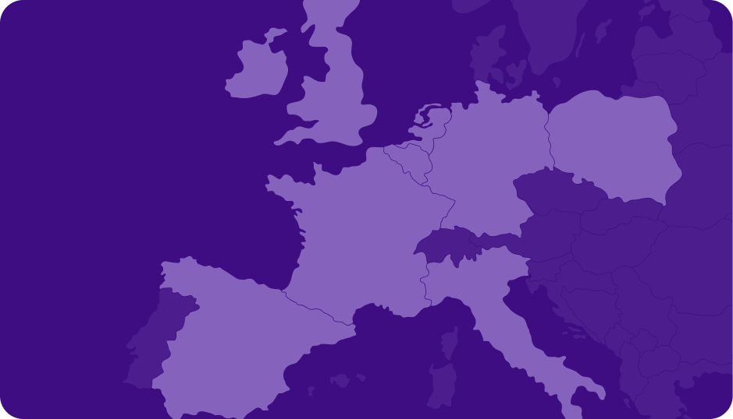





Table of content
01
02
03
Presentation of the group
Workplace
Infrastructure
04
05
06
Audiovisual
Financing
CSR & Impact

Slide 3
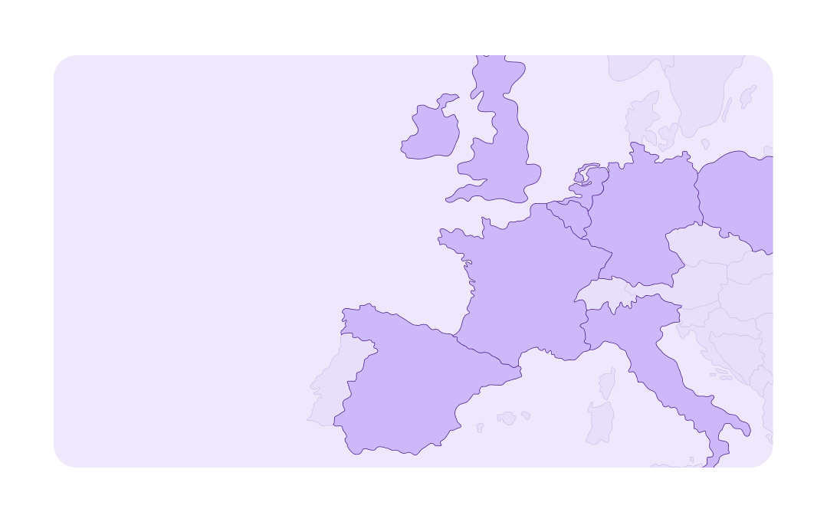

Presentation of the group
01

Slide 4

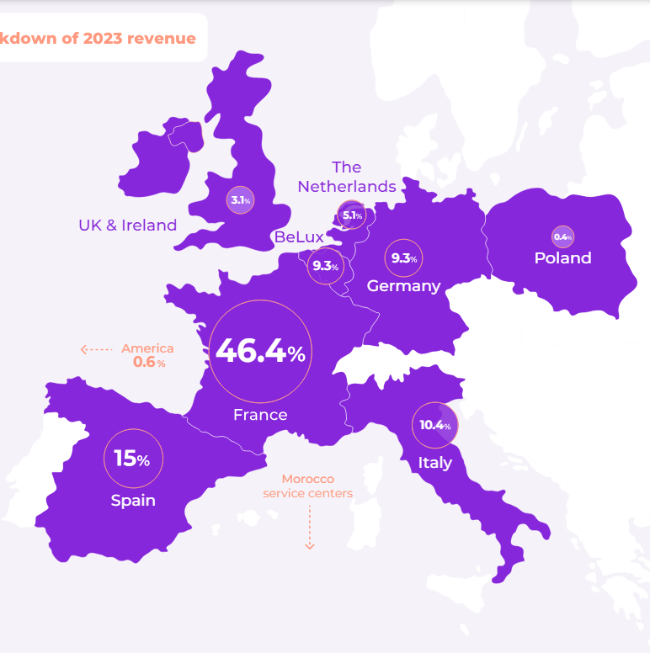




A European group
Econocom group
The Econocom group conceives, finances and facilitates the digital transformation of large firms and public organizations
Since its inception 50 years ago, the Econocom group has been a pioneer in creating solutions to support the digital transformation of companies and public bodies
€2.7 bn
Including
17%
2023 revenue
from green solutions
16
8.800
countries
employees

Slide 5
50 years of history
Econocom group
From a leasing specialist to a global digital transformation company
Development in the telecoms market
with the acquisition of Signal Service France, followed by the corporate division of the Phone House France. In 2007, acquisition of Tecnolease, an Italian company, specializing in IT equipment rental.
Acquisition of Abeilles
from the Bourbon Group.
JL Bouchard sells his stake in ECS France to Société Générale but buys back all the foreign subsidiaries. In the meantime, he bought Econocom an American company. The Group is renamed « Econocom ».
Launch of the acquisition program and stakes in satellite companies.
Econocom is listed on the Second Marché of the Paris Stock Exchange.
The Group diversifies by setting up Econocom Telecom.
Econocom
acquires ECS
from Société Générale to become
the European leader in leasing services.
Econocom achieves the objectives
of its “Mutation” strategic plan.
1974
1986
2002
2008
2013
2015 ∙ 2016
2020
1985
2000
2004 ∙ 2007
2010
2014
2017
2023
JL Bouchard founds Europe Computer Systèmes (ECS) in France.
Acquisition of Comdisco-Promodata in France (administrative and financial management of IT assets).
Acquisition of Osiatis group,
thus making decisive headway
in the digital services market.
Launch of One Econocom
2024-2028 strategic plan.
Econocom Belgium is listed on Euronext Brussels
Acquisition of Databail
a French IT infrastructure financing company.
Econocom joins the Tech 40 index
and continues its ambitious acquisition strategy to position itself in innovative segments.

Slide 6






One Econocom – Our 2028 ambitions versus 2023
Econocom group
FINANCIAL AMBITIONS
NON-FINANCIAL AMBITIONS
Reach €4.0 Bn revenue and double net income
Improve our social and environmental impact
Clients
+€0.9 BN IN ORGANIC GROWTH
x3 recycled or refurbished assets by Econocom
x2 assets maintained by Econocom
70% of total increase
Environment
SBTI commitment (scopes 1, 2 and 3)
Ecovadis Platinum certification
+€0.4 BN IN ACQUISITIONS
People
30% of total increase
HR employer certification
Gender equality index >90/100
Inclusive social model – x2 Econocom employees with disabilities

Slide 7

End-to-end solutions in 4 domains
Econocom group
Workplace
Infrastructure
Audiovisual
A complete transformation of the working environment designed to significantly boost the productivity of digital users
In the fast-evolving digital era, infrastructure is the backbone of a company’s growth and efficiency
Innovative solutions to transform spaces, unite people, captivate audiences, and enhance information exchange
From selecting the right equipment to managing its lifecycle, we provide support in project design, procurement, financing, and even refurbishment of end-of-life equipment
Our extensive Infrastructure and network solutions are crafted to meet complex business needs, offering a solid foundation for innovation, security, and operational excellence
With our new brand, Gather, we reaffirm our dedication to reshaping the AV landscape by delivering innovation, expertise, and converged services
Financing
Technology Management & Financing (TMF) offers tailored financing and asset management services, helping businesses access the resources they need for growth, while meeting technological, industrial, and environmental demands
Flexible groundbreaking solutions to address the new modes of consumption

Slide 8

Workplace
02

Slide 9





Summary
Workplace
Your partner for Workplace and innovation, no matter what you need
Would you like to know more? Please click below
Digital User eXperience
Workplace Security
Digital Users
Smart Service Desk
Endpoint Intelligence & Automation
Governance
& ITSM
Adoption & Change Management
Identity & Access Management
Software Solutions
Multi-platform Services
Collaboration & Productivity
AI Solutions
Unified
Communications
Unified Endpoint Management & Security
One Device
Personal Devices
ePortal & Employee Choice
Device-as-a-Service
Mobility
Printing Solutions
Product Care
eXtended Detection & Response
SOURCE
CUSTOMIZE
PILOT
MAKE LAST
EASI
EcoCarbon
EcoSwitch
EcoImpact

Slide 10














Smart Service Desk
Workplace
Digital Users
User centric and AI powered support to deliver an optimal digital employee experience
Discover
Proximity & efficiency balance, with local and nearshore options in Rabat
Premium employee support
  Single point of contact
  24x7x365 – Follow the sun operations
  Multi-language
  Omnichannel
Automated for fast, efficient troubleshooting
  Holistic shift-to-left strategy powered by AI
  Smart routing
  Advanced knowledge base
Best practices and governance
  Service management cockpit
  Infinity loop of continuous improvements
Cutting edge technologies
(SN, Nexthink, Amazon Connect)
Strong certifications (ISO, ITIL and others)
Immersive customer training and change management methodology
Key certifications:
Hospitality
Eco GRID
  Grid of + 15 service centers in France, Belgium, Italy and Spain
  Shared technologies and processes
Rabat Service Center
  High quality near-shore alternative
  Integrated in Eco GRID for hybrid models
End-to-end service for 40,000 users at 25 sites in +10 countries
Unified service model for all countries with control tower for continuous quality control
Remote and on-site support with hybrid service desk
New GenAI-powered support agent
Workstation management and endpoint intelligence
+15% improvement in user satisfaction and -25% of incidents
>1.5m
>10
>1k
Users supported
Languages covered
Agents in our Support Centers
Key technologies

Slide 11





Endpoint Intelligence & Automation
Workplace
Digital Users
The ultimate solution for assessing, monitoring and optimizing the digital experience of all employees
Discover
Full support throughout DEX adoption process:
Strategy definition
Tool implementation
Continuous operations and improvement
Improve your DEX score through:
Monitoring the usage of devices and applications
Promote data-driven decisions leveraging data insights and actionable intelligence
Optimize IT investments and resources
Identify and resolve issues proactively before they escalate
Benchmark IT performance and user experience against industry best practices
Excellence center in Rabat
Fully integrated in our end-to-end Workplace catalogue
Industry
Reduce Mean Time To Repair (MTTR) through real-time visibility and automation
Enhance employee productivity and satisfaction by optimizing boot and logon times and reducing crashes
Facilitate smarter and easier decisions through improved service desk interaction with end-users
Integration of Nexthink in the end-user service desk and improvement of employee experience
DEX Operational integration (Sdesk, ITIL roles)
DEX Council for continual improvement
Development of DEX use cases
+40%
>100
>150k
User satisfaction with DEX solution
Certified DEXperts
Assets managed with Nexthink
Key technologies

Slide 12

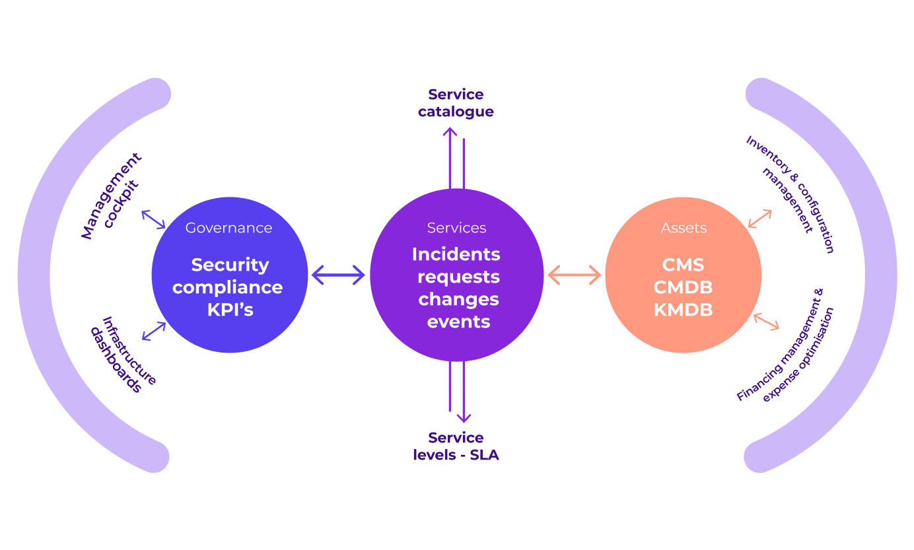



Governance & ITSM
Workplace
Digital Users
Take charge of your IT services and digital assets by leveraging best practices, efficient processes and powerful management tools
Discover
More than 25 years promoting best management practices
Full coverage of processes and best practices including:
Incident and request management
Service level management
Financial and asset management, with expense optimization option
Inventory and configuration management CMDB and CMS
Observability and event management
Management cockpit, business intelligence and reporting
Security management and compliance
360° approach: consultants, implementers, trainers and service providers
Teams with the highest certifications (ITIL, SMBOK, PMBOK, ISO, Lean, Agile)
Flexible solution that easily adapts to your tools or integrates with ours
Finance
Expense optimization:
  Tailored solutions for mobility communications domain
  Auditing mobility CMDB for telecommunication and IT cross check
  Powered by twist technology
Lack of control of IT assets and associated services, with more than 50k users and +500k assets to manage
Deployment of asset management framework:
Assessment of existing data sources and procedures (AS-IS)
Definition of AM, CM and IM processes
Implementation of ITSM tool and CMDB with integration and federation of existing sources
Application discovery and dependency mapping
Catalogue of IT and business services
+40%
20%
>500
Reported improvement of service quality
Average IT cost savings from governance and innovation
ITIL / ITSM certified experts
Key technologies

Slide 13
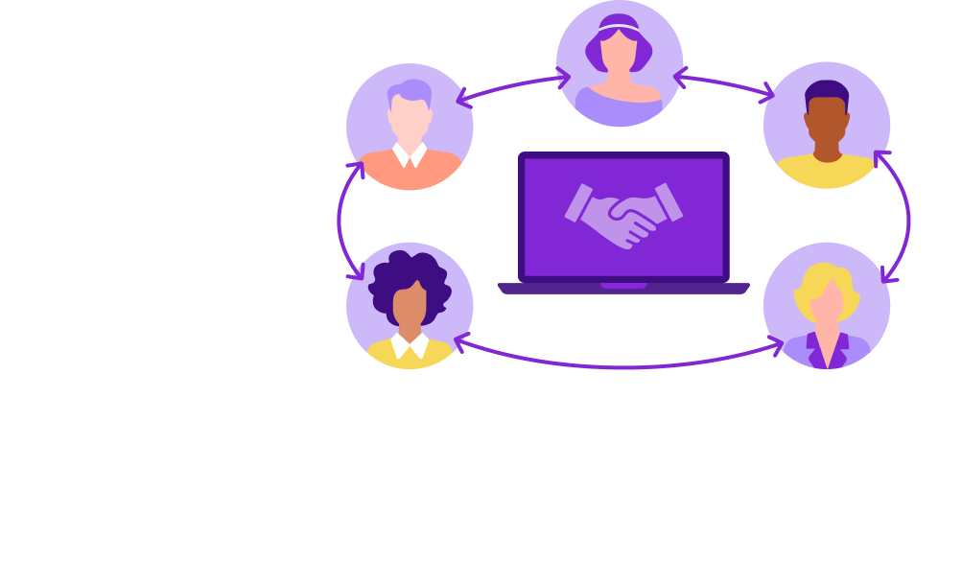
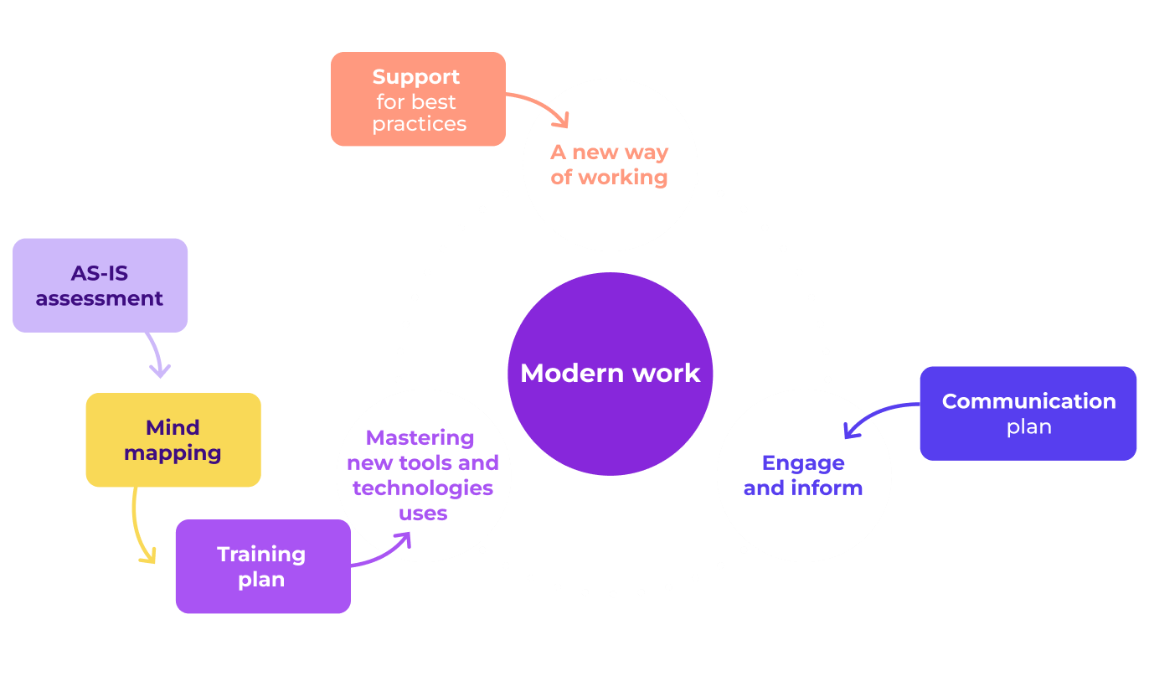



Adoption & Change Management
Workplace
Digital Users
Supporting changes in IT working practices by leveraging on technological expertise and adopting a collaborative and pragmatic approach to user adoption
Transforming to remain competitive by addressing tool obsolescence
Discover
Human-centric solutions based on employees needs
Driving digital transformation through:
AS-IS assessment of the current state of processes, tools, and people, including usage metrics of key tools to identify gaps and opportunities
Advisory plan for identified areas of organizational improvement
Change management support to engage stakeholders, define use cases, and implement changes with external guidance at every phase
Employee training and train-the-trainer programs to empower the organization
Communication campaign support in design and execution for effective change adoption
360° approach: consultants, implementers, trainers and service providers
Core focus on usage and digital experience
Aligned with market best practices backed by 40 years of experience
Transport
Increase performance and employee's satisfaction with:
  Training resources with web platforms to training pills and workshop templates
  Ergonomic interfaces
  Specific on-demand support
Leverage your IT project to impact your business and organization
Modernization of workstations and deployment of Windows 10 and Office 365 on 5,000 workstations « airport » and 6,500 « office » positions
An adoption strategy that highlights the benefits of the new tools while minimizing resistance to change
>60%
<25%
>70%
Of projects underperform due to poor change management
Average employees use of M365 functionalities
Of employees declare lack of training in new tools

Slide 14

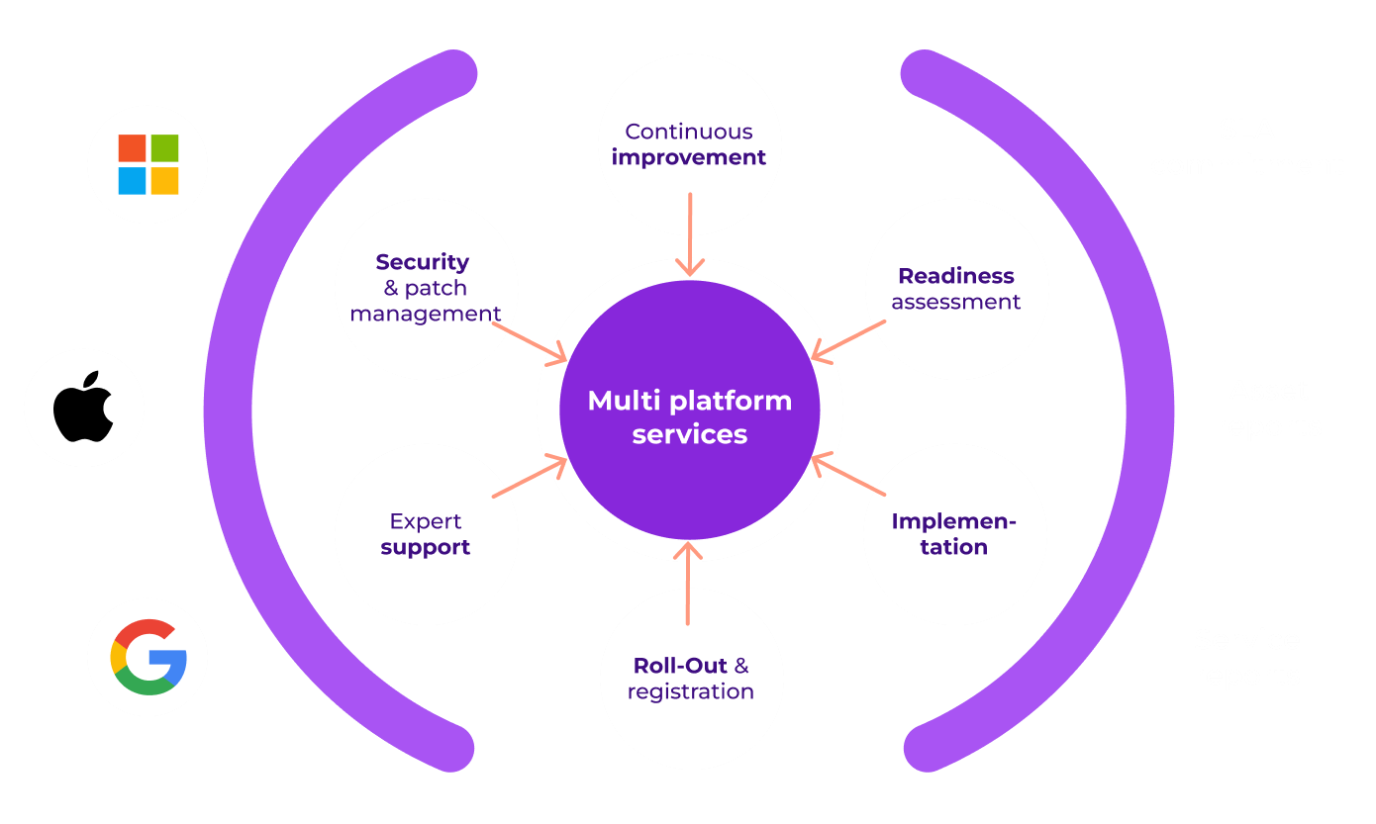

Multi-platform Services
Workplace
Software Solutions
No matter the workplace platform, we’ll help you get the most out of it
Discover
Agnostic approach with dedicated teams for Microsoft, Apple and Google
Adopt modern work practices with multi-platform flexibility and the freedom to choose:
Unique combination of distribution, deployment and managed services
Readiness assessment (network, directory, security etc.)
Cross-platform implementation and integration
Device and application deployment
Expert/Premier support
IT & Security operations: patch management, security policies, inventory and asset management, supervision, etc.
Engineering and continuous improvement
Cross platform with zero-touch and auto-enrolment process
Full coverage of traditional workplace (Windows, MacOs, ChromeOS) and mobility (Android, IOS, IpadOS)
Energy
Empower digital users the freedom to choose
Minimize risks by keeping the same management and security standards across all platforms
Simplify support and operations, with single provider, reduced costs and real time expense tracking
Accelerate the adoption of new releases
Optimize and maintain a mobile fleet of 50,000 assets (lines and terminals) for 140,000 users, interconnect with mobile operators in France and abroad
Deployment of our autonomously managed SaaS solution, Twist
Real-time user consumption analysis via intuitive BI Dashboards
Interconnection with customer IS and suppliers
Identification of lines to be terminated, settlement requests, monitoring of credit balances and proposal of the most suitable mobile offers
+30%
>1m
>850
Companies offer or plan CYOD programs in 2023 vs. 2022
Devices managed by Econocom
Accreditations from MS, Apple and Google
Key certifications

Slide 15

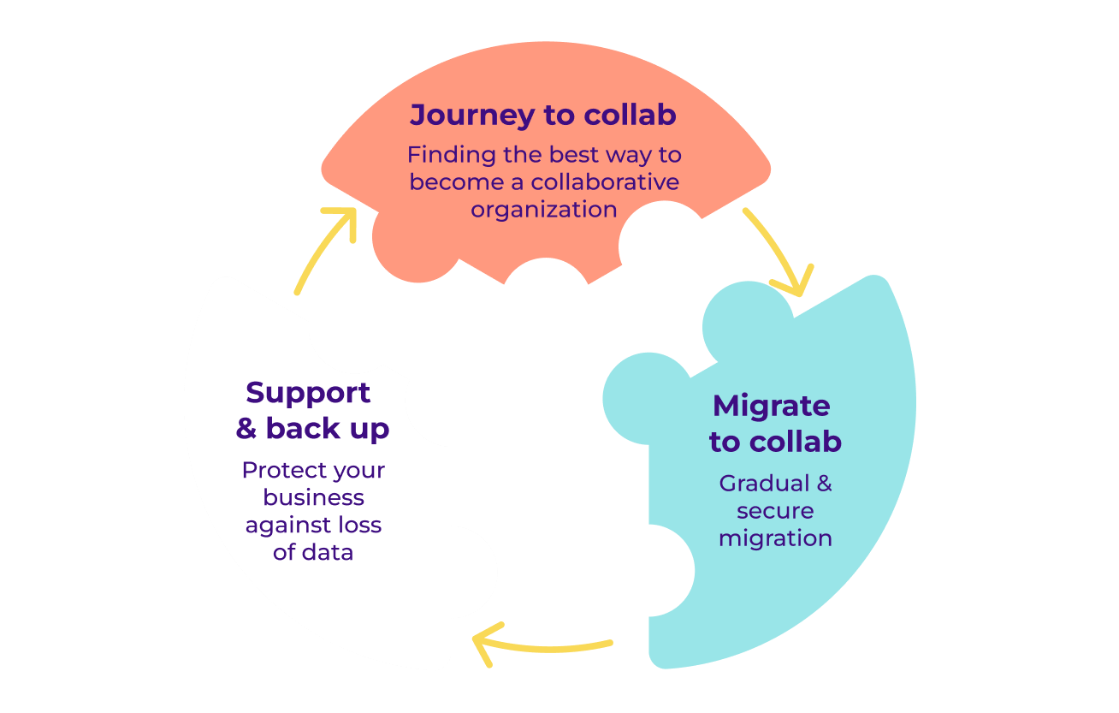


Collaborations & Productivity
Workplace
Software Solutions
User first: support users and the IT department in setting up and using collaborative tools
Exploit the full potential of current tools, as usually less than 25% of functionalities are used
Discover
Agnostic approach with partnerships alongside key leading vendors
Share a common vision across technical collaboration, organizational and financial dimensions
Journey to collaboration (M365, Google, Slack)
  Identify collaboration opportunities for your organization
  Define the scope the project with an end-to-end vision
Migrate to collaboration
  Set up governance and change management
  Source the right products and licenses
  Implement the new solution and configure security
Support and back up (stand alone or powered by Veeam)
  Expert L2-L3 support
  Automatic backups for all tools
  Setup and testing of data recovery mechanisms
Flexible approach: implementation partner, service provider or both
Microsoft Modern Work designation in 5 countries with millions users on daily basis
Specialized Gather brand to create cutting-edge digital collaboration spaces https://gather.econocom.com
Transport
Combine user-oriented approaches with infrastructure expertise for optimal solutions
Integrate collaborative tools with change management and data protection
Enhance productivity and speed in daily tasks
Enable real-time collaboration from anywhere, using tools for documents, messaging, meetings, and tasks
Reconcile the operator’s cloud with one of its subsidiaries within 10 days
Support for analysis, strategy definition and collaboration data migration
Centralize information
Data governance
Training and team building
80%
>75%
>300
Of companies work under hybrid models in 2023
Of employees see collaborative working as a competitive advantage
Certified experts in our team
Key technologies

Slide 16

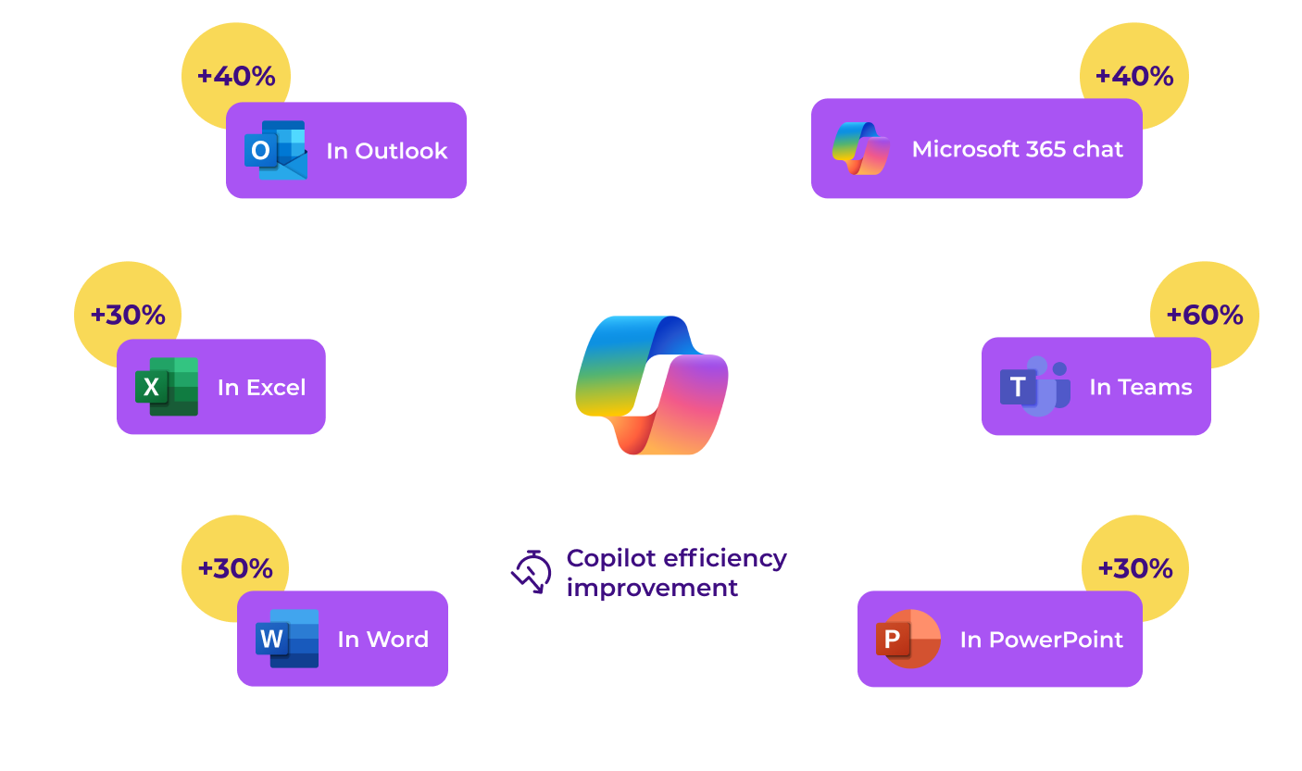



AI Solutions
Workplace
Software Solutions
Increase productivity and boost creativity with disruptive AI technologies
Envisioning new ways of working with a seamless transition
Discover
360° approach: HW reselling, SW advisory, consultancy and managed services
Project support from the initial Proof of Concept, all through the implementation, up to user training, adoption and change management
Implementation of AI solution with either Employee Copilots, to increase productivity, or other business AI solution
Wide AI service catalogue including:
  Assessment of needs and AI application areas
  Proof of Concept (PoC): exploring what’s possible
  Reselling and financing of AI-enabled HW & SW licenses
  Implementation of AI tools: MS Copilot and other
  Enabling and training: embark with confidence
  AI (user) adoption support
Ad-hoc solutions for assessment, migration and adoption
Agnostic approach with partnerships alongside key AI industry leaders
Dedicated expert team certified by Microsoft
Banking
Realize your needs, desires, and use cases
Develop a clear AI strategy: identify what is feasible and what is not (yet) possible
Accelerate AI adoption in daily routines with immediate return on investment
Increase user productivity and foster creativity
Following limited deployment of MS Copilot licenses, a partner is needed to monitor user adoption and provide onsite training
User workshops with IT, champions and end users
Monthly follow-up with onsite surveys and inspection
+90 min
3 month
5
Saved weekly by average user​ using MS Copilot
ROI with MS Copilot solution
Countries certified in MS Data & AI
Key technologies

Slide 17

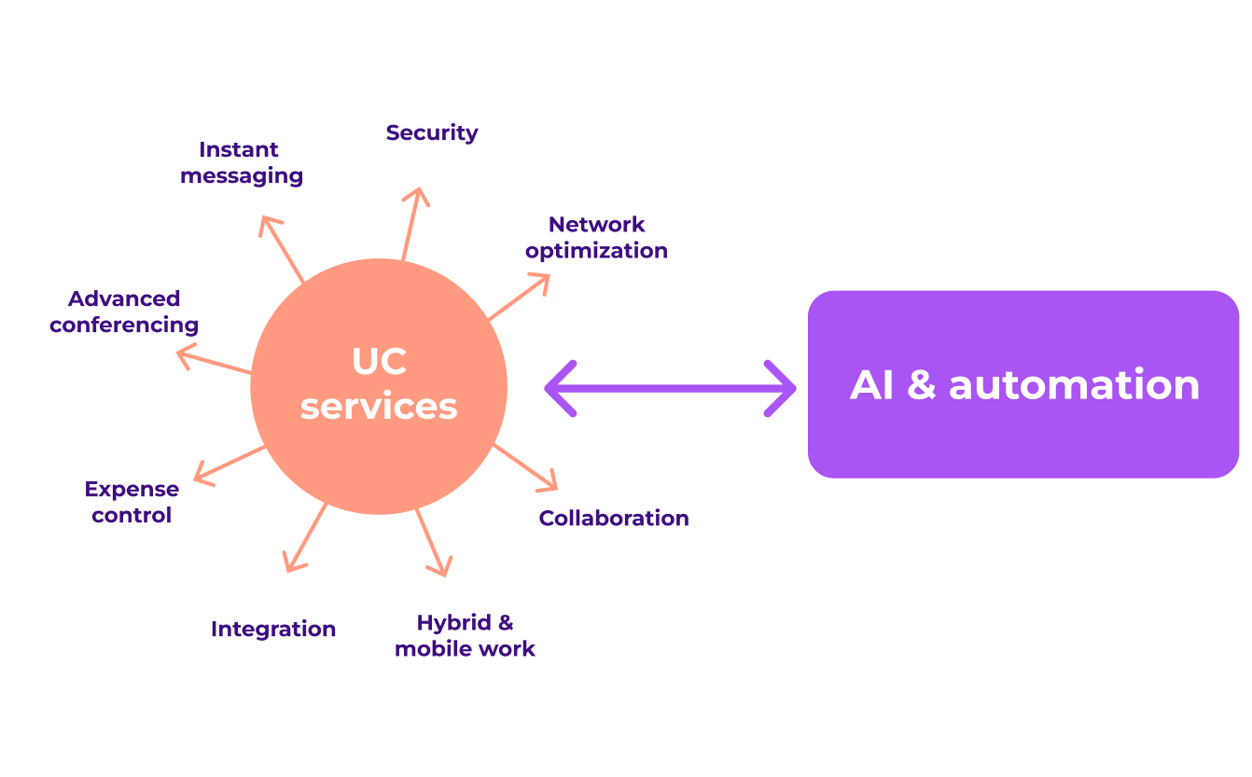



Unified Communications
Workplace
Software Solutions
Address all collaboration challenges: meetings, videoconferencing, telephony and contact centers
Discover
Recognized expertise for all leading vendors of the market​
End-to-end UC & UC-as-a-Service (UCaaS) solutions including all products and services​
Cutting edge UC technologies including:​
  Microsoft Teams - direct routing full cloud and direct routing Hybrid with on premise Session Border Controller (SBC)
  Cisco WebEx​
  Zoom
360° capabilities: Network, Security, UC and Audiovisual
Agnostic approach with partnerships alongside key leading vendors
Dedicated and certified UC experts to manage the project
Non-profit association
Ensure seamless integration with your ecosystem and contact center platforms
Allow more control and optimization of UC costs ​
Enhance flexibility and security by choosing your level of control ​
Simplify daily operations and administration with high availability and scalable solutions
Modernize communication infrastructures for the new HQ ​
Integration of Teams based telephony solution, meeting rooms and LAN/WLAN network from different suppliers including:
Modular room conferencing (audio, video...)
Equipment for all physical workplaces​
+30 min
>60%
>100
Saved daily by the average user​ with UC solutions
Of CIO are evaluating modernization of their UC/UCaaS solutions​
Certified UC Experts on our team​
Key certifications

Slide 18





ePortal & Employee Choice
Workplace
Products
Embrace new ways of ordering and sourcing digital devices, licenses and services
Faster and easier access with better control and traceability
Discover
Customer-centric focus emphasizing user experience
ePortal for IT and procurement ​
Employee Choice portal​
Tailored solutions with role-based workflows and customizable look & feel
Order faster, any time, from anywhere​
Delegate purchases across different functions and locations within your organization ​
Tailored integration into your corporate information systems (punchout option)​
Access to valuable reports and tracking information
Create your multi-vendor corporate catalogue of devices, licenses and lifecycle services ​
Setup employee personas and validation flows ​
Give your employees the freedom to choose and upgrade their devices ​
Streamline deployment, security and multi-platform operations with the support of Econocom
Embedded in as-a-Service bundles ​
Integration and automation: ready for small transactions​ and wide catalog with >50k references
Banking
Enhance productivity and user satisfaction​
Reduce administrative task with dedicated support and online management ​
Allow more flexibility at reduced costs with One-stop-shop ​
Ensure more security and compliance with corporate catalogues and modern devices​
Renewal of mobile fleet (10k devices) for managers in a business environment. The client wants users to choose devices that best suit their personal criteria.​
​Tailored online portal for employee orders including:
Personalized catalogue, graphic chart and content
Home delivery to employees with tailored packages and content​
Device configuration and registration​
Support Services: multi-language service desk, incident and lease contract management
>80%
>150
>20%
Of employees would choose different devices if they could
Portals developed for our customers​
Average savings with eProcurement strategies​
Check our portals for:
CYOD Education SMB Licensing Plan Cafet

Slide 19

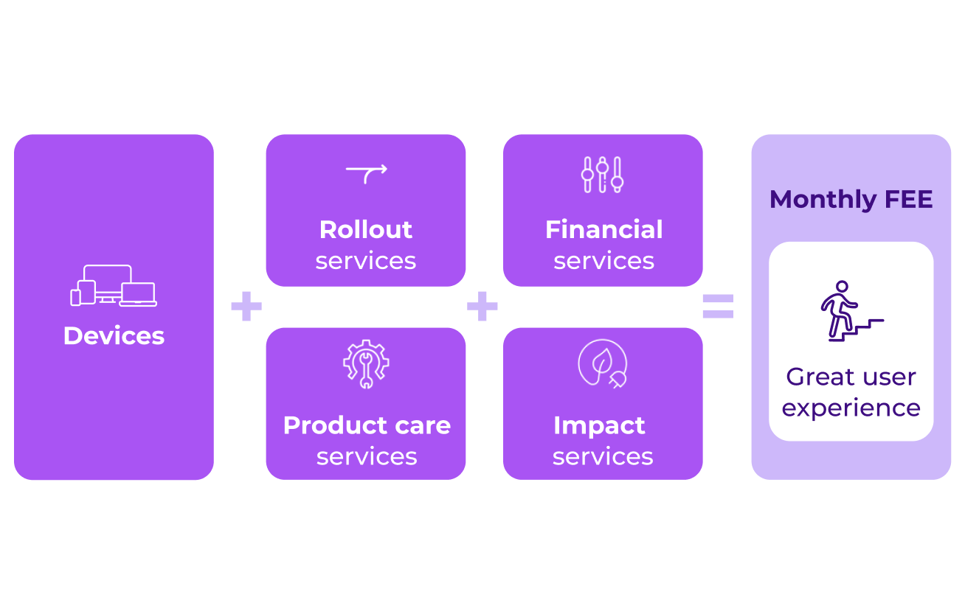
Device-as-a-Service
Workplace
Products
Manage the full lifecycle of all your devices
Create an outstanding employee experience ​
Discover
Large portfolio of partners and device models​
Outsource the entire device management and services:
Seamless automatic provisioning and enrolment (autopilot, zero-touch, white-glove)​
Security by default and reduced administrative tasks​
Devices are always protected from accidental and functional damage​
Unparalleled sustainability with our impact services​
Wide range of financial services and options
Flexibility and modularity through composable DaaS services ​
Financing and CSR compliance in a single contract​
All-in-one: multi-country, multi-language and multi-brand​
Large utility
Free up IT resources with streamline device support and increase security
Achieve cost reduction, preserve cash flow and maintain control over time​
Access cutting-edge solutions by upgrading outdated equipment at no extra cost
Promote sustainability with CSR friendly solutions
Outsource the entire End User Computing (EUC) processes covering the full lifecycle of multiple devices on different locations
Full DaaS service for 3,500 employees offering:
High degree of flexibility in managing multiple devices
Dispatching and logistic
Proximity services
Virtual remote operations​
>55%
>1m
>98%
Of large companies have adopted DaaS​
Devices managed by Econocom​
Of 24/7 SLA fulfillment​
Key partners

Slide 20

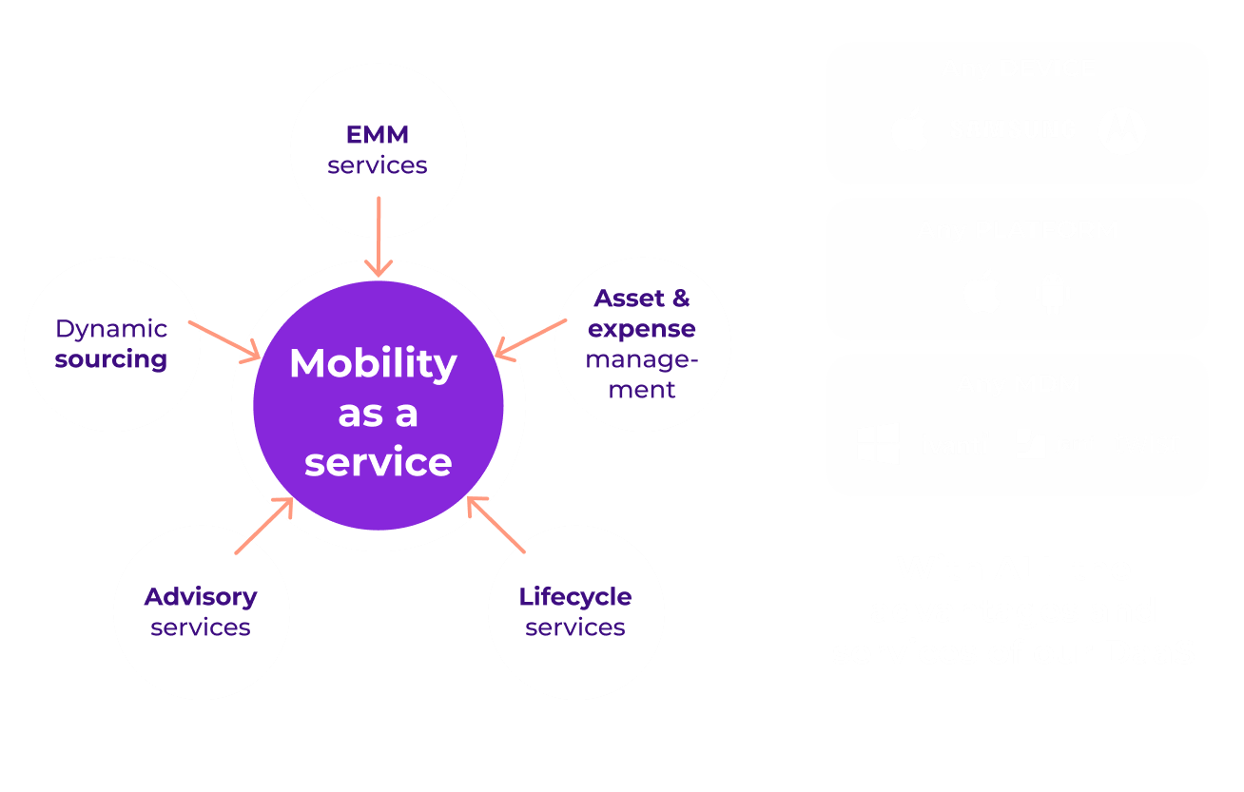



Mobility
Workplace
Products
From corporate strategy to daily operations: design and implement a nomadic approach for ubiquitous SATAWAD access
Discover
Large portfolio of partners for devices, accessories and applications​
Tailored services to address the specific challenges of mobility:
Advisory services: guidance on selecting the right devices, accessories and applications for your needs​
Dynamic sourcing: zero-touch provisioning and configuration​
Enterprise mobility management: comprehensive administration of endpoints, applications and security​
Fleet and asset management: efficient management of assets and telecom expenses with auditing capabilities​
Mobile-first lifecycle services: full-risk insurance, swap services, premier support and in-house repair and refurbishment
Our own mobility SW solutions Hubreg, TWIST and others
Tailored DaaS solution for mobile users and devices
More than 15 years specialized in enterprise mobility​
Retail
Benefit from our multi-brand zero-touch device enrolment with Hubreg:
  Streamline registration of Apple, Android and Microsoft endpoints​
  Access to direct API with Apple-approved in 5 countries​
  Support of Knox and HP carepack
Mobile solution for POS across more than 1,000 stores with aftersales and in-store service points​
Econocom DaaS mobility solution with more than 10,000 devices​ including services:
Ordering and service portal for store employees​
Product Care service with 1-day swap​
Yearly refresh of 50% of the fleet
x5
+50%
>250k
Incidents with mobile than workplace devices
Increase in the refresh rate of mobility assets with DaaS
Mobile devices refurbished yearly in Econocom Factory
Key technologies

Slide 21

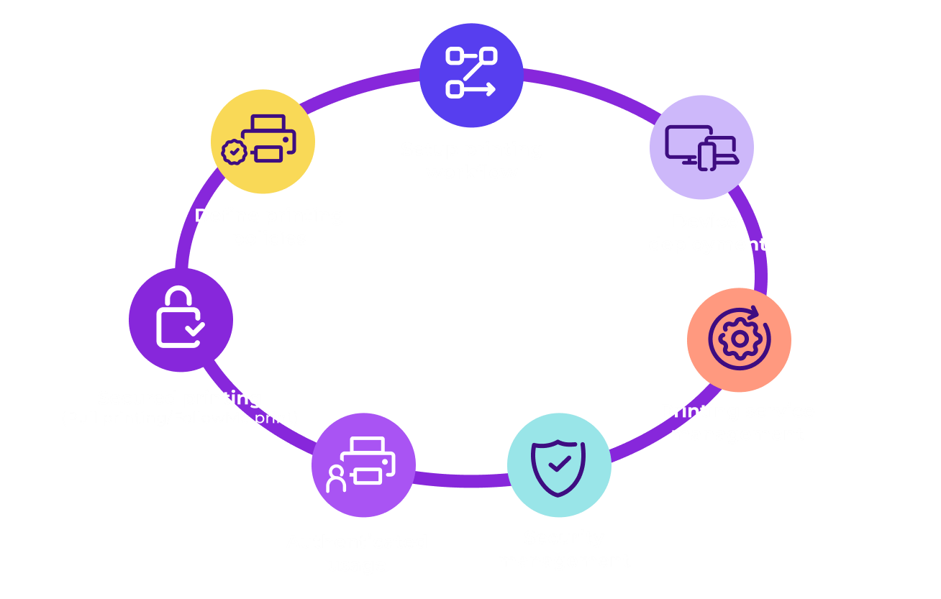



Printing Solutions
Workplace
Products
Econocom Managed Printing Solutions (eMPS) is designed to cover all your printing and digitalization management needs
Discover
Flexible, adaptable, modular and scalable solutions​
Tailored printing solution:
Customized printing solutions with tailored design and implementation, covering devices such as office printers, plotters, scanners and thermal printers​
Advanced printing management software: on-premise and cloud platforms for monitoring, AAA security, OCR, and digital object management​
Comprehensive lifecycle services including equipment provision and return, proactive supply management and maintenance, user and group printing control
Waste management according to regulations
Large portfolio of technologies and partners​
Econocom remanufacturing program (second life): Phoenix (BS-8887-220)
Extensive geographic coverage with dedicated local teams​
Healthcare
Unify device management and control costs by device, user, department, or cost center
Strengthen security management at regulatory, data and user level​s
Improve user experience with personalized printing services and support
Enhance energy efficiency and reduced carbon footprint​
Managed printing solution for 3,000 users for offices and health centers in cities across the country
Complete managed printing service solution with :
1k printing devices (A4 and A3 multifunctional, 50% remanufactured)​
Cloud software platform for monitoring
User management (triple A) limiting color printing and copy quota per user with authentication
25%
>40k
-55%
Average cost savings​ with Econocom printing solutions
Printers managed by eMPS​
Reduction in carbon footprint with remanufactured printers​
Key technologies

Slide 22





Product Care
Workplace
Products
We maintain, repair and extend the lifespan of your telephones, tablets and laptops
Because your corporate devices are becoming ​business-critical, we care about them
Discover
Unified offering for all major vendors (Apple, Samsung, …)​
Product Care by Econocom:
Single Point Of Contact for all after-sales services​
Warranty extension ​
Temporary swap service during repairs with D+1 and D+3 options​
Pick-up and return services ​
Operational follow-up (internal and third-party vendors) and reporting​
Optional coverage of theft and accidental damage (EcoCare)​
Optional IT-Corner and platinum services​
Recycling and WEEE management
Simple and SLA-based service model with an eco-responsible approach​
Premium certified repair service provider for all main leader OEM and dedicated expert team
Warranty extension for up to 7 years​
Finance
Ensure service continuity with fast repairs and optional temporary swaps at D+1/D+3​
Maintain device residual value with certified repair centers​
Reduce administrative workload with single point of contact for all inquiries and incidents
Lower costs and carbon footprint by extending product lifespans
Provide and cover smartphones for all employees, ensuring business continuity and a uniform process across multiple brands (Apple, Samsung)​
Econocom DaaS solution for mobility:
Bundles include smartphone, screen protector and case
Protection with "EcoSwap" service for all employees for 3 years
Employees can choose smartphone with uniform service request process across brands ​
-8 hours
>1.5m
>95%
Average productivity loss per week with non-functional device
Devices protected with Product Care​
Of SLA ​
fulfillment
Official repair partner for

Slide 23

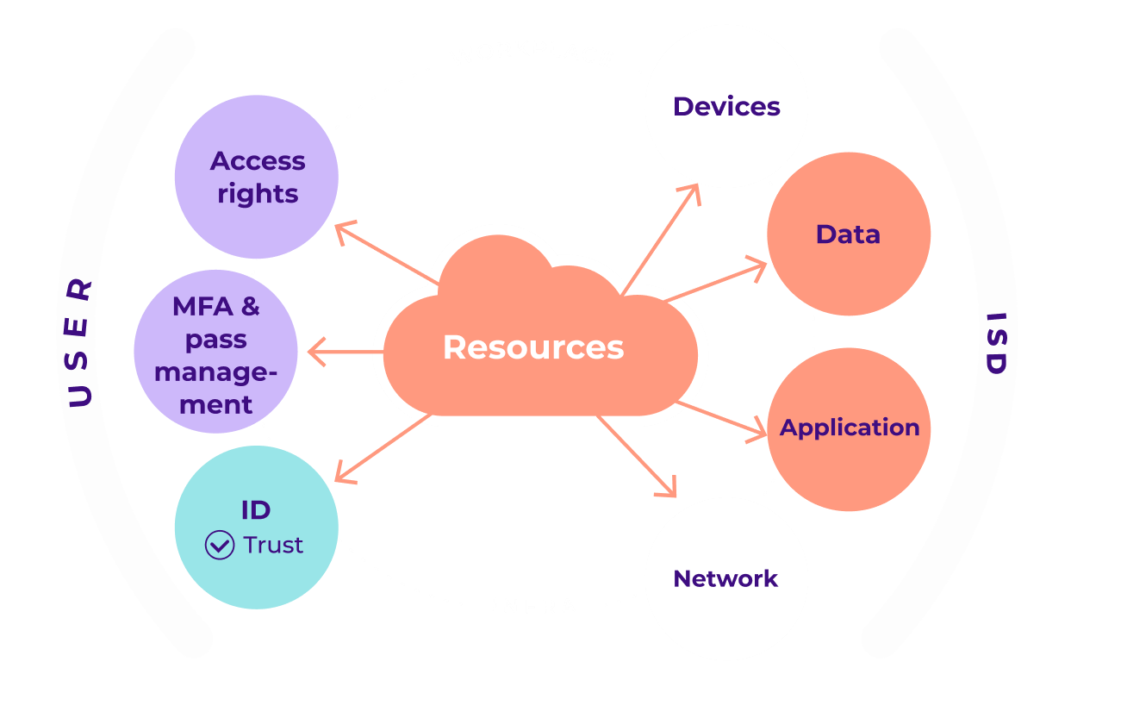



Identity & Access Management
Workplace
Security
Protection from attack vectors such as phishing, IT vulnerabilities and CEO fraud
Combat the effects of security risks like production disruption, compromise, ransomware, and loss of reputation​
Discover
Extensive and agnostic IAM portfolio of solutions​
Holistic approach to Identity & Access Management (IAM):​
Secure access to all kind of resources: network, devices, applications and data​
Modern security mechanisms to protect users: hybrid identity, conditional access, multi-factor authentication, etc.​
Move from implicit trust to Zero Trust
Unify internal application logins with the corporate IdP
Simplified user account management for applications, network, and Wi-Fi access
Practical approach with short projects and quick wins
Certified experts and dedicated team for cybersecurity
Integration with our managed services​
Telecommunication
Simplify the authentication for user​s
Improve security by reducing risk for your company and simplifying hybrid work​
Reduce costs by centralizing and improving threat visibility
Enhance security through a unified platform against cybercriminal attacks
Identification, detection and investigation of advanced threats​
Implementation of MS Defender and MS Defender for Identity to manage vulnerabilities and protect devices​
+255%
>35%
>47%
Of YoY increase in ransomware attacks for ​5 years
Of user incidents are linked to IAM
Of teleworkers are caught in phishing scams​
Key technologies

Slide 24

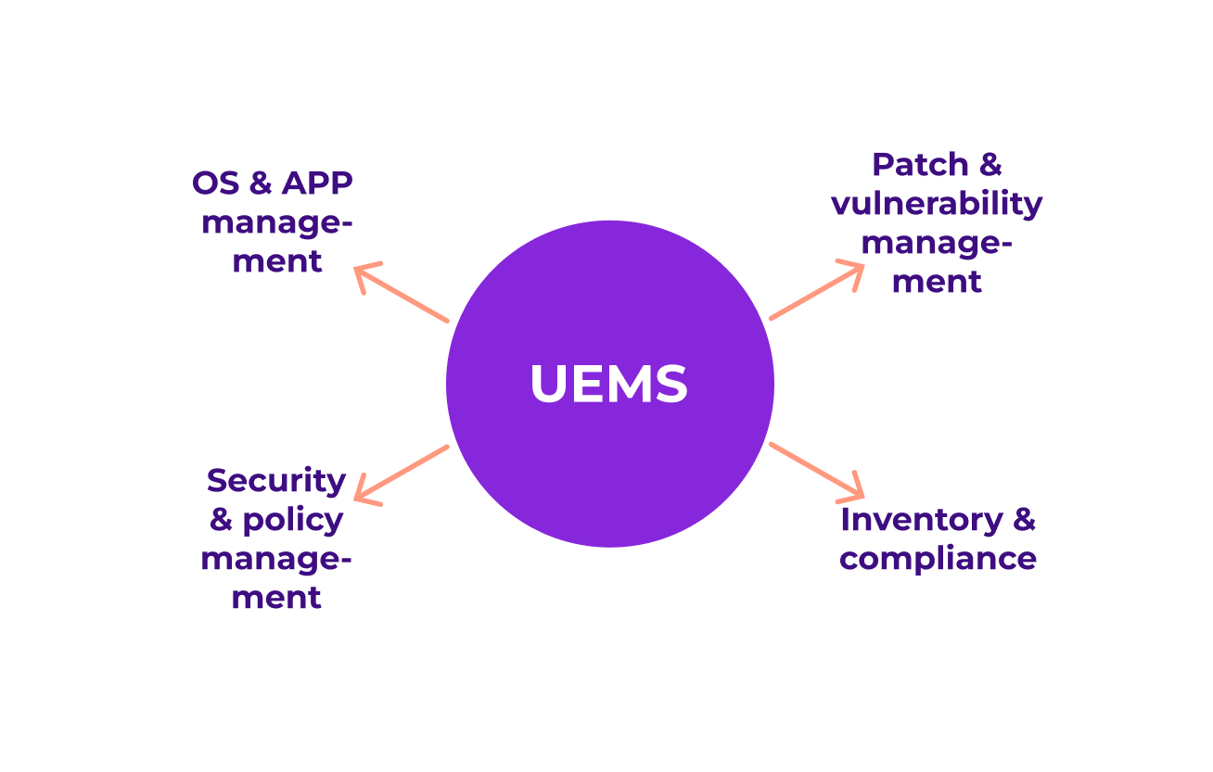


Unified Endpoint Management & Security
Workplace
Security
Securely manage your fleet (mobile to desktop, laptop, workstation and servers) with a unified solution enabling remote processing
Discover
Platform agnostic, allowing the use of either your platform or ours​
Centralized management of devices and applications:
Guarantee an up-to-date inventory​ for all devices and operating systems
Certify consistent security policies and restrictions​
Keep applications and OS updated​
Analyze activity and ensure fleet compliance​
Manage enrolment and removal of your devices
+1 million endpoints managed on behalf of our customers​
Integrated in our 24x7 managed services center​
Flexible approach based on your need​ and constraints
Energy
Enhance security and compliance with automatic enforcement and easy audits​
Free up internal resources for high-value, business-oriented tasks and minimize the need for on-site support​
Access to certified and SLA-based service​s
Streamline support and unified management of all devices
Management of 16,000 devices: iPhone, PC, Mac and other HoloLens-specific devices​
Streamlined support and unified management of all devices with:
Unified endpoint management solution: Microsoft Intune and transition support​
Apple Business Manager and Defender for Endpoint (EDR) deployment​
Migration with Exodus​
Zero-touch to eliminate the mastering stage​
-60%
54%
+217%
Terminal deployment time with UEMS​
Average savings from support costs​ with UEMS
ROI over 5 years by avoiding attacks and improving efficiency​
Key technologies

Slide 25

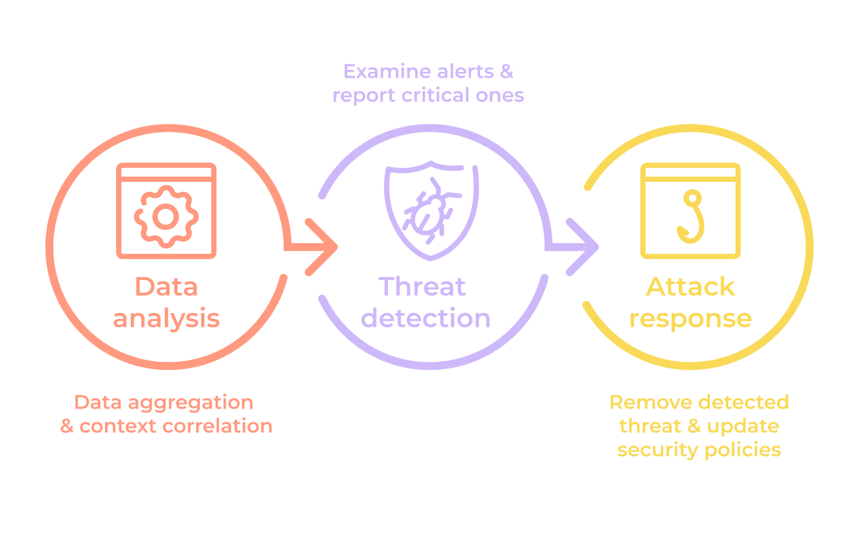


eXtended Detection & Response
Workplace
Security
Eliminate visibility gaps and seamlessly detect and resolve threats, make better decisions and prevent future cyberattacks
Discover
Triple expertise across advisory, integration, and managed services
Advisory, implementation and support on cutting-edge XDR technologies from leading market vendors
Managed XDR security service provision from our 24x7x365 Security Operations (SO) center
Unique set of certifications with world security leaders​
Our own specialized and highly certified SOC​
High proximity and reactivity for our clients​ with +90% customer satisfaction rate​
Public
Increase prevention and reduce future risks with faster and better attack detection​
Optimize data utilization and prioritize threats effectively​
Free up internal resources with automated response and continuous security improvement
After a malware attack, the customer needed support from security specialists to recover operations and prevent future incidents
Behavioral analysis of affected systems​
Deployment of XDR solution for malware identification (cryptominer)​
Development and deployment of remediation script​
Execution of remediation and restitution plans​ with the implementation of processes and services for future protection​
→ Normal operation restored in less than 5 days
>50
<30 mins
>200k
Certified cybersecurity experts​
Average time to address threats in our SOC
Users protected by our SOC​
Key technologies

Slide 26

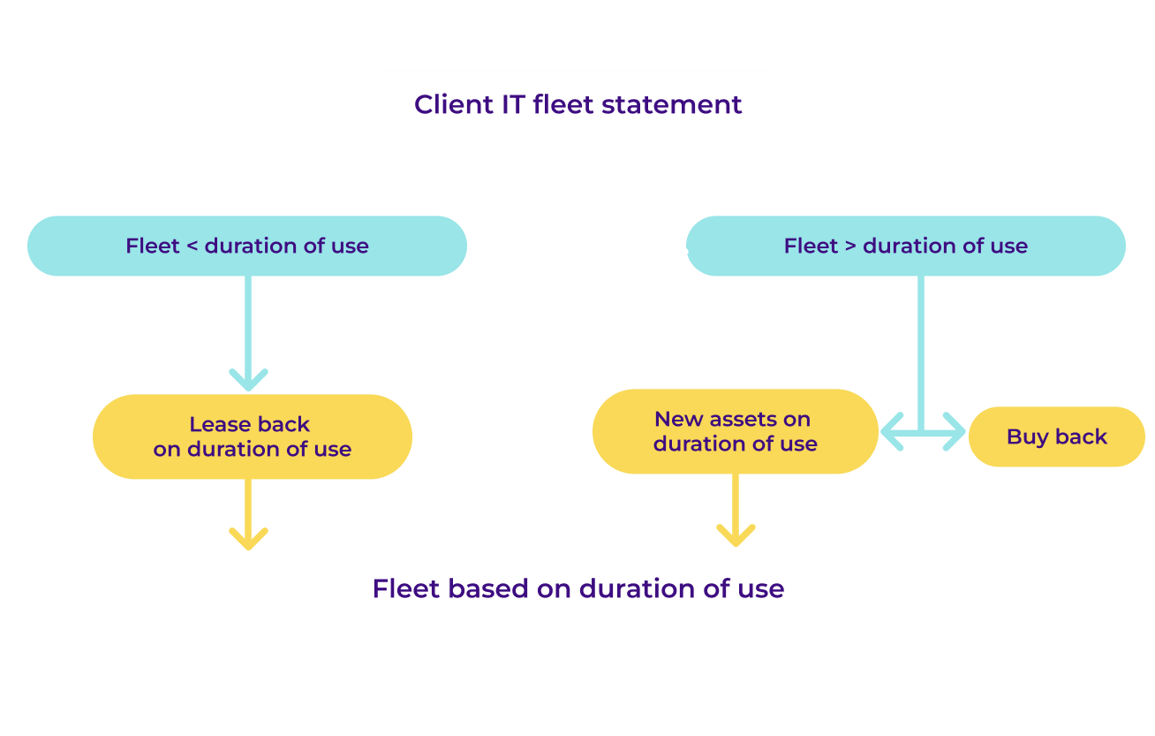

EcoSwitch
Workplace
EASI
A strategic CSR and financial optimization plan for your assets fleet​​
Discover
Certified methodology to assess CSR optimization and carbon footprint​​
Free strategical plan for the current IT fleet in 3 steps:​
Detailed analysis of the current IT equipment fleet​​ (duration of use, model, brand)
Usage duration determination for all equipment based on your profile, needs, and budget​​
Final costed report with proposed CSR and financial optimization plans, including:
  Identification of equipment to be refurbished or maintained through
  Buyback and leaseback options
Integrated in EASI offers and compatible with all workplace assets and contracts​​
Tailor-made solutions for IT fleet: buyback and leaseback offers, or other financing options
Approach based on the lifespan of equipment tailored to their model
Food industry
Reduce costs and carbon footprint through usage-based models​​
Standardize asset lifecycles for easier tracking and resource allocation
Enhance budget management and extend equipment lifespan, reducing replacement costs​​
Optimize and rationalize its IT fleet (10,000 devices across Workplace and Mobility)​
A tailor-made strategic plan including:
Buyback of existing IT fleet for €5m with refurbishment of old devices (>50%)
Leaseback on remaining duration for the rest of the fleet
New asset financing​​
>500k
€400k​
Devices already refurbished by Econocom​
Devices leaseback after EcoSwitch report​​

Slide 27

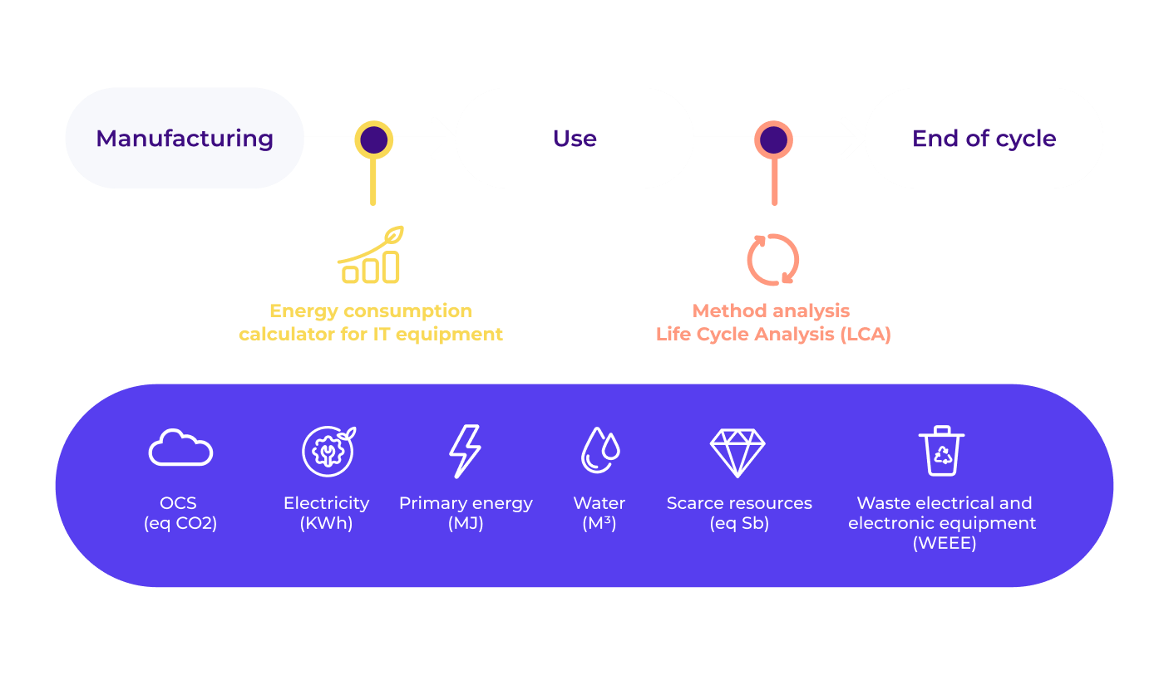

EcoCarbon
Workplace
EASI
Monitor and control the carbon footprint of your IT assets with an optimization and compensation strategy​
Discover
Integrated within the EASI offer or accessible as a standalone service
Assessment of the environmental impacts and action plan through:
Green Catalog: a curated list of products rated by environmental impact and energy efficiency
Environmental impact monitoring: tracking of the IT fleet's energy use and environmental footprint, covering usage, manufacturing, and end-of-life stages
CO2 emissions reduction plan with equipment-specific recommendations, savings projections, and green IT best practices
Ecolmpact certified report assessing the CO2 savings from refurbished end-of-life devices
Carbon offset projects to reach net-zero (optional)
Certified methodology and report with a carbon centric and tailor-made solution to improve footprint​
SBTI certified company with ambitious commitments
Accredited partner with international quality labels and certifications for CO2 projects
Transport
Enhance environmental responsibility with a comprehensive assessment of your digital impact​​
Reduce your CSR impact with short-term energy saving and long-term carbon savings​
Achieve net-zero with compensation projects
Analyze of the impact of 20k equipment (Workplace including printing, AV, Infra) and provide recommendations for CO2 savings​​
EcoCarbon one-shot report with an action plan to reduce energy and carbon footprint
→ -15% energy savings following our recommendations
​
>30
-10%
Reports delivered per year​
Average energy savings with EcoCarbon​
Key partner

Slide 28





EcoImpact
Workplace
EASI
Get a certified report on the carbon footprint of your end-of-life assets​​
Discover
Integrated within EASI offer and compatible with all workplace assets and contracts​
Certified CSR assessment on asset fleet for:​
The IT fleet's carbon impact post-refurbishment, compared to destruction and repurchase of new equipment (e.g., energy or water saved)
Annual sustainability report detailing yearly savings, fully compliant with EU CSRD standards
Including:
The environmental and societal benefits of transitioning to an EASI offer after refurbishment (KPIs, investment choices, certifications, communication strategies)
Certified methodology and reporting covering all CSR aspect (e.g. CO2, water, energy)
Customized solutions to enhance CSR footprint with actionable KPIs
SBTI certified company with ambitious commitments
Reduce significantly energy and water usage by refurbishing IT equipment
Promote sustainable business practices: resource conservation, greener operations, positively influencing CSR
Elevate corporate reputation with data-driven investment decisions and effective (transparent) communication of CSR initiatives through detailed KPIs and certifications
2024
6
Launch of EcoImpact offer
Environmental KPIs tracked
Key commitments

Slide 29
Infrastructure
03

Slide 30
Summary
Infrastructure
Your partner for Infrastructure and innovation, no matter what you need
Would you like to know more? Please click below
Intelligent Infrastructure
Cyber Security
Smart Services
Move2Cloud
Remote Management & Operation
Data Centers Services
Critical Maintenance
Network protection & Intrusion prevention
Software Platform
Virtualization
ITOps Automation & AI
DevOps
Cloud Management
SIEM
Backup & Disaster Recovery
Infrastructure Equipment
One Infrastructure
Compute
Storage
Networking
Hybrid Cloud
Security Service Edge (SSE)
SOURCE
CUSTOMIZE
PILOT
MAKE LAST

Slide 31

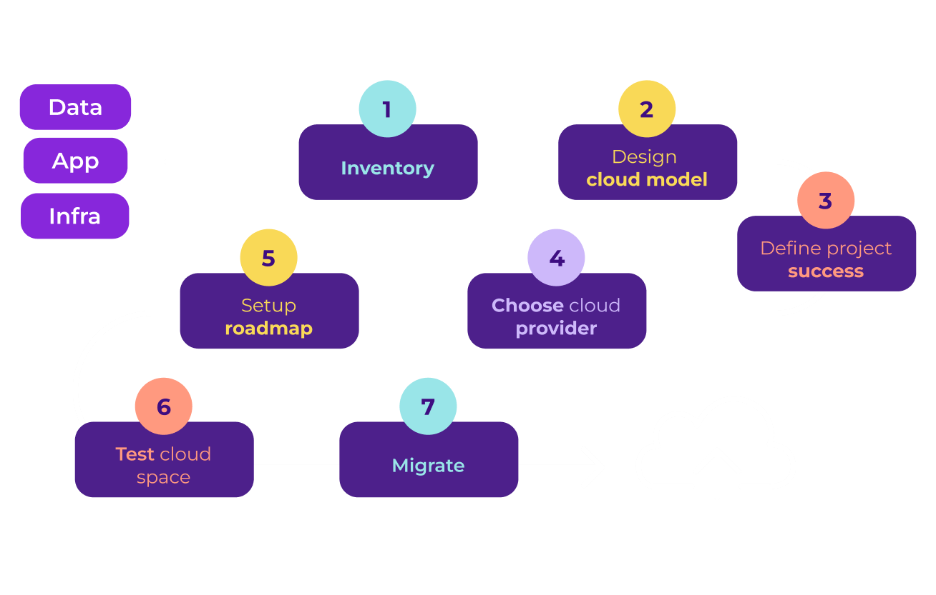


Move2Cloud
Infrastructure
Smart Services
Unlock the full potential of modern cloud architectures with our comprehensive Cloud Solutions​
Discover
Flexible approach with either private, public or hybrid cloud support​ed
Implementation: develop a scalable, resilient, and secure cloud infrastructure tailored to your business needs​
Adoption: ensure full utilization of the new (hybrid) cloud infrastructure for migrated Apps/Data​
Operating maintenance: maintain and secure an efficient cloud environment while monitoring associated costs
Tailor-made solution to fit the right hybridization balance​
Assessment
Design
Data migration
Focus on efficient project supervision and cost management
Configuration
Optimization
Change management
Support throughout the full process (before, during and after)​
Regular updates
Performance check
Continuous improvement
Finance
Access to tailor-made design for your needs​
Reduce the costs associated with infrastructure and maintenance
Strengthen security for work environment, data, and applications​
Enhance flexibility and scalability
Modernize IS to improve agility, secure identity and equipment management and reduce worldwide infrastructure costs across 1,6k assets, covering 18 sites across 4 continents​
Decommissioning of the existing network and replacement by a new infrastructure:
Cloud-based infrastructure from Microsoft technologies with a global network from Azure SD-WAN, replacing the existing MPLS network (developed with Terraform)
On-site deployment for all servers
30%
+90%
+18%
Average cost savings in operation and maintenance ​
Improvement in security with cloud solutions
Faster innovation and rollout of new products/services​
Key technologies

Slide 32

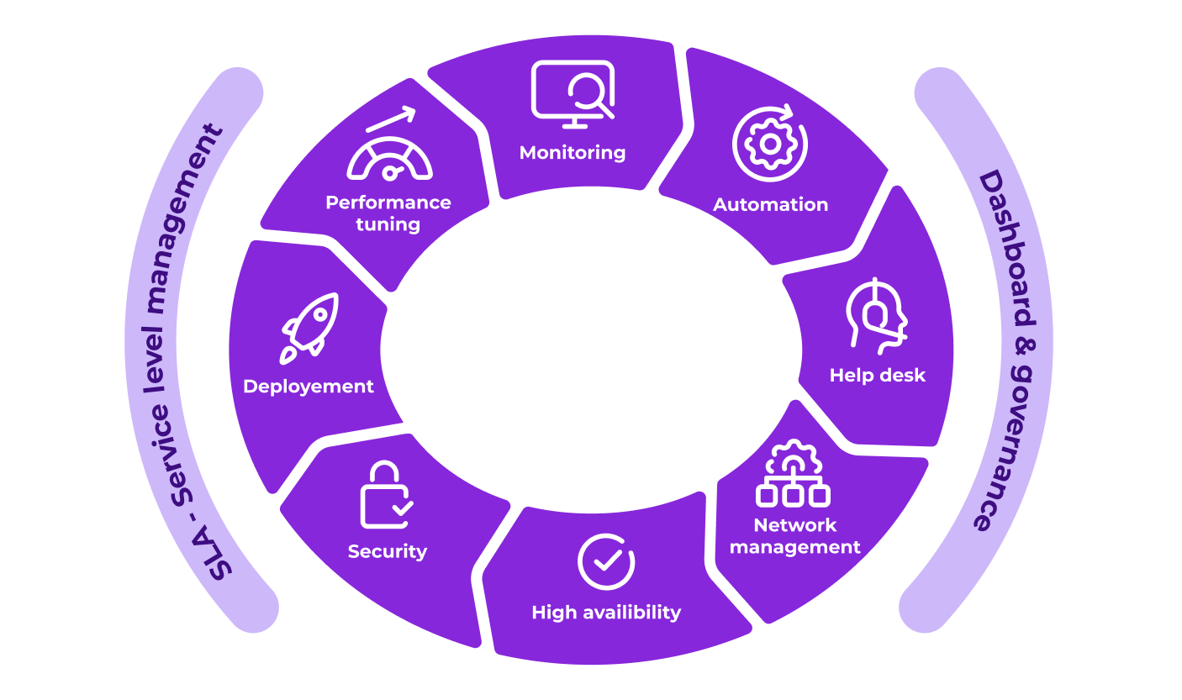




Remote Management & Operation
Infrastructure
Smart Services
Industrialized and certified remote operational management of IT systems​
Delegate management to experts for enhanced efficiency, continuity, and security
Discover
Multilingual certified service centers available 24/7, backed by 20+ years of expertise
24/7 Remote operations including management of job and task, patch and update, automation, access management, deployment and configuration control​
Proactive monitoring and security through real-time supervision and event management, malware, cyber-attacks, and unauthorized access detection and response
Comprehensive support services including remote assistance, root case analysis, incident response and restore services​
Dashboard for data-driven infrastructure governance and decision making
Competence centers for Cloud, AI, cybersecurity, DevOps and SW engineering​
Full integration with service desk, Workplace, AV and Infrastructure management​
Multi-vendor certified technicians (eg. Microsoft, VMware, Oracle etc)​
Key certifications
Industry
Increase availability and performance​
Mitigate security risks through fast issue resolution​
Achieve cost efficiency thanks to highly industrialized services
Simplify management, allowing you to focus on critical tasks
IMS provider to unify and modernize ITOps and existing hybrid multicloud infrastructure, including faster application deployment and business continuity​
24x7 IMS with enhanced availability and application deployment SLA’s​ including:
Design, implementation and operation of backup and Data Recovery system​
Setup DevOps service / Kubernetes operations​
3rd level support for databases and SAP environment, including improved data protection with RTO/RPO SLA
>99.9%
>40k
>300k
Of SLA fulfillment​
Systems managed by Econocom​
Experts within our Infrastructure service centers​
Key technologies

Slide 33

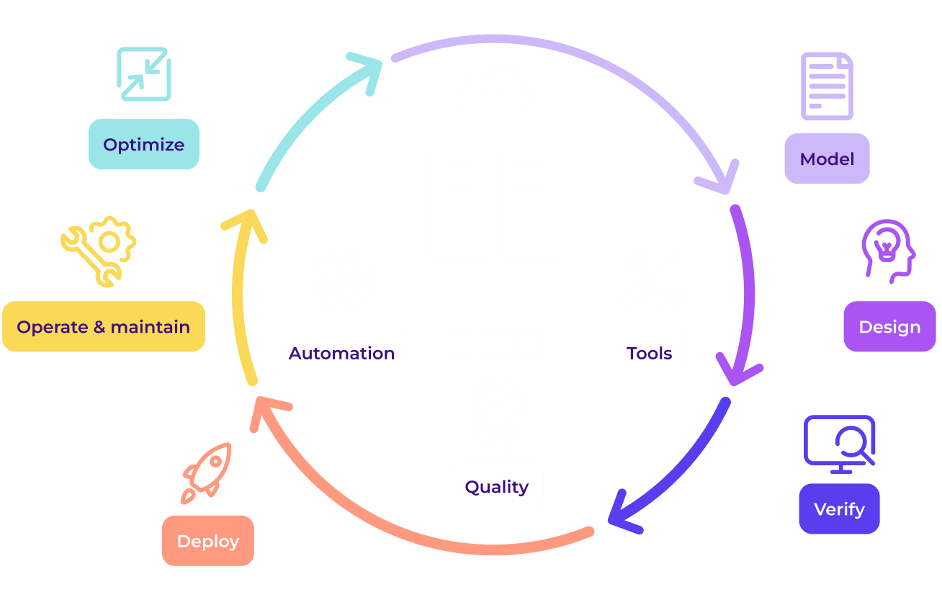

Data Centers Services
Infrastructure
Smart Services
End-to-end remote and on-premise services for your data centers​
Ensure performance, efficiency, security and business continuity
Discover
DC owner with standard rating 4 (former tier) and 22237 DC certified ​
Advisory on DC design, consolidation, integration, operation and maintenance model definition​
24x7x365 DC operations and support with dedicated and on-demand teams
Full territory coverage with customizable SLA options to meet your needs
DC asset management
Green DC program for energy efficiency advisory and integration of renewable energy systems (solar and wind)
Internal competence centers (cybersecurity, AI, SW engineering, Cloud)​
24x7 support​ through our DC field services
Green DC with a climate program actively contributing to sustainability efforts
Retail
Optimize performance and reduce cost​
Reuse and integrate existing DC into new hybrid models​
Improve business continuity and compliance with improved security and reliability, and 24x7 model ​
Get more sustainability by modernizing and consolidating your DC
Support in the modernization of their local DC at each geographic area including support and SLA on-site service to maximize the availability of store systems​
DC modernization project including:
Design and energy consumption optimization​
Extensive DC services with 4 hours on-site SLA
>38%
40%
>1k
Of companies still run their own Data Centers​
Average savings from DC modernization​
Data Centers supported by Econocom​
Key technologies

Slide 34

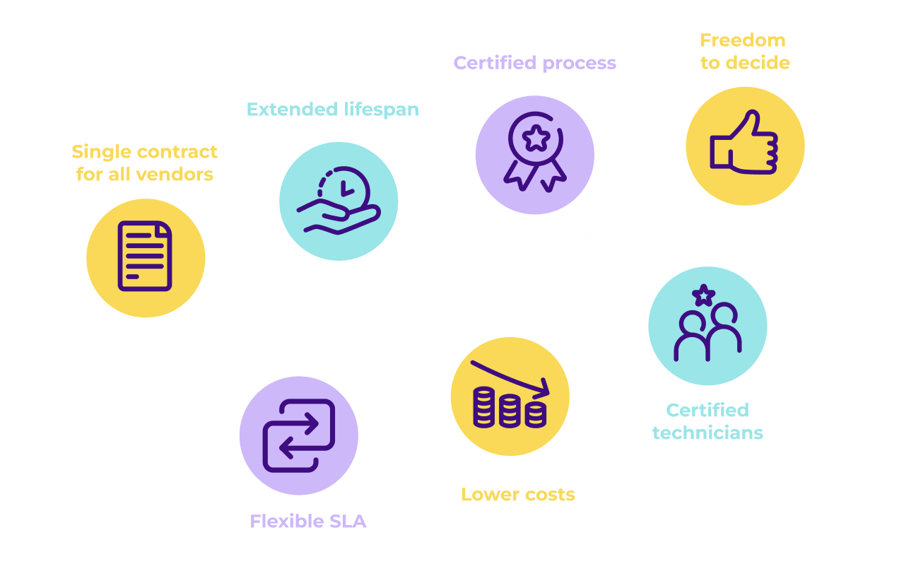
Critical Maintenance
Infrastructure
Smart Services
Extend the longevity of all infrastructure equipment with reliable SLA-based maintenance service​
All-in-one single contract for all devices
Discover
Highly certified support teams from main manufacturer​
Extensive coverage for critical maintenance supporting:​
All-infrastructure equipment: servers, storage, hyperconverged systems, security appliances and networking devices​
All-tier: entry, mid-range or high-end ​level
All-brands: certified maintenance for all main leader brands, including HPE, Dell, PureStorage, NetApp, Huawei, IBM, Cisco, Oracle, Lenovo etc.
All-location: full coverage of the territory​
All-SLA: from 2 hours 24/7 to NBD 8x5, on-demand protection for all equipment​
Extended support: maintenance beyond vendor EOSL
Extensive spare parts inventories including options for dedicated stock​
Flexibility to combine multiple SLAs, brands, and services for maximum efficiency
Enhanced reactivity and service oriented with +95% SLA fulfilment​
Telecommunication
Simplify management with only one provider for all equipment and consolidated incident management​
Achieve significant cost reduction​ (up to 60%)
Promote sustainable IT and ESG compliance by extending equipment lifespan
Maintain IT Infrastructure including 5 different brands, supporting crucial applications with challenges in risky technology migration and high costs of system extension after 4 years
A hybrid maintenance strategy using OEM-authorized and OEM-independent support, with Econocom as a single point of contact to simplify incident management
→ 60% yearly costs reduction and lower risks
35%
45%
>300k
Of infrastructure TCO is attributed to maintenance
Average cost savings with Econocom’s maintenance
Systems maintained by Econocom​
Key technologies

Slide 35

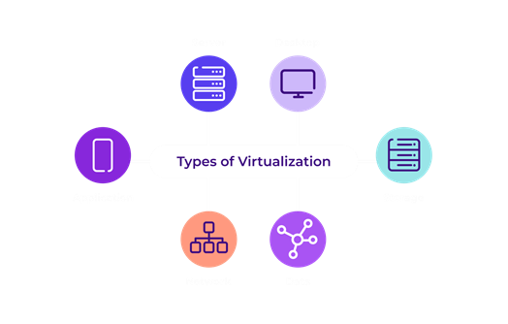

Virtualization
Infrastructure
Software Platforms
Modernize and add flexibility to your infrastructure​
Seamless virtual environments on top of your hybrid, cloud and hyperconverged architectures
Discover
Full support regardless the starting technology or environment
Advisory and design services for your virtual architecture​
Legacy servers migration to hybrid hyperconverged multi-cloud platforms ​
Provision of virtual environments (general purpose or for specific/ad-hoc use cases)​
Complete or partial migration from current virtual platform to alternative new vendors​
Deployment and configuration of management consoles​
Remote management, administration, support and security operations of virtual environment
Tailored solution: on-premise, private cloud, hyperscaler or hybrid​
Triple expertise across resellers, integrators, and service providers
Agnostic approach with partnerships alongside key leading vendors
Energy
Improve operations with automation, software-defined and self-service infrastructure​
Increase security and resilience​ of your infrastructure
Avoid lock-in with specific vendor or physical infrastructure​
Delegate to experts the design and management of virtual platform
Migrate from legacy aging servers used for VDI and other purposes to a modern consolidated data platform, including single management consoles across multiple location
Deployment of VX Rail Server stacks across multiple data centers including:
Setup a VMware vSAN software-defined storage and the VMware vSphere ESXi hypervisor​
Configuration of intelligent LifeCycle Management (LCM) systems
Preparing the infrastructure for future modernization
60%
51%
>50
Reduction in deployment time and operation workload​
Average TCO savings ​achieved with virtualization
Certified ​virtualization experts
Key technologies

Slide 36

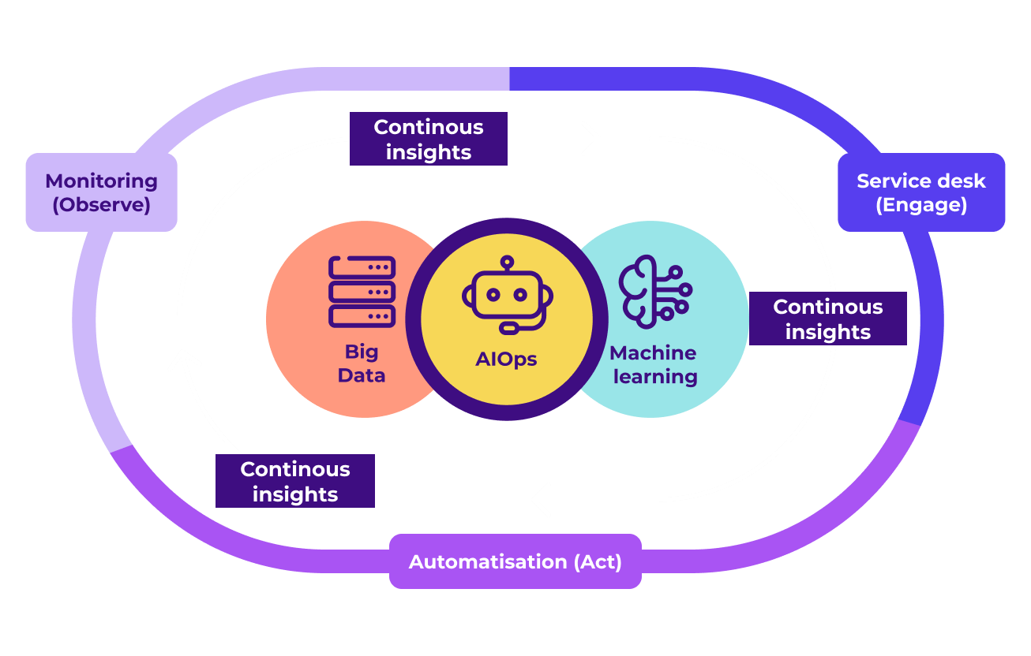


ITOps Automation & AI
Infrastructure
Software Platforms
Benefit from hyper-automation and AI to increase performance and reduce risks in your IT operations
Discover
Multi-technology and multi-domain support
Benefit from AI and Automation to improve your infrastructure:
Automate recurring task such as event correlation and response, application, HW & SW upgrades, security operations, disaster recovery, and incident response
AI-driven insights with automatic root cause analysis, anomaly detection, and predictive capacity management​
AI-powered enterprise conversation solutions and domain-aware chatbots for IT-Operations​ implementation
Streamline deployments through low-code workflow designers for simplified deployments and auto-Discovery & Dependency Mapping (DDM)
Extensive coverage for both infrastructure and workplace​
Delegate service model ensuring seamless operations
Expert automation team designed to keep you in control
Public
Reduce manual effort and minimize potential errors
Increase security while reducing response times
Lead with auto-provisioning and forecasting
Enhance understanding and monitoring of cost control
Enhance infrastructure knowledge and observability
Unify over 20 management tools for distributed network and security environments, all lacking correlation and task automation capabilities
Automation and tool rationalization project:
​Assessment of current tools and processes​
Implementation of Ansible and the development of task automation playbooks
Establishment of a central console for event correlation
→ +70% of tasks automated within 12 months
>90%
44%
+80%
Of ITOps tasks ​
can be automated
Reduction in average in tickets​ volume
Adoption rate for AI solutions compared to traditional methods
Key technologies

Slide 37
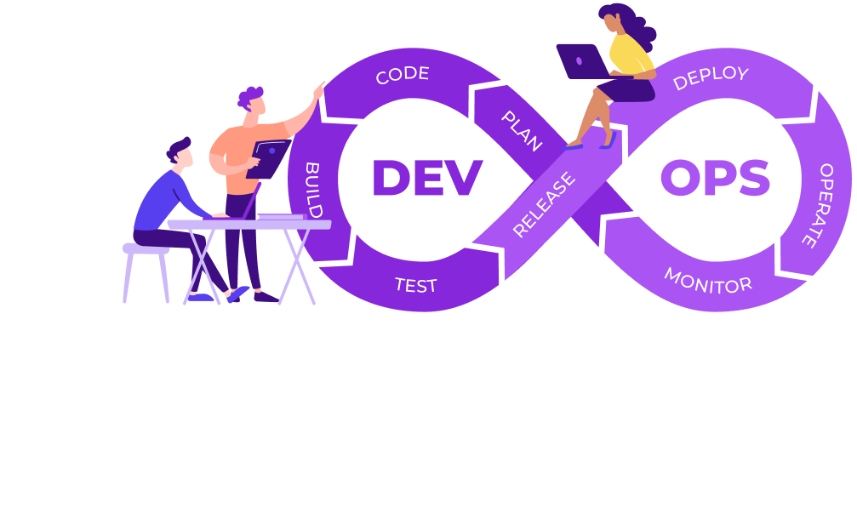
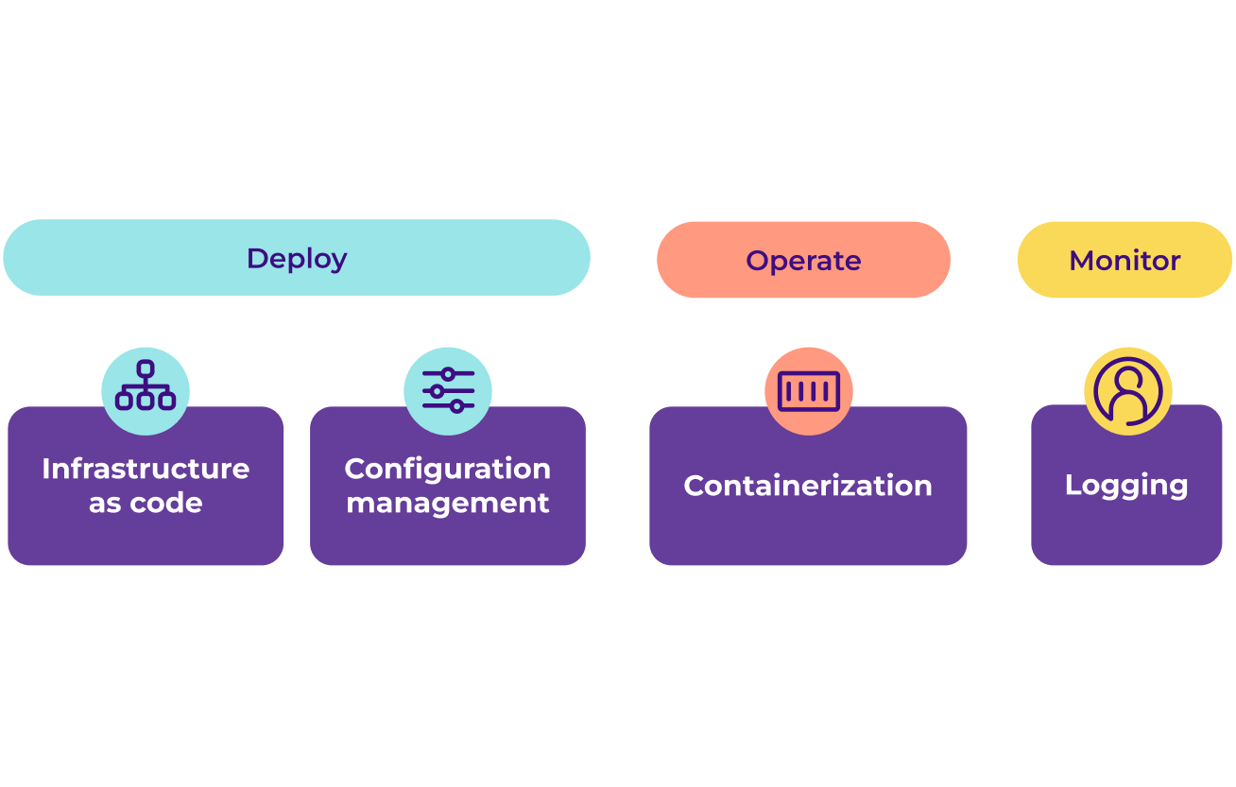

DevOps
Infrastructure
Software Platforms
Simplify DevOps by transforming your IT environment for seamless application deployment in production
Discover
DevOps processes integrated in cloud operations​
Analysis of infrastructure and readiness assessment to evaluate the current state for DevOps and containerization adoption
Alignment with development teams ensure seamless collaboration
Configuration of Continuous Improvement/ Continuous Delivery (CI/CD) pipelines, version control, etc.
Implementation of security practices, including secret management, network policies, Role-Based Access Controls (RBAC) and data security
Continuous operation and supervision of application and container cluster performance
Dedicated expert team certified for leading solutions​
Guidance throughout the DevOps adoption curve
Agnostic approach with partnerships alongside key leading vendors
Food
Achieve seamless integration of development and operations with improved change control​
Boost scalability and flexibility through automation​​
Strengthen security and ensure compliance
Enhance application portability for faster innovation and deployment
Transform web applications into container-based formats to achieve cost efficiency, deployment agility, and scalability
A hybrid Kubernetes environment, using Econocom Cloud powered by Rancher and Azure AKS services
Achieved more than 40% cost reduction in IaaS
60%
+50%
28%
Average savings in infrastructure and operations costs
Improvement in application deployment​
Average reduction in data breach likelihood​
Key technologies

Slide 38

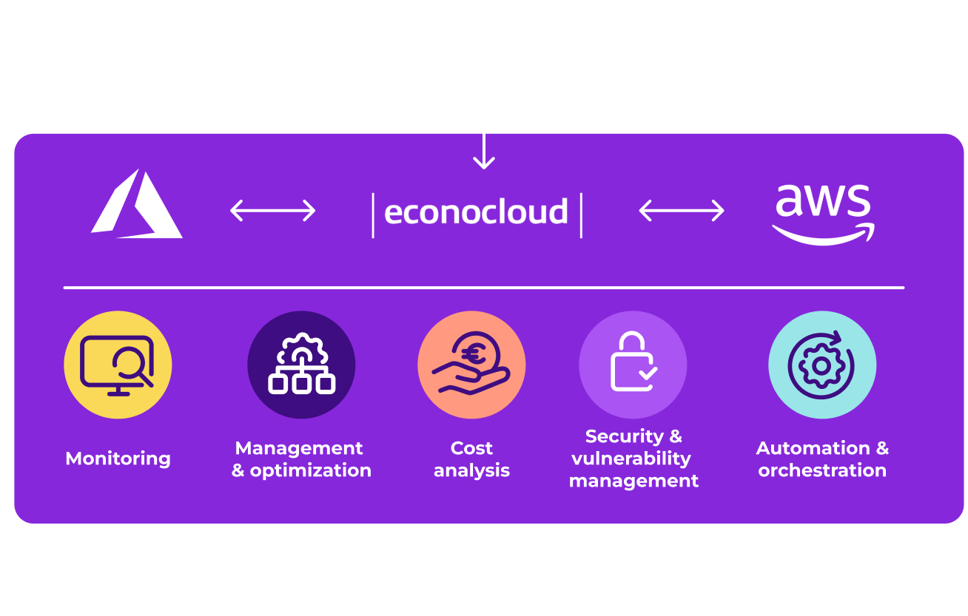


Cloud Management
Infrastructure
Software Platforms
Simplify and optimize your cloud operations with unified multi-cloud service management
Discover
Flexible and tailored made service (traditional, cloud native SaaS/PaaS)​
Comprehensive cloud management: manage all cloud solutions (Econocloud, public cloud such as Azure and AWS, and on-premise) from one console
Self-management portal​ for Econocloud
Automation and orchestration of infrastructure in cloud environments
Cost control: monitor and optimize cloud expenses with cloud manager​
Security and compliance: receive expert advice on cloud security and regulatory compliance​
Service distribution: get guidance on the best-fit cloud platform for each of your services and applications
Agnostic approach to benefit from cutting-edge modern cloud​
Focus on cost control and multi-cloud governance​
24/7 SLA-based service delivered from our certified service centers​
Food
Manage multiple platforms through a unified environment avoiding lock-in
Increase efficiency through automation
Gain freedom with self-provisioning services while maintaining cost control and predictability
Strengthen security and compliance
Unified management of both on-premise data centers and cloud environments, with workloads migrating to Econocom Cloud and Azure for PaaS/SaaS services
Management of both on-premise and cloud environments including:
Tools like Jira, Zabbix, and Confluence for ticketing, monitoring, and documentation
Personalized dashboards providing the real-time service status​
Unified security controls for access management, user authentication, and provider integration
>93%
>46%
>200
Of companies are multi-cloud​
Of companies need support optimizing on-premise vs private cloud​
Cloud environments are managed by Econocom​
Key technologies

Slide 39

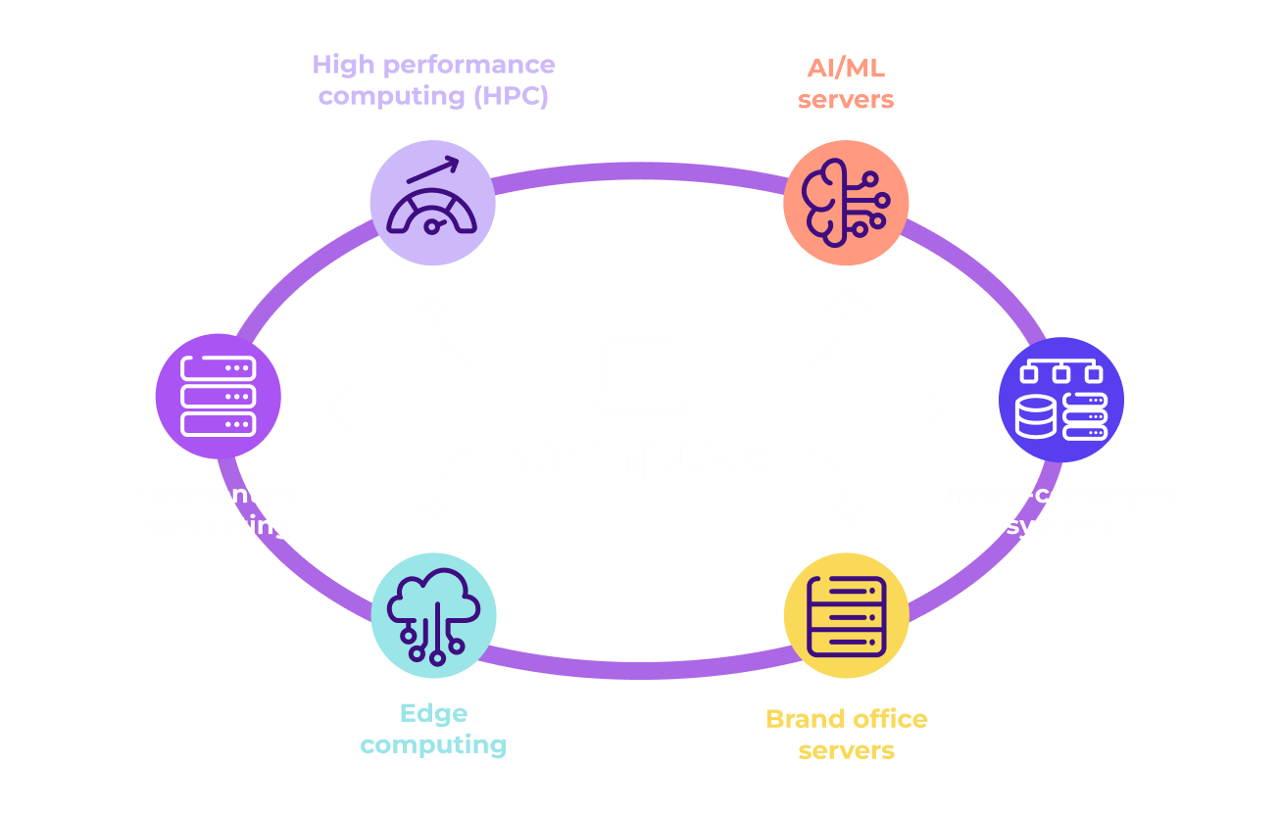


Compute
Infrastructure
Infra Equipment
Select the right infrastructure for your business
Streamline tech evolution, ensuring up-to-date infrastructure, by optimizing your existing investments
Discover
Flexible solutions: as-a-Service (OPEX), purchase (CAPEX) or mix
Design and implementation of your core or edge infrastructure:
Hyperconverged systems: integrate computing, storage, and networking into a single, scalable solution
High Performance Computing (HPC): execute complex computations and data analyses at high speeds
Edge computing: bring data processing closer to the source of data generation
Hybrid cloud solutions: leverage both on-premises and cloud resources efficiently
Artificial intelligence (AI) and Machine Learning (ML): specialized infrastructure for AI / ML use cases
Option for Compute-as-a-Service solution with integrated software solution on top
360° approach: advisory, design, deployment and managed services
One-stop-shop, with broad catalogue and expertise
Dedicated expert team with certifications alongside key leading vendors
Transport
Optimize design customization to meet your business needs
Leverage specialized expertise to drive innovation
Improve performance and energy efficiency
Increase flexibility with our ‘as-a-Service’ option and avoid vendor lock-in
Digitize operations, enhance rail network safety, and improve punctuality with applications requiring a high-performance and highly available compute platform
Design and implement of over 4,000 HPE servers (Proliant, Apollo, Integrity) including:
Optimized configurations for the latest innovations
Sizing for specific applications, such as SAP Hana
Maintenance with strict SLA aligned to the criticality of the servers
+250%
x2
>15k
Average computing power gain with modernization
Per-watt performance with Econocom compute solution
Servers deployed yearly
Key technologies

Slide 40

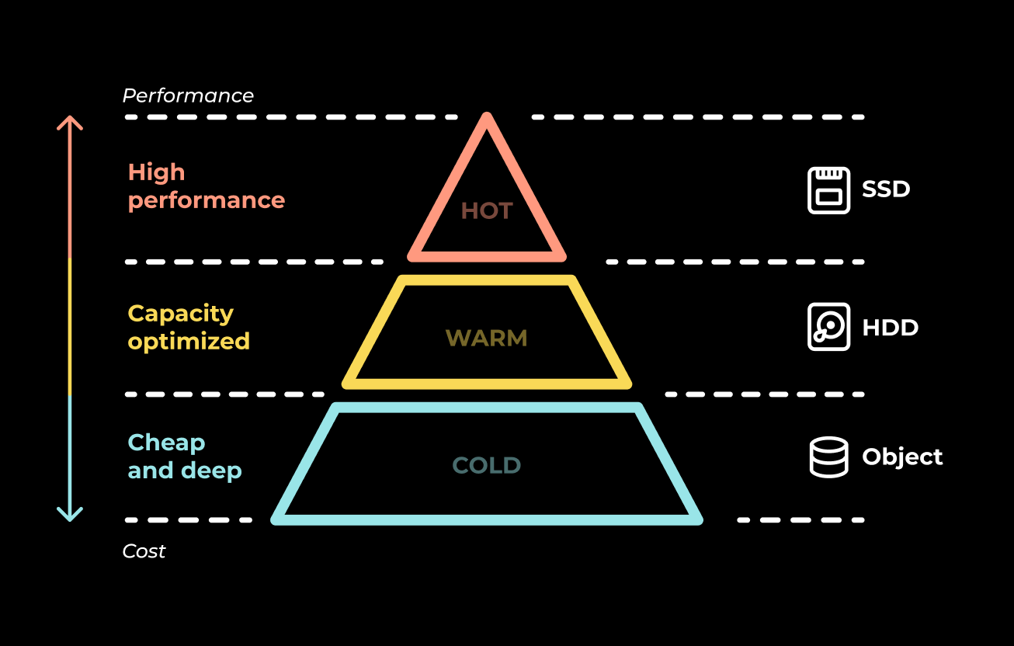

Storage
Infrastructure
Infra Equipment
Create efficient and tailor-made shared storage platforms: on-premise, hybrid, cloud and private cloud
Ensure your data is protected and highly available
Discover
Storage designs that encompass both business and management goals
Design and implementation of your storage infrastructure:
Migrate from legacy slow storage to fast protected data platform:
  Reduce drivers’ errors and costly support overheads
  Remove old siloed storage
Implementation and operation of the storage infrastructure for a tailored architecture
Option for Storage-as-a-Service solution with integrated software solution on top
Flexible solutions: as-a-Service (OPEX), purchase (CAPEX) or mix
360° approach: advisory, design, deployment and managed services
Dedicated expert team with certifications alongside key leading vendors
Luxury goods
Optimize design customization to meet your business needs
Leverage specialized expertise to drive innovation and experience cloud-like simplicity
Reduce latency and increase energy efficiency, minimizing data center footprint and costs
Increase flexibility with our ‘as-a-Service’ option and avoid vendor lock-in
Migrate from legacy infrastructure to handle more 4K/8K corporate content and support more editors and codecs
Decommissioning of the existing storage and replacement by a new infrastructure:
NVMe storage layer with object storage private cloud
Training services on the new infrastructure
+27%
+50%
>200PB
Of YoY growth of generated data
Performance boost with modern storage solutions
Of storage capacity managed for our clients
Key technologies

Slide 41

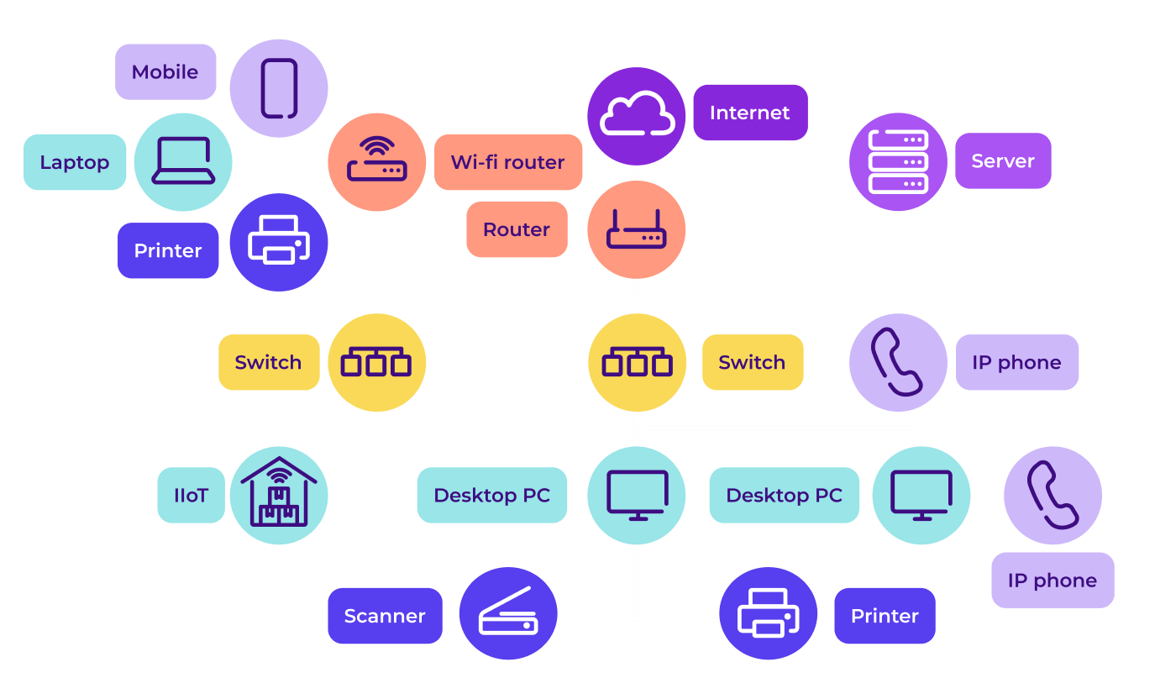

Networking
Infrastructure
Infra Equipment
Full set of intelligent networking solutions (local, internet and WAN)
Automated, unsiloted and high-performance solution without impact for users
Discover
360° capabilities on network distribution and integration
Deploy and manage networking (LAN/WLAN) infrastructure including:
Access control: implement NAC for secure network access
SD-WAN solutions: upgrade legacy MPLS with managed SD-WAN and branch technology
Cloud management: offer cloud-managed infrastructure solutions with proactive alerts
Security solutions: enhance network security by coordinating SSE/ZTNA solutions with IT teams for comprehensive security coverage
Broad catalogue offering a wide array of network products and solutions
Advisory and expertise on all leading vendors of the market
Dedicated expert team with certifications alongside key leading vendors
Luxury goods
Reduced costs, without operator lock-in
Improve network visibility with centralized monitoring
Simplify security with unify authentication and integrated access control across LAN and applications
Enhance flexibility to be ready for new technologies
Renew LAN/WLAN infrastructure and implement secure access to LAN in all countries, using TLS authentication with certificates and Microsoft Intune
Designed WLAN with Ekahau and deployed a new switching infrastructure with unified credentials
Implemented NAC using HPE Aruba ClearPass, integrated with Intune, to secure LAN/WLAN access and enhance WLAN performance through IoT profiling
+85%
>1.2k
>150
Increase in uptime with modern network architecture
Network clients from all sectors
Network and cybersecurity experts
Key technologies

Slide 42
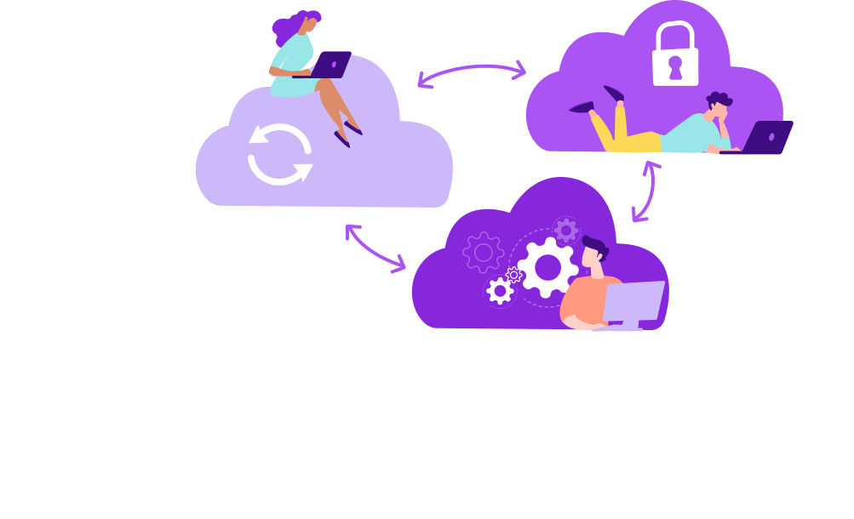
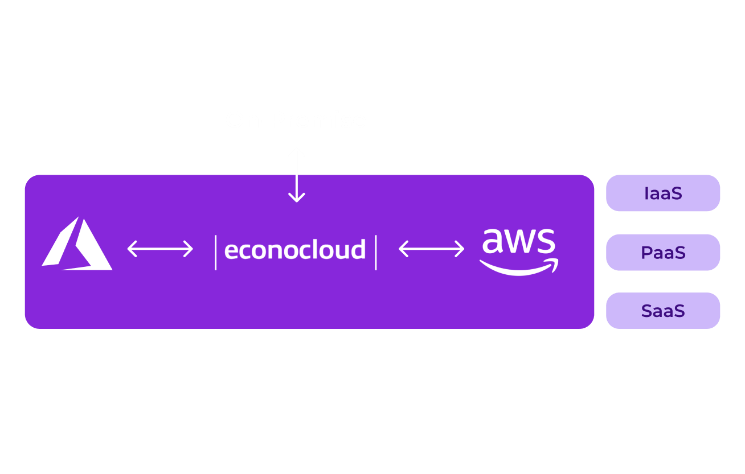


Hybrid Cloud
Infrastructure
Infra Equipment
Solution on top of on-premise infrastructure and public cloud
Econocom Cloud is the perfect complement for all existing cloud
Discover
Unified vision and management of on-premise and cloud environment
Business-oriented advisory on the best cloud architecture tailored for your needs and requirements
Comprehensive private cloud solutions in Econocom data center or client data center: Iaas, PaaS and SaaS
Public cloud services from leading market players
Hybrid solutions with hardware deployment in the client’s DC or in Econocom Cloud, and connected to a (public or private) cloud environment
Microsoft, Veeam, VMware (and others) licensing in service mode for on-premise and cloud environment
On-premise infrastructure equipment under as-a-Service model (storage, servers and networking)
Deployment of our own cloud technology at your premises
Cloud services without hidden costs with predictable bill
Tailor-made solution based on your needs and current blueprint
Healthcare
Achieve transparent pricing while reducing costs
Increase flexible with HW-as-a-Service solutions and license usage without subscriptions
Reduce vendor and technology lock-in
Improve efficiency and agility through reduced down-time and an adaptable environment
Manage workloads across a cloud environment, including Windows/Linux, VMs, SQL, databases, and more, while ensuring data protection with disaster recovery solutions
Econocom cloud solution (Econocloud) using VMware SDDC and vCloud Director secured by
NSX-T and Fortinet
Veeam handles backups to Azure, with HPE Zert0 for near-sync replication to Azure (Low RPO/RTO), Azure disaster recovery with pay-as-you-go resources
>400
>5PB
>10k
Customers using Econocom Cloud
Of storage provisioned for hybrid cloud in our datacenter
Virtual machines deployed
Key technologies

Slide 43

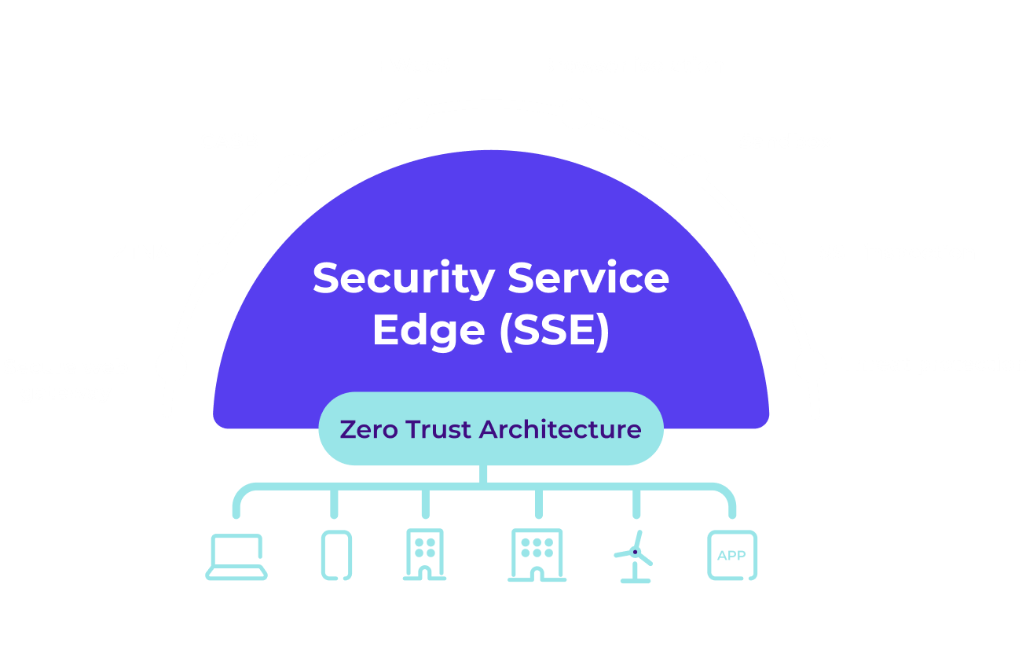

Security Service Edge (SSE)
Infrastructure
Infra Equipment
Secure access to the web, cloud services (SaaS, PaaS, laaS) and private applications
Cloud-delivered protection service, regardless of user location, device or application
Discover
Expertise on every project phase: advisory, design, build, run
Simplified and secure global data access without VPN risks, leveraging Zero Trust Network Access (ZTNA) and a secure web portal for internal applications
Unified security and compliance centralized management of security policies (ZTNA, SWG, CASB)
Enhanced security features including URL filtering, malware protection, threat prevention and Cloud Access Security Broker (CASB) for SaaS apps
Modern workplace support access from any location with support for Windows, MacOS, iOS and Android
Streamlined IT operations with centralized, cloud-hosted management and visibility
Strong partnership with the major Gartner and Forrester leaders
Managed SSE offer with GO4WEB solution
Customer-centric approach: security at the service of users
Industry
Strengthen security and reduce risk across the organization
Improve user experience and overall performances
Reduce IT workload with no on-premise footprint and vendor consolidation
Enhance visibility and control
Replace obsolete on-premise remote access solutions to improve security and performance for mobile users globally, especially in China
Implemented CATO Network Solution for secure access to private applications and internet browsing for 800 mobile users
Provided design, configuration, and deployment support
Elimination of all on-premise equipment for enhanced security using CASB and IPS
Threat prevention for all traffic
-50%
+230%
>25
Likelihood of cyberattack with ZTNA and modern SSE
ROI over three years with SSE implementation
Certified cybersecurity experts and analysts
Key technologies

Slide 44

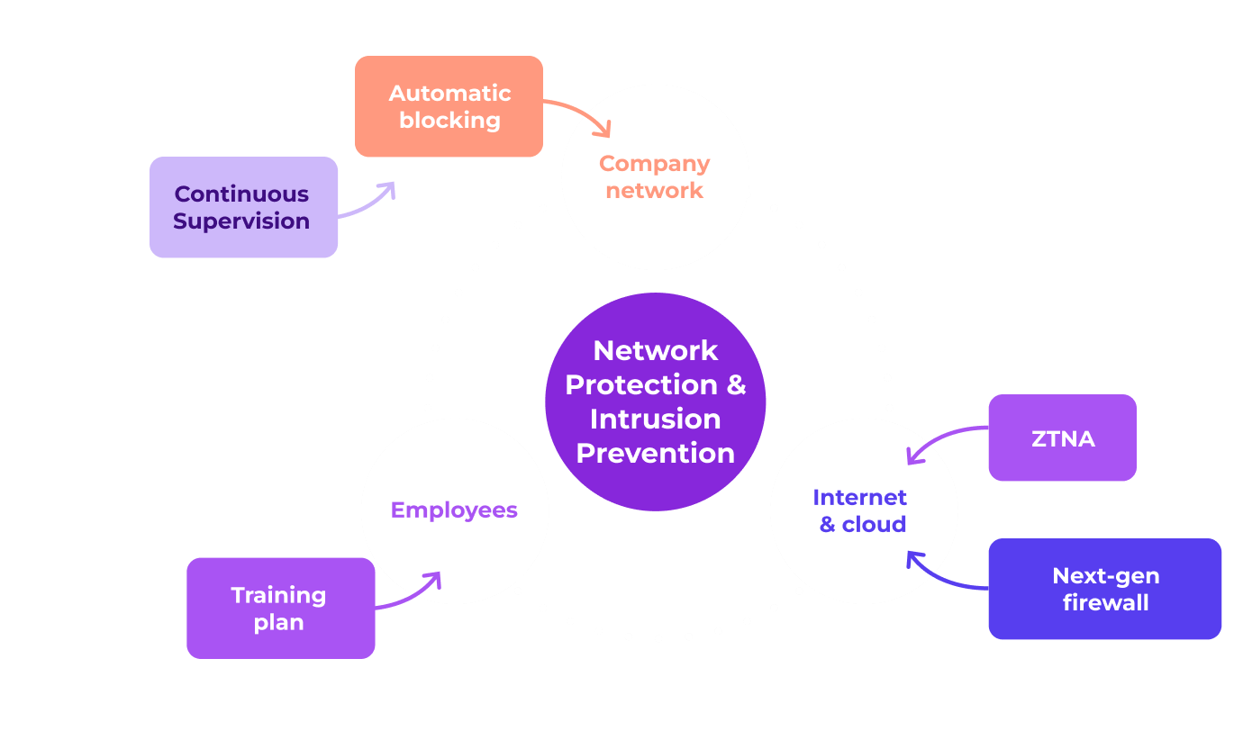

Network protection & Intrusion prevention
Infrastructure
Security
Protect your network from cyberattacks without disturbing your users
Unstacked approach for high availability and advances supervision and detection capabilities
Discover
Advisory and expertise on leading market vendors
Deploy solutions to protect your company and ensure business continuity including:
Next gen firewalls (antimalware, DNS protection, protection deny of service, web filtering…)
IPS and NDR (AI and behavioral analysis)
Mail security, internet browsing security
Cloud app security
Zero Trust Network Access (ZTNA)
360° capabilities on solution distribution and integration
Customer-centric approach: security at the service of users
Dedicated team for proximity and reactivity
Public
Protect your corporate network with industry-leading security
Address an extensive range of threats effectively
Detect and respond faster to lower risks
Enhance user experience with convenient remote access
Implement a security architecture to protect interbank payment processes while providing secure external access for employees and third-party providers
Advisory and integration of security solutions:
Next-gen firewall implementation
PaloAlto, Fortinet & Juniper security suites
Protect critical email communication
External secure access for employees and third-party providers
ZTNA and micro segmentation
Periodic pen testing
+95%
>1.2k
>150
Of YoY growth of cyberattacks last 5 years
Network and cybersecurity customers
Network and cybersecurity professionals
Key technologies

Slide 45



SIEM
Infrastructure
Security
24/7 event management and supervision from certified service centers
Prompt response to security incidents
Discover
Service Center grid across multiple countries including FR, IT, ES, BE and MOR
Supervision of any kind of resource: physical or virtual, network, databases, business applications etc.
Cross-platform automatic event collection and correlation
Remote remediation and escalation
Security incident management from our SOC with possibility to escalate to third parties
Wide set of tools (from market and self developed):
  SEKOIA security information and event management
  Orbital event correlation
  Zabbix
  Splunk
  ServiceNow
Internal SOC capabilities (24/7, strong expertise, highly certified)
Strong partnerships with key providers
High proximity and reactivity for our clients
Public
Anticipate and respond faster to events
Ensure efficient 24x7 coverage, releasing valuable internal resources
Balance security and costs without compromise
Improve availability and resource management
Unify existing supervision services with multiple tools and stakeholders, and improve event response efficiency
Econocom SIEM solution with:
Initial AS-IS/TO-BE consultancy and advisory
Implementation of a SIEM console
Automation of event correlation and response policies
Development of automated scripts
24/7 supervision team consisting of over 20 people
>85%
30 min
>400k
Of event response are automated
Average dealing time with SIEM solution
Users protected by Econocom SIEM
Key technologies

Slide 46

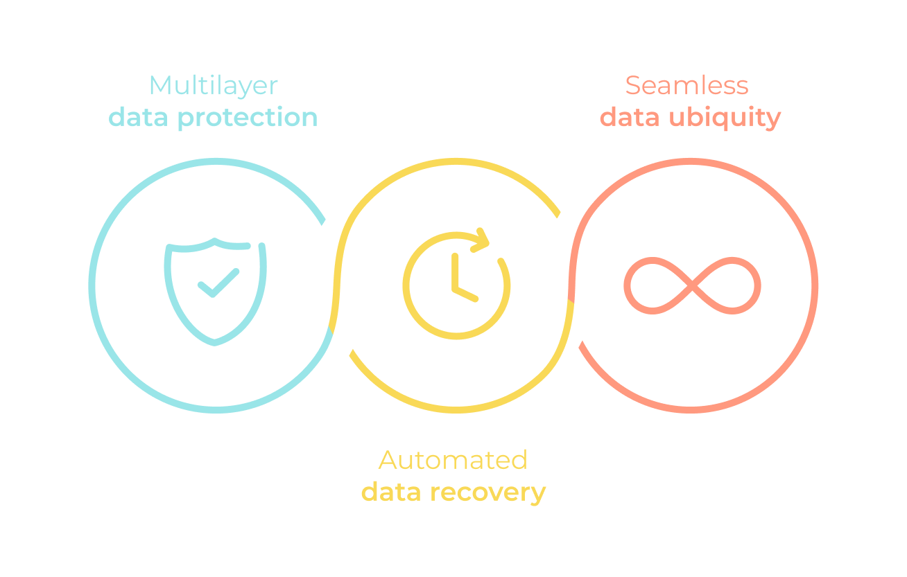

Backup & Disaster Recovery
Infrastructure
Security
Guarantee the continuity of your business and applications
Protect and manage your data from attacks and outages, across any environment
Discover
Triple expertise across advisory, integration, and managed services
Built on top of latest technologies, our backup and DR solutions include:
Advisory and design: tailored strategies for IT business continuity, backup policies, and architecture
End-to-end implementation including:
  In house, hybrid and cloud infra (public or private)
  Deployment and configuration
  Integration with existing systems
Recurrent update, testing, awareness and recovery support services
SLA based Backup-as-a-Service (BaaS) and DR-as-a-Service (DRaaS)
BaaS and DRaaS solutions delivered through Econocloud, on-premise, or hybrid models
Fully compliant with GDPR and data sovereignty regulations
Certified expert team for main solutions from market leaders
Energy
Shield the continuity of your IT services and critical applications
Respond and recover from cyberattacks faster
React quickly to disruptions
Rely on experts and benefit from SLA-oriented end-to-end solutions
Ransom-proof backup for 3PB of data spread across multiple data centers, which was previously unprotected from ransomware
Collaboration with Veeam and Wasabi to design a secure solution:
Data copied from the data center to Wasabi through multiple links
Another copy sent to Wasabi in Amsterdam with a quick recall system that locks the data
>73%
+65%
25%
Of companies experienced ransomware attempts
Of data availability with less critical workload
Average savings on backup operation costs
Key technologies

Slide 47

Audiovisual
04

Slide 48

Audiovisual
Summary
Your partner for to enhance your Audiovisual, no matter what you need
Would you like to know more? Please click below
AudioVisual Experience
Digital Spaces
Corporate Offices
Retail
Hospitality
Education
Event & Public Spaces
Healthcare
Services & Software Solutions
Design & Interior
Solutions
Control & Automation
User & Experience Solutions
Content Management Services
Network Integration & Operation
Media Security
Media Devices
One Audiovisual
Pro Displays
Digital Signage
Audio, Lighting & Climate Solutions
Collaboration Devices
Room-as-a-Service
SOURCE
CUSTOMIZE
PILOT
MAKE LAST

Slide 49

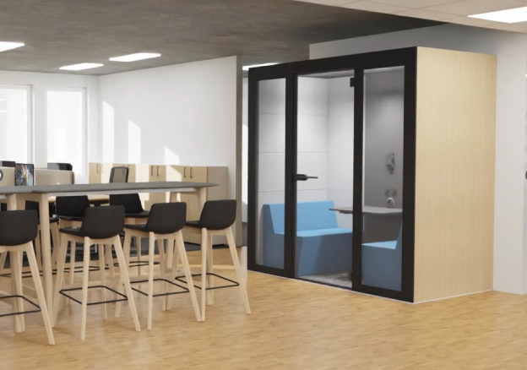
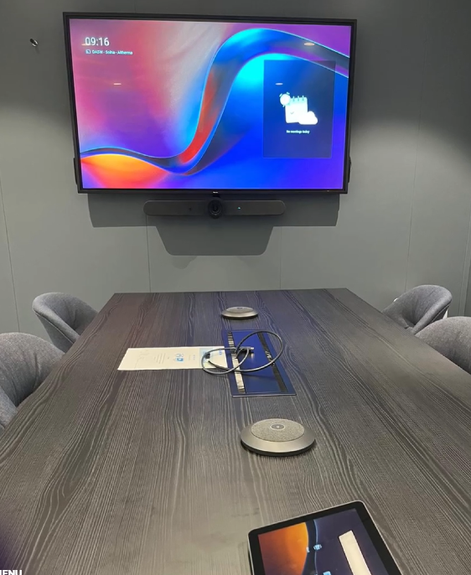






Corporate Offices
Audiovisual
Digital Spaces
Cutting-edge corporate audiovisual integrations with stunning video display, immersive and professional audio systems with a versatile infrastructure for (hybrid) meetings and presentations
Discover
360° approach: consultants, implementers, trainers & service providers
Transform corporate offices into vibrant InOffice experience:
Office as a meeting place: everything is designed to facilitate face-to-face and hybrid meetings, presentations and cooperation
Enhancement of all shared areas from entrance to auditorium, coffee corner to boardroom, creating spaces where teams can meet, interact, share information, and collaborate seamlessly
Experts for both tailor-made and standardized room solutions
User-centric solution design with additional professional services
Supported by professional and smart services:
Global presence with a local approach and dedicated teams
Room design (with attention to sightlines, furniture, technology integration and lighting),
User training
Remote management
HVAC Industry
Reduce administrative workload with a one-stop shop for all room types, spaces, and solutions
Access flexible and affordable options that ensure seamless sharing of ideas and information
Reduce Total Cost of Ownership (TCO)
Seeking a reliable partner to equip meeting rooms in offices worldwide including high-quality solutions, uniformity, ease of use, inclusiveness, and top-tier services and support
Equipment of 500 hybrid meeting room across 31 countries with:
Standardized hybrid audiovisual and collaboration solutions
Maintenance with support & SLA agreement
Centralized stock
Unified supply chain process
+50%
+3k
>30
Of attention and effectiveness with new meeting room
Meeting rooms deployed in corporate offices
Countries
Key Technologies

Slide 50

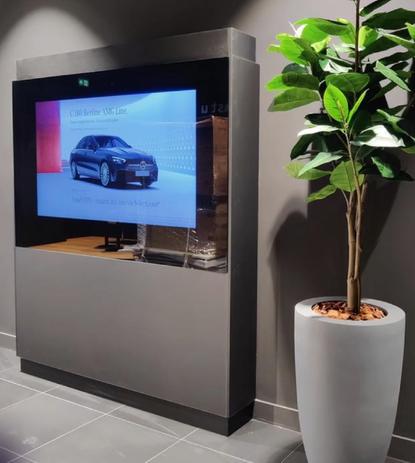
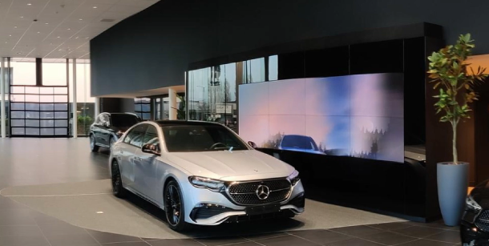

Retail
Audiovisual
Digital Spaces
Transform physical spaces into more attractive digital environments through the integration of audiovisual systems, the creation of spectacular content and innovative sensory marketing solutions
Discover
Worldwide deployment managed by one single partner
Connected physical and digital stores to enhance the consumer journey:
Consultancy and interior design to create immersive spaces that optimize operational processes and elevate the retail experience
Tailor-made communication and experience to develop, adapt, and distribute your brand guidelines to enhance customer engagement with cutting-edge tools
Global integration through partnerships with world-class technology providers, delivering innovative solutions across all projects worldwide
24/7 management with multilingual nearshore monitoring through MSC in Spain
Full project support from definition and design to delivery, integration, and ongoing support
A creative team dedicated to elevating your brand
Cutting-edge tools to optimize recurring operations
Automotive industry
Optimize processes and improve efficiency
Access a wide range of solutions and technologies
Expand your business internationally more efficiently
Accelerate the implementation of new projects
The client seeks to enhance the shopping experience, upgrade the sales and personalization process, and unify and standardize process across Europe and globally
A complete and immersive shopping experience for users including:
More than 100 dealerships designed worldwide
120 people working on the 5-year project
Over 10,000 items deployed
>8k
>110
>200
Projects dedicated to Retail
Countries with Retail projects done by Gather
Specialized technicians for installations
Key Technologies

Slide 51






Hospitality
Audiovisual
Digital Spaces
Solutions and equipment that make guests stay unforgettable
From spectacular lobbies, communication campaigns, commanders or PMS, we are a multidisciplinary integrator
Discover
Integrator with the highest number of success stories in hotel sector
Spectacular audiovisual solution for each room, elevating the guest experience from the entrance to the top of the business: lobby, common areas, meeting rooms, guest room…
Advanced entertainment services on the hotel room:
  Professional TV equipment and accessories
  Casting service from Chromecast integrated into the television to the server that guarantees isolation between rooms
  Infotainment service composed of an operating system embedded in the television and a content server
Hotel Communications Services including WiFi network, network electronics, captive portal, firewalls
Additional hospitality equipment: Lighting, safety deposit boxes, minibars, telephony...
Caribbean and Brazil warehouse
360° approach: consultants, implementers, trainers & service providers
Full support spanning project definition, solution design, delivery, integration, and ongoing assistance
Hotel
Access to a richer, more personalized guest experience
Create a more productive environment for meetings and events
Increase customer satisfaction and unlock additional revenue potential
Ensure efficient and secure communication for all users
Integrate TV solution in the hotel for all rooms and common areas
Installation of LG LED screens All-in-One in strategic areas of the hotel
Digital signage among main areas, projecting audiovisual content
TV signal for specific moments as sport events
Specific TV solutions for the room, more than 200 rooms equipped
+10%
>25
>25k
Guest satisfaction with an entertainment solution vs traditional
Years experience in hospitality sector
TV delivered in hotel per year
Key Technologies

Slide 52

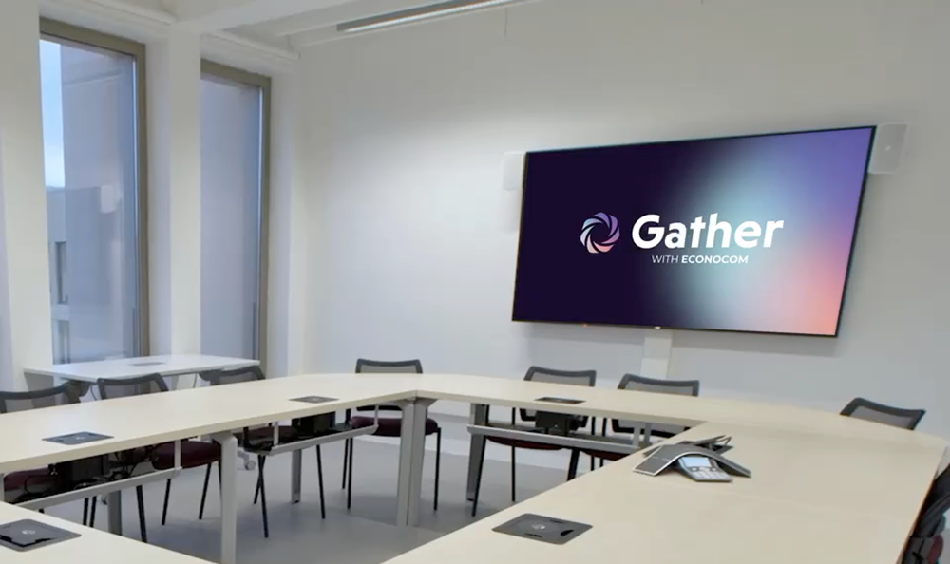



Education
Audiovisual
Digital Spaces
A step into the classroom of the future: interactive solutions for all types of educational spaces
From schools and universities to vocational training centers, we are experts in the supply, installation, and maintenance of fully equipped classrooms
Discover
Agnostic approach with partnerships with key leader vendors
Consultancy and design of a school project:
Integration of essential systems: air conditioning systems, energy efficiency and lighting
Lecture theatres and auditoriums connected to the future: online and virtual sessions with broadcast solutions
STEAM Solutions: robotics, 3D printing or Virtual Reality for education
Audiovisual for classroom: Interactive displays, microphones or projectors
Centralized management: control centers for all devices to ensure successful sessions
Certified and dedicated expert teams
360° approach: consultants, implementers, trainers & service providers
Comprehensive solutions: project definition, solution design, delivery, integration and support
Education
Engage students and access to more effective learning
Facilitate the use of technological tools by students
Share knowledge more interactively and remotely with collaboration tools
>7k
Solution to digitalize schools and improve the commitment of students including installation and support across dispersed places in a rural and unpopulated environment
Deployment of +1,000 interactive displays in collaboration with other partners including:
All accessories including wall brackets, casters and other necessary components
Specific trainings for +200 users to explore all the capabilities provided by the technology
2030
>80k
Objective to digitalize all pupils by UNESCO
Students impacted with new AV solutions
educational spaces equipped with AV solutions in 2023
Key Technologies

Slide 53

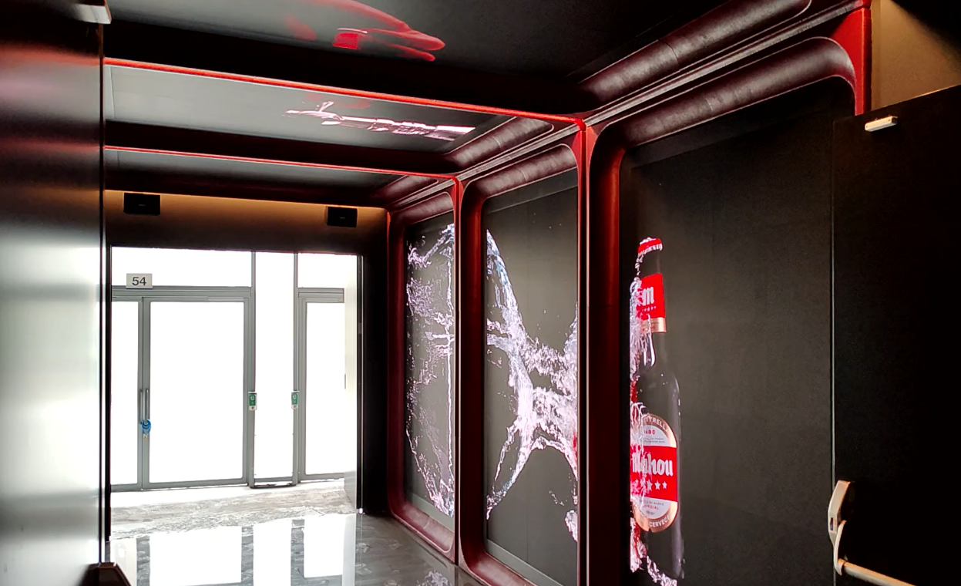


Events & Public spaces
Audiovisual
Digital Spaces
Design, supply, installation and configuration of customized audiovisual systems for event spaces
Our team of engineers, certified with the main partners in the audio and video market, will accompany you throughout the project
Discover
Complete integrator for large space solutions
Creating memorable experiences tailored to your event:
Preliminary technical studies conducted to evaluate the appropriateness of selected technologies and recommend modifications to enhance AV performance
Tailored AV systems specifically designed for the unique characteristics of each space" for smoother flow
Implementation of automation processes to simplify system management and optimize operations for future users
Integrated IP-based technology for video and audio, replacing traditional analogue systems
Wide catalog of solutions for immersive experiences
360° approach: consultants, implementers, trainers & service providers
Our solutions fit your current environment to create an enhanced experience
Sport
Reduce operating costs and improve overall facility efficiency
Ensure solutions are perfectly tailored to fit the intended usage
Reach optimal performance and simplified operations with professionalized and standardized solutions
To provide spectacular audiovisual solutions that envelop the spectators for a large stadium in a specific area
An immersive and complete public space with +2.000m2 inside Stadium including:
Multiple LED screens installed to create a striking and uniform visual environment
Dynamic and synchronized content managed through LG’s Supersign system
Ambient sound system
Centralized control to facilitate the management of all AV
+20%
>100
>200
Increase in customer engagement with our solution
Projects developed in 2023 & 2024
Specialized technicians for installations
Key Technologies

Slide 54

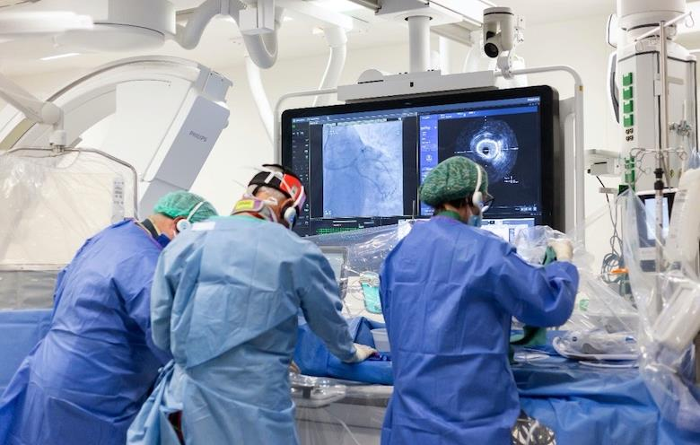



Healthcare
Audiovisual
Digital Spaces
Advanced equipment and technical solutions to optimize all operations in the operating theatre
Tailored solutions to meet patients' needs within the room
Discover
Knowledge of control and diagnostics in hospital systems
Professional hospitality equipment & experience:
Smart operating rooms for the future:
  Video signal camera management
  Camera switching
  Recording and streaming
  Intelligent industrial pedal connected with camera system enabling clean transmission/recording
Advanced entertainment services for the patient room:
  Professional TV equipment and accessories
  Casting service with Chromecast in the television to the server that guarantees isolation between rooms
  Infotainment service composed of an operating system embedded in the television and a content server
Comprehensive, secure and centrally managed entertainment system
360° approach: consultants, implementers, trainers & service providers
Full support spanning project definition, solution design, delivery, integration, and ongoing assistance
Hospital
Achieve greater precision and efficiency in medical procedures
Reduce workload through camera management, intuitive controls, and centralized streaming
Deliver a superior patient entertainment experience
Enhance security and privacy with a private casting system for each guest
Ensure stable connectivity between the different elements that make up an operating theatre, from cameras, touch screens that operate surgical robots to an electric foot pedal
Creation of a secure and centralized space:
Installation of an electric pedal, connected to the cameras to ensure a stable intervention and transmitted by a system of screens
Projection and live broadcasting of operations for educational purposes
Ambient and emergency sound system
30%
+10%
>5
Reduction of surgical chamber interruption
Guest satisfaction with an entertainment solution vs traditional
Hospitals and nursing homes equipped in 2023
Key Technologies

Slide 55

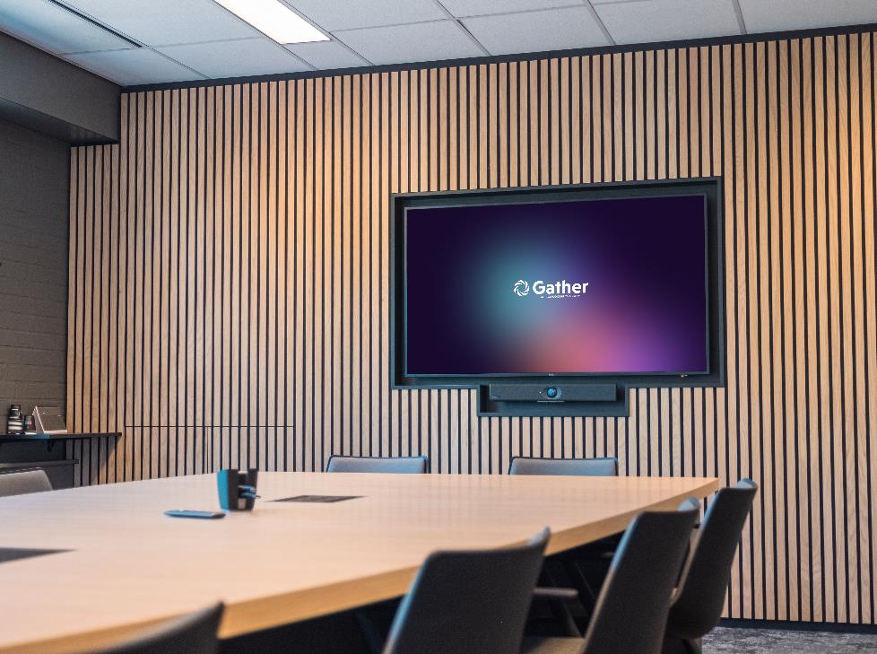


Design & Interior solutions
Audiovisual
Services & Solutions
We create the perfect harmony between technology, user experience, and atmosphere through user-centric design and smart technology integration
Discover
Holistic approach from floor to ceiling
We can create a suitable design for every space and budget:
Detailed designs shown with 3D visualizations or presented with Virtual & Augmented Reality applications
Spatial Sense projects: showcase solutions in Augmented Reality instantly which facilitates the creation of precise room scans, providing accurate dimensions
Design of prototypes with the possibility to integrate third-party designs you provide
Integration of the entire eco-system: hardware, sightlines, cable management, acoustics, positioning of furniture, etc...
User-centric solution design based on an optimal user experience
Own, in-house designed and developed furniture line
Immersive presentation with SpatialSense XR
Insurance
Ensure an optimal user experience with tailor-made solutions
Optimize the alignment of room design and hardware integration for a perfect match
Stimulate confidence and encourage spaces usage through smart room design
The client required a high-end boardroom, multiple hybrid meeting rooms, and a fully furnished atrium, with interior design that reflects the company's core philosophy
A 360° solution for a custom-made interior for hybrid meeting rooms, boardroom and atrium, including design with:
Own VisionLine portfolio and SpatialSense solution to optimize the designs
Interactive screens for collaboration
4K projection
+14%
>100
>5k
Increase employee satisfaction with designed solution
Projects designed per year
VR design made with SpatialSense XR
Key Technologies

Slide 56





Control & Automation
Audiovisual
Services & Solutions
Control of large audiovisual systems to efficiently organize and manage spaces
Adapt to the desired usability of customers based on their technical level
Discover
Integrated and centralized management, with nearshore monitoring in option
Unified and simplified control system for managing audiovisual subsystems through a single user interface including:
Customizable user profiles based on user technical expertise or the operational needs of each space
Comprehensive advisory services from the initial concept phase to improve and optimize advanced control systems
Design and development of customized and attractive graphical interfaces tailored to specific needs
Advanced diagnostic tools for preventive maintenance, reducing failures and extending equipment lifespan
Tailor-made solution to fit all technical levels and operational needs
Unique and intuitive interface designed by Econocom
Comprehensive solutions: project definition, solution design, delivery, integration and support
Public
Save time and effort with a simplified and unique interface
Minimize training needs, allowing focus on production
Reduce interruptions and increase system reliability with advanced diagnostic tools
Bring expertise to resolve previous installation issues and implement an effective controlled lighting solution, even without technical documentation, while improving the entire system
Implement a 3-step project:
Fix the current installation by thoroughly documenting the initial project status and identifying areas for improvement
Conduct an audit and provide technical advice, identifying areas for optimization and offering advices to enhance the installation
Improve the installation by deploying new equipment and architecture, preparing it for future expansion and upgrades
+90%
>30
>200
Time and cost savings by implementing our solutions
Projects developed all over the world last year
Incidents resolved remotely per year
Key Technologies

Slide 57

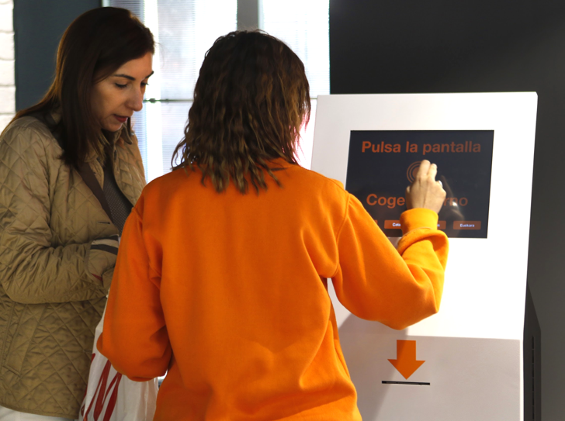


User & Experience Solutions
Audiovisual
Services & Solutions
Designing experiences for each space using the best tools to capture and retain end users' attention
Discover
Own solutions developed by Econocom
Enhance management experiences and user interactions:
Social Wi-Fi: secure and complimentary Wi-Fi access
People counting and tracking: monitor foot traffic and customer behavior
Facial recognition: analyze customer attention and profiles (gender, age, time spent) for insights into store
Queue management: optimize shift management, queue handling, and wait times with the BeWin solution
Aromaxperience: influence mood and brand perception through tailored aromas, creating lasting emotional connections
Additional solutions: geomarketing, smart scanning, live demos, and more to enhance the user experience
Advanced entertainment services on the hotel room
Remote and managing services with MSC in Spain
Comprehensive solutions: project definition, solution design, delivery, integration and support
Dedicated expert team
Telecom
Improve decision-making with data-driven analysis and real-time monitoring
Increase customer satisfaction and reduce risk of abandonment through enhanced PoS efficiency and service quality
Optimize costs and resource allocation by streamlining processes for enhanced efficiency
Design immersive spaces that fully showcase the potential of products and services for more than 1,200 shops
Tailored solution to create immersive experience:
Demo space for all solutions (mobile, wearables, smart office etc…)
Econocom Realdooh management tools for appointment management and retail analytics
Indoor and outdoor digital signage with intelligent LED displays adapted to the environment
+5%
+10k
x3
NPS in customers with BeWin solutions
Spaces around the world with User & Experience solutions
Time spent by users with our solutions vs. traditional
Key Technologies

Slide 58

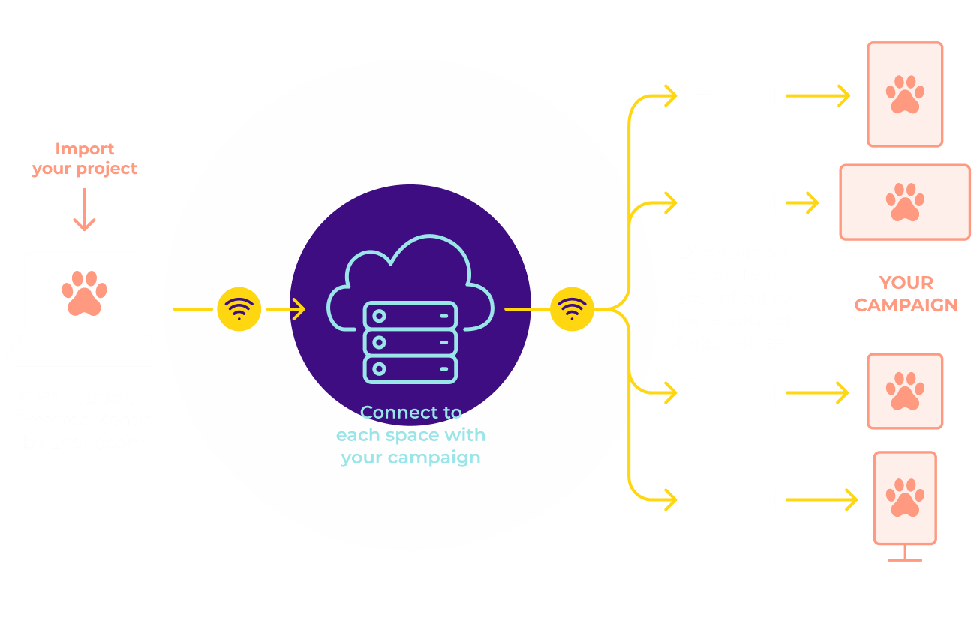



Content Management Services
Audiovisual
Services & Solutions
Software solutions that make it easy for users to create, manage and modify content from a single place and distribute it to any point of communication
In-house and partner solutions for maximum simplicity
Discover
Certified experts on main leading solutions including MagicInfo, SuperSign and Scala
Deployment of unified solutions for global and local control of the equipment
Content management across regions by time zones, countries, languages, and stations for precise localization
Intelligent display transformation with integrated technologies such as motion sensors, IoT, tracking, facial recognition, and NFC
Advanced CMS solution:
  By Econocom with Kentia to provide a comprehensive content management system with all the necessary features for efficient management
  By third parties with experts of market-leading CMS such as SuperSign, Magic Info by LG, Deneva, BrightSign
Own CMS system - Kentia
Remote and managing services attended by MSC in Spain
Agnostic approach with partnerships with key leader vendors
Retail
Increase customer engagement through clear communication
Enable self-management or unattended service capabilities
Distribute campaigns simultaneously to any connected point
Simplify the management of communication campaigns across global spaces, while supporting the creation, adaptation, and distribution of content efficiently
Implementation of Econocom CMS – Kentia including:
Creation of its own unattended communication channel thanks to the CMS
Management of the piped music
Integration of large curved LED screens in the backstage area and spectacular lighting
MSC support, 24x7
50%
+90
+1k
Reduction of time spent on content management
Clients using Kentia CMS around the world
Campaigns broadcast per year
Key Technologies

Slide 59

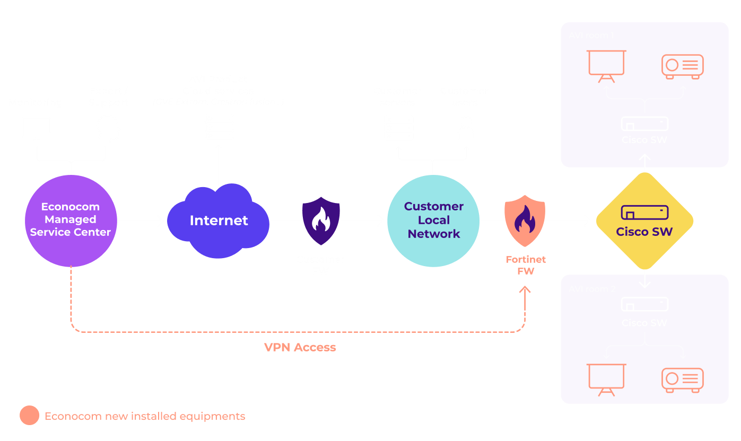
Network Integration & Operation
Audiovisual
Services & Solutions
Design and implementation of network connectivity for AV needs, with compatible, secure, reliable and professional network solutions
Enables enhanced managed services for AV: advanced monitoring, remote maintenance, and operation
Discover
Network and Security expertise, with full knowledge of AV needs
We help you modernize, secure, unify and simplify your AV networks:
Modernize your infrastructure with reliable, remotely managed network devices that are compatible with the latest AV standards
Secure IT and AV networks with "Secured by Design" solutions, using state-of-the-art devices and best practice configurations
Unify IT and AV systems by standardizing and optimizing network solutions
Access additional services like advanced monitoring, proactive problem detection, and remote maintenance & operation
Design, implementation and operation of network architectures
24-hour remote monitoring and maintenance center
Unique approach of IT and AV network merging possibilities
Healthcare
Improve AV infrastructure security and protect against evolving threats
Maximize ROI by leveraging existing network partnerships
Gain confidence in an architecture integrated and operated by network and security experts
Enhance capabilities through managed services
Digital Signage, reservation screen and MTR for a brand-new building, along with a network and security solution for both IT and AV needs
Design, implementation and maintenance of a complete network architecture built upon :
Cisco Meraki Solution
Fortinet Firewalls
The solution is fully compatible with the deployed AV solution and is being remotely monitored and maintained through VPN connection
>€120m
>1.5k
>60
Revenue in 2023 for cybersecurity and network offer
Clients in Managed Services (Maintenance and RUN Services)
Certified experts in cybersecurity and network
Key Technologies

Slide 60

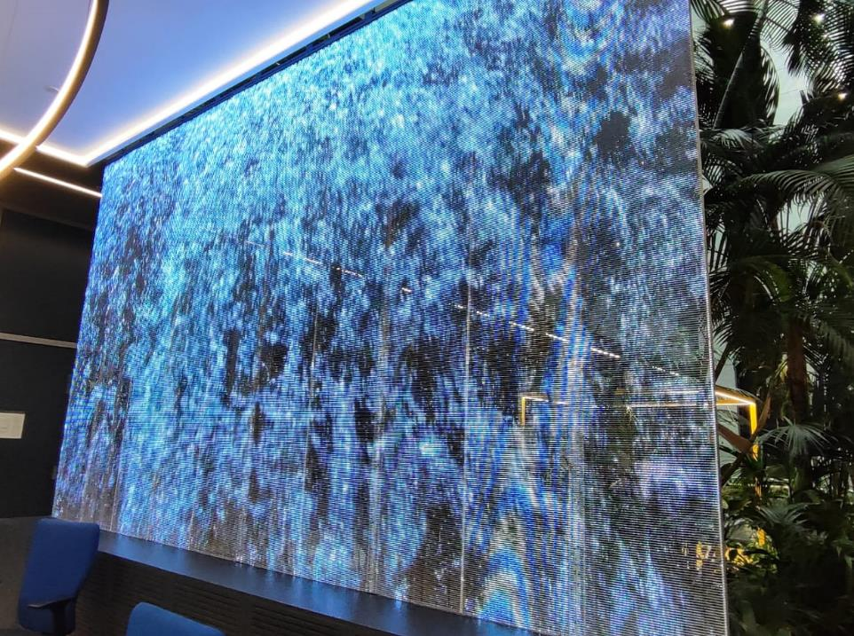


Pro Displays
Audiovisual
Media Devices
Ensure your message resonates with your audience, helping you stand out and make a lasting impression
Discover
Extensive professional services (financing, installation, repair etc.)
A-brand professional displays guarantee perfect and vibrant images:
Versatile communication across environments whether in a shopping mall, corporate office, auditorium, or along highways, Pro displays ensure your message — whether informative or commercial —stands out and reaches its audience effectively
High-end display solutions:
  Indoor displays: high-quality LCD/LED displays for in-office applications and LED solutions for entrances and auditoriums
  Outdoor displays: robust and powerful LED walls designed for impactful outdoor communication
Centralized management with all pro displays integrated into a digital signage network, enabling instantly adaptable communication across multiple locations
Circular approach with environmentally friendly solutions
Certified A-brands with large stock and immediate delivery
Professional expertise tailored to user needs and specific purposes
Airport
Guarantee operational excellence with A-brand quality
Access to the right display solution for every application and situation
Ensure a unified user experience across countries and continents
Simplify fleet management with easy remote access
Chasing their ambition of becoming the most digital airport, they want an extensive display solution for all airport information and create enhance experience for customers
An 8-year Display-as-a-Service partnership, including:
4.000+ displays for Flight Information
Indoor & Outdoor LED videowalls in the APOC
50+ interactive self-service units designed by our interior designers
x5
>20k
>1k
Attracting target’s attention with a high-resolution display
Pro Displays deployed in different projects
interventions for improvement
Key Technologies

Slide 61

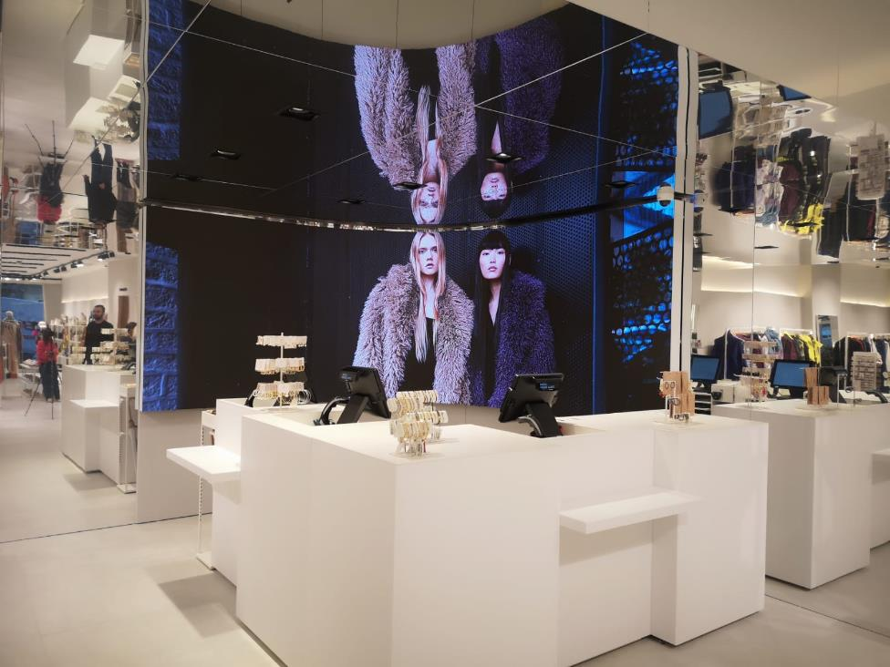

Digital signage
Audiovisual
Media Devices
Create tailored communication experiences for each space, capturing user attention
Comprehensive capabilities from concept and interior design to technical solutions and infrastructure
Discover
Digital transformation projects focus on key communication points
We bring your vision to life by shaping objectives and creating a communication channel that embodies your unique identity:
Professional digital signage devices:
  LED technology for indoors and outdoors: LED Transparent, LED Curved, LED Anamorphic
  OLED technology, ultra-thin, without casing.
  Video wall systems
  LCD technology: touch and interactive displays
  Holographic technology
  Video projection systems
Additional options including Muppis, Totems, LED banners or video scoreboards
In-house creative team for personalized experiences
Dedicated tools to measure the success of campaigns
Remote and managing services with MSC in Spain
Retail
Improve decision-making with data-driven analysis
Reduce workload by delegating service management and monitoring communication status with minimal effort
Achieve "Incident Target 0" with connected and proactive resolution through Econocom MSC
A spectacular audiovisual solution with LED that allows to broadcast campaigns dynamically in more than 150 corners in Spain
Transforming spaces into experiences through:
Design and conceptualization of all spaces across the country
Centralization of the supply-chain, commissioning and maintenance of the AV elements
Distribution of unattended marketing campaigns
>15 years
>10k
>90
Of experience with Digital signage
Spaces around the world with Econocom solution
Active clients across the world
Key Technologies

Slide 62

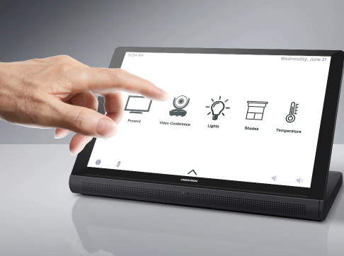


Audio, Lighting & Climate Solutions
Audiovisual
Media Devices
Integrated solutions for the management of Audio, Lighting and Air Conditioning on spaces
The centralization of the building's environmental control ensures a comfortable, technologically advanced and efficient environment
Discover
Deliver compliance-ready solutions aligned with each country's safety regulations
Tailor-made solution to offer maximum functional, operational, and high-quality performance in the spaces:
AUDIO
Emergency evacuation systems (EN54)
Soundproofing systems
Musical thread
Comprehensive solutions: project definition, solution design, delivery, integration and support
CLIMATE
Photovoltaic self-consumption
Air-conditioning
Technology leasing studies
Reduction of energy demand
Dedicated expert with proximity team
LIGHTING
Industrial lighting
Decorative lighting
Consumption optimization
Centralized management
Remote and managing services with MSC in Spain
Banking
Optimize space with efficient and centralized management
Ensure a high level of safety and compliance
Reduce operating costs while enhancing operational efficiency
Improve conversation privacy through sound masking
A comprehensive solution was required to efficiently and centrally manage the lighting of its facilities, adapting to natural timetables and allowing constant monitoring
A building-wide DALI control system integrated into a centralized BMS including:
Dynamic time scheduling: lighting automatically adjusts, optimizing energy consumption and improving occupant comfort
Remote monitoring and control: monitor the status of all luminaires and adjust lighting scenes as needed from a central location
Increased energy efficiency
+20%
90%
+1k
Operating costs savings with control systems
Reduced disruption through centralized management
Spaces equipped with our solutions
Key Technologies

Slide 63

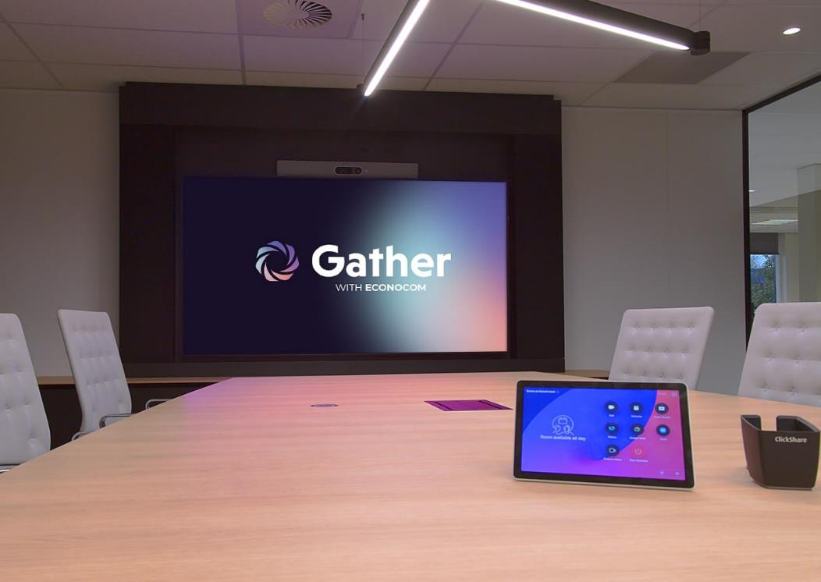

Collaboration Devices
Audiovisual
Media Devices
Our collaboration solutions provide the ultimate platform for hybrid working, cooperation, co-creation, and idea sharing between remote teams and individuals
Discover
Extensive professional services (financing, installation, repair etc.)
Our AV Collaboration Devices offer comprehensive solutions that enhance teamwork and streamline operations, including:
Seamless collaboration: work together on documents, communicate via chat, and hold international meetings effortlessly, from any location
Unlimited connectivity: collaborate effectively, whether participants are physically present or connecting virtually, overcoming barriers of time and distance
Boosted team performance: enhance team efficiency with tools designed to improve productivity, streamline processes, and foster better work-life balance
Cost and sustainability benefits: save on travel costs while reducing environmental impact through more sustainable, remote-friendly work solutions
Intelligent usage and adaptation programs, including information videos
High information security and data protection standards
Global presence with a local approach and dedicated teams
Retail
Save time and money by reducing travel and enabling faster decisions
Promote sustainability with CSR practices
Improve work/life balance for your teams and yourself
Create brand-agnostic platforms for hybrid working, collaboration, co-creation, and idea sharing
Equip their collaboration rooms in which their tens of thousands of employees can easily use smart technology for (hybrid) cooperation, co-creation and information sharing
Creation of 1,000+ hybrid collaboration rooms including:
Pan-European project, including professional services program
High sustainability standards, according CSR regulations
Dedicated expert team for all locations
>25k
>10k
Employees using Econocom collaborative solution
Rooms equipped with complete project solutions
Key Technologies

Slide 64


Room-as-a-Service
Audiovisual
Media Devices
The ideal meeting room, fully equipped and benefiting from the latest technological innovations
Shift from ownership to usage, ensuring maximum financial flexibility and minimal ecological footprint
Discover
One-stop-shop, all technology and expertise needed in one hand
Tailored meeting room solutions:
  Access to all collaboration, presentation, and meeting facilities with customized equipment tailored to environmental factors and future needs
  Full support with technology replacement, maintenance, and training
Complete financial flexibility:
  Investment covered by Gather, from installation to maintenance, assuming depreciation risk
  No upfront costs and fixed monthly fee
Sustainable end-of-life management ensures equipment is removed, reused, or responsibly disposed of at the end of its lifecycle
Extensive partnership with experts to fully support each customer across countries
Experts for both tailor-made and standardized room solutions
Global presence with a local approach and dedicated teams
Automotive industry
Promote sustainability with CSR-friendly solutions
Free-up resources with streamline support, simplify operations and administration
Achieve cost reduction, preserve cash flow and maintain control over time​
Ensure access to cutting-edge solutions by upgrading old equipment at no extra cost
Modern, future-proof and scalable hybrid work environment with a uniform digital user experience for mobile and flexible workers
Long term partnership to create new spaces across all geographies including:
Technically advanced rooms at a fixed fee per month
Comprehensive services, tailored RaaS with MS Teams optimization
CSR-driven design with optimized sitting position, lights and ambiance
→ +100 standardized rooms for unified communication and hybrid collaboration
>1k
>10k
Rooms equipped last year
Employees using RaaS rooms
Key Technologies

Slide 65

Financing
05

Slide 66
Summary
Financing
Your partner for financing your equipment, no matter what you need
Would you like to know more? Please click below
Workplace
Infrastructure
Audiovisual
Non-IT equipment
Financial Offers
as-a-Service
Classic
Capacity
Dynamic
Sales & Leaseback
Equipment finance
FAST
Distribution Services
Supply & order
Preparation & configuration
Deployment & delivery
Asset Management Services
Houston
EcoCare
EcoTwice
EcoWipe
Refurbish-ment

Slide 67


Classic
Financing
Financial Offers
Access an easy-to-use financing solution tailored to your needs for your IT assets
Discover
Unified contract for all assets type (Workplace, AV, Infrastructure, industrial assets)​
Classic contract to finance your IT assets including:​​
Pre-defined project with:
  Defined assets 1ist including different assets and brands
  Fixed amount​ for the project
Fixed start date and rental fees​ with to set-up fees
One single contract for all assets over a defined renting period
Tailored project solutions supporting multiple brands and assets
Usage-based payment with no set-up fees​
Large panel of additional services to enhance your project​
Retail
Gain high financing flexibility accessing to all suppliers and asset types
Manage your budget efficiently with fixed pricing for all project milestones
Reduce administrative tasks with a standardized contract model and efficient asset management
Financing equipment in different locations with 5 delivery milestones and different start periods
Unique classic contract over 5 years for all equipment covering different locations and start date​s with:
Predefined lease rate factor ​
Asset management tool and reporting
>50 years
>€500m​
>4m
Of experience​
Assets financed per year​
Assets managed per year​

Slide 68


Capacity
Financing
Financial Offers
An extended version of the Classic contract offering more flexibility for financing your IT assets
Discover
Unified contract for all assets type (WP, AV, Infra, industrial assets)​
Flexible investment plan in 3 phase:
  Investment plan over an agreed period:​
    Net investment capacity based on the expected supply for all assets with a defined budget​
    Net investment under agreed renting conditions​
    Roll-out period to deploy the assets (3 to 6 month)​
  Ramp-up, installation and setup in a defined roll-out period ​
  Final rent set-up based on real investment​
One single contract for all assets over a defined renting period
Tailored project solutions supporting multiple brands and assets
Usage-based payment with no set-up fees
VAT deferment with no upfront collection
Energy
Achieve full flexibility with a tailor-made contractual envelope to suit your needs
Efficiently manage your budget with a single online contract aligned to actual usage
Optimize delivery times with streamlined processes, enabling you to receive and start using assets immediately
Flexible solution to finance Workplace fleet for all agencies including mobile, laptop, monitor and printer (incl. hardware, software services) across different geographies
€5m budget over 6 months including extra-services:
Assets management
Return collection logistics
Certified data protection and erasure​
>50 years
>€150m
>250k
Of experience
Assets financed per year​
Assets managed per year​

Slide 69


Dynamic
Financing
Financial Offers
The most flexible financing solution for your IT assets
A large-volume solution that keeps your fleet at the cutting edge of technology​
Discover
Unified contract for all assets type (Workplace, AV, Infrastructure, industrial assets)​
Flexible financing solution with stable OPEX during the period of the contract and renewal period:​
  Initial set-up phase: first fleet purchase and rent and investment planning for future assets​
  Renewal periods (bi-annual, can be adjusted): adjustments to rent based on updates and improvements of current IT fleet and purchase of new devices ​
Reporting tool for continuous tracking of fleet and investment performance with online reporting​
One single contract for all asset types
Designed specifically for managing large volumes of assets​
Flexible contract with the possibility to refresh assets and add new assets
Asset management tool included (report on past, present and future investments)​
Tailored project solutions supporting multiple brands and assets
Energy
Keep your fleet up-to-date with regular upgrade opportunities
Manage your budget efficiently with payments aligned to actual usage through flat monthly fees
Start using assets immediately without the need for upfront equipment financing
Flexible financing solution for all actuals entities and future acquisition with same IT hardware
Dynamic contract with technological refresh option to structurally renew the fleet and integrate new devices every 6 months
6 months
>€100m​
>200k
Average rotation period​
Assets financed per year ​
Assets managed per year​

Slide 70



Sales & Leaseback
Financing
Financial Offers
Leverage your IT fleet for immediate liquidity and adopt an ‘as-a-Service’ model​
Flexible financing solution through 3 different financials offers (Classic, Capacity, Dynamic)
Discover
Convert your current IT fleet into an ‘as-a-Service’ model (from Capex to Opex)​:
Tailored project solutions to meet needs with monthly rent adapted to device usage
Immediate liquidity without discontinuities:
  Econocom purchases IT assets at balance sheet value providing immediate funds while continuing using devices
  Access asset disposal and technology refresh options to stay up-to-date
  Full tax deductibility
Management of all devices (old and new) by serial number on Econocom online platform and control the full lifecycle of the fleet
Dedicated supply and end-of-life process for replaced devices
Large panel of additional services to enhance your project​
Healthcare
Gain immediate cash and smoothly transit from a Capex to an Opex model
Ensure no service discontinuity by continuing to use assets immediately
Reduce administrative workload with online managing platform
Standardize device usage duration
Generate immediate cash flow by leveraging a fleet of 650 devices with various usage durations and finance new assets acquiring
Sales & leaseback of the fleet with master agreement contract including the possibility to take out old devices every 3 months
Acquisition of 300 new units, with the flexibility to manage and replace them as needed
Implementation of a device management platform
>€50m
Assets buy and leaseback by Econocom per year ​

Slide 71





Supply & order
Financing
Distribution Services
Access a simplified ordering process for all your assets and suppliers
Discover
Agnostic company with all different brands can be supplied with only one supplier for all assets​
Streamlines process of procuring and managing both new and refurbished devices with:​
  Tailor-made designed order solution​
  Warranty services​
  Stock and buffer stock management​
  Additional services: Plug and play hardware, pre-configured devices with software for easy registration and zero-touch setup, and device enrollment programs ​
  Framework agreements and standardized device options​
One single contract to manage all devices and assets
‘As-a-Service’ model with both distribution and financing activity ​
Dedicated e-portal and employees' choice in option to enhance employee’s satisfaction​
Official technical service from leading manufacturers ​
Education
Ensure timely availability and quick delivery to employees​ improving satisfaction
Optimize device management and security with pre-configured settings​
Reduce administrative workload by unifying and delegating the order process
Procurement hub for all universities to provides workplace equipment to all students and employees
Order and delivery of more than 40k workplace devices across the country with customized orders for each user for both services and equipment (OS, laptops, screens, peripherals, etc)
>80k
>4k
>150
Orders supplied in 2023​
Active service contracts​
Active self-provisioning portals​
Key certifications

Slide 72





Preparation & configuration
Financing
Distribution Services
Preparing your devices and ensuring that they meet your personal requirements​
Discover
Partnership ecosystem
with main industry leaders​
HW personalization:
  Engraving, tagging and labelling
  Bundling and providing accessory services to meet your needs​
SW personalization: ​
  Down streaming of common user data for a 'white glove' approach​
  Auto-provisioning with automatic download of applications and settings for each user​
  User profiles configuration (personal data, BIOS, OS settings)​
  Dedicated EMM experts to help you with enrolment/mastering​
Integrating partner with a 360° approach: HW sales, SW advice, consulting and managed services​
Official technical service from leading manufacturers​
Dedicated and certified team to prepare your devices
Education
Reinforce brand image by clearly identify company ownership
​Improve security by configuring devices in accordance with company policies
Simplify customer asset storage and management processes ​
Reduce productivity losses due to device restoration
Deploy 10k devices (mainly chromebook) in 300 educational centers across the country in less than 2 months ​
Configuration and delivery of equipment in all centers with PoC phase to adjust client needs:​
Applying last security updates and encryption layer for security ​
New cloud platform (with EU standards)​
Dual OS system allowing very fast updates and reboots in seconds ​
Additional services including tailor-made manuals for both administrators and users
>300k
>400k
Configurated devices per year​
Users managed​
Key technologies

Slide 73


Deployment & delivery
Financing
Distribution Services
Ensures seamless and efficient delivery of all your equipment wherever you want​
Discover
Dedicated project team and pilot phase​
Tailor-made delivery including:
Flexible logistics for specific transport to sites, employees, or relay points
Scalable stock management and buffer warehouses with wide geographical coverage
Zero-disruption installation focused on workplace ergonomics
Real time tracking with digital handover script and digital signature of acceptance reports
Large storage capacity: own warehouse and private with the main wholesalers​
High geographical capillarity​
Supported by additional services:
1-to-1 deliveries available​
Automated deliveries for inks and toners
On demand training and adoption
Carbon footprint reduction plan to minimize emissions throughout the logistics operations
Education
Enhance efficiency with optimized logistics
Achieve cost savings through centralized management and automated delivery systems
Improve user experience with seamless installation and digital handovers
Promote environmentally friendly logistics by reducing carbon footprint
Deploy and deliver to all 12k students a computer across more than 80 schools
2-month deployment ensured through: ​
Dedicated staff to the service (1 deployment manager and 8 field technicians to install)​
4 logistics and warehouse service technicians ​
3 dedicated vehicles
>52k
>4k m²
>30k
Direct shipments in 2023​
Of available storage
Managed MPS devices​

Slide 74



Houston
Financing
AM Services
Monitor your IT assets with our Econocom’s 360° lifecycle portal​​
Discover
Direct order through the platform​ for fast delivery
Portal to provides 360° monitoring of the asset lifecycle ​(developed by Econocom) offering:​​
Fleet overview and assignment (duration of use of equipment, validation of acceptance report by location)​​
Administrative tools (contract, budget, acceptance report, supplier invoices, customer invoices, sub-rental management)​​
Order management (eProcurement order)​​
“Eco” reports and services (Ecocare, EcoTwice, EcoCarbon)​
Tailor-made financial management at the cost center level aligned with your need
Flexible asset lifecycle options with the possibility to return, extend, or buy-back equipment
Advanced and automated reporting capabilities
Transport
Achieve more flexibility on asset purchase and budget control​​
Reduce financial administrative workload with contract, budget and, invoices overview
Simplify device management with real-time tracking, acceptance report of IT fleet and end-of-life solutions​
Platform allowing self-purchase for all their site and subsidiaries​
Implementation of Houston with 8 different supplier with multi-site billing and automated quotation
→ 56k devices ordered on the platform​
>5.3m
>1.3k
>46k
Asset managed by Houston
Clients using Houston
Webshop orders per year

Slide 75


EcoCare
Financing
AM Services
Protect your device against accidental breakage​
Discover
Extensive cover including accidental damage and theft​ and premium option with D+1/D+3 swap
Protection for accidental breakage including:​​
Coverage of all-risk damage with repair or replace full cost including:
  Theft
  Clumsiness
  Accidental and property damage​​
Global management of the after-sales cycle:
  Support service (ticket, helpdesk)
  Logistic (pick-up, transport and return services)
  Swap services (in option, at D+1/D+3)
One-off purchase for covering all devices during their lifespan​
Competitive pricing with no deductible​
Simplified and accelerated process with online ticketing tool​
Aerospace
Ensure service continuity with dedicated team, fast repair/swap at D+1/D+3​​
Maintain devices residual value with certified repair or new product​​
Reduce administrative workload with dedicated portal to submit claim and one-off purchase​
Cover and ensure continuity of 100k devices across 5 countries in EU and UK which are subject to frequent breakage​
End-to-end solution for all devices​​ including:
D+2 replacement
Dedicated spare parts and devices stock​​
Online portal to submit breakage
>500
>340k
>13k
Clients using EcoCare​
Devices covered per year​
Managed tickets per year​

Slide 76


EcoTwice
Financing
AM Services
Offer your employees the chance to buy their professional devices​​
Discover
Platform “made in Econocom” offering full flexibility and catalog of options
Tailor-made platform providing employees the opportunity to purchase their professional equipment with:
Integrated supply-chain for device management
Customizable sales price and product selection
Submission of associate and asset lists
Communication regarding the purchase period
Monitoring of purchases and secure payment processing
Packaging and management of unsold equipment
Dedicated team to design the platform
Integrated in EASI offers and compatible with all workplace assets and contracts​​
Transport
Enhance employee satisfaction offering possibility to buy their device at low costs​​
Reduce financial administrative workload by outsourcing equipment end-of-life management​​
Reduce costs thanks to lower breakage rates and fewer claims, as employees are better informed and more responsible
Offer employees a benefit to increase their satisfaction and reduce breakage rates​
Dedicated and personalized platform based on Econocom platform, enabling employees to purchase at very low cost.
→ 40k units purchased, with a conversion rate of 80%
>25k
>70%
99.9%
Devices sold per year​
Of devices are bought by their users​ with EcoTwice
Satisfaction rate (1 litigation over 1000 order)​

Slide 77




EcoWipe
Financing
AM Services
Ensure your devices are properly cleaned with end-of-life​​ certification
Discover
Certified audit and test with strong partnership with proof of test of more than 10 components​
Certified solution to clean data on devices during end-life management with 3 levels of cleaning:
  Data erasure
  Degaussing
  Shredding​
Automatized end of contract reports connected to our asset management solution with complete visibility on activities and certification of erasure
Transparent process by tracking all steps and assets from picking to the sales on the ITAD market​
Cleaning report with official certification​​
Tailor-made process to ensure compliance with company policy​​
Insurance
Reduce administrative workload through automated end-of-contract reports and single point of contact​
Enhance data security with certified data cleaning to ensures complete data destruction
Manage the entire end-of-life process for +10k devices (mix owned and leased), including complex multi-site pick-ups, audit and inventory to separate rented from owned devices and WEEE management​
EcoWipe solution adapted to client constraints over one single point of contact with:
10 picking over 12 months
Complete inventory of devices
Erasure certificates and physical data destruction for special devices​
<10%
>150k
>20
Of devices returned are correctly wiped​ in Europe
Erased devices per year​
Clients using the solution​
Key technologies:

Slide 78



Refurbishment
Financing
AM Services
Breathe new life into your devices with end-to-end refurbishment solutions
Discover
Company-owned refurbishing factory in France
Support of the entire refurbishing cycle for all workplace assets including:​​
Strong international partnerships ensure comprehensive, high-quality refurbishing services worldwide​
Full equipment processing including:
  Reception
  Audit
  Data erasure
  Refurbishing
  Waste treatment (WEEE)
  Revaluation​​
Monitoring and reporting with operational reporting, certificate of deletion and waste tracking slip
Dedicated supply-chain and expert team
Certified company with Ecovadis Gold and Science Based Targets initiative (SBTi)
Energy
Achieve significant reduction in equipment costs and maximize asset value
Promote sustainable practices and adhere to WEEE regulations, reducing carbon footprint​​
Streamline end-to-end management of the asset lifecycle to minimize downtime and enhance productivity
12K devices to process (laptop, desktop, monitors) across 3 countries (France, Germany, Belgium) within 1 month
Refurbishment of the fleet, including:
Logistics to collect al devices
Auditing of the fleet
Certified data erasure
CSR report and WEEE management
→ €550k immediate cash, 2,350,000 kg eq. CO2 avoided, and 418 FTEs mobilized for the work​​
>150k
Refurbish devices per year by Econocom Factory​
Key partners and certifications:

Slide 79


Equipment finance
Financing
Financial Offers
Use alternative financing for your Non-IT equipment​​
Discover
Tailor-made solution to meet
your needs and constraints​
Non-IT equipment financing solution as an alternative to traditional banking offering:
  A new approach to asset financing (except real estate)
  Enhanced financial flexibility with strong financial partnership​​
Flexible financing options:​​
  Sales & Leaseback: unlocks instant cash flow by converting existing equipment into liquid capital​​
  New equipment financing: facilitates growth by financing new equipment, supporting expansion and operational efficiency​
Handling of advance payments with suppliers during the deployment of new equipment
Fastest financing solution (4 weeks in average)
Possibility to structure cross-border deals ​with very wide range of assets (except real estate)
Retail
Simplify access to funds with easy procedures, no covenant and straightforward contracts​
Increase financing capacity by diversifying funding sources with more suitable options for non-IT equipment​​
Ensure fast funding and immediate liquidity by completing transactions within one month
Obtain new financing solution to continue investments (€4M one shot + €1M later) with a tight schedule and a limited cost on operations​
Sales & Leaseback on all business assets for rapid cash injection​​
4 weeks
€300m​
Average duration of funding​
Non-IT equipment financed by year​

Slide 80


FAST
Financing
Financial Offers
Use alternative financing for your strategic assets​​
Discover
Fast financing solution
(4 weeks in average)
Financing solution for your strategic assets as an alternative to traditional banking offering:
  An innovative approach to finance assets for companies willing to manage their growth or liquidity
  Combination of our internal funding capacity and external ones
Flexible financing options:​​
  Sales & Leaseback: unlocks instant liquidity by converting existing strategic assets ​​
  New equipment financing: facilitates growth by financing new strategic assets, supporting expansion and operational efficiency ​
Possibility to structure cross-border deals ​with very wide range of assets
Flexible approach with optimization of operating rate with external funder if needed​
Strong expertise: more than 50 years of experience throughout 14 countries​
Automotive industry
Provide immediate liquidity through Sales & Leaseback, offering flexible financing options
Simplify access to funds, bypassing the complex procedures typically associated with bank financing​​
Monetize assets usually not financed by other players
Need for liquidity in a banking cashdrain situation ​​
Leverage existing productions chains and machine tools​ for immediate cash entry with Sales & Leaseback solution
27
>€130m​
14
Deals in 2023​
Strategic assets financed in 2023​
Countries covered​

Slide 81
CSR & Impact
06

Slide 82
A solid and sustainable path
Econocom CSR Commitments
Signing of the manifesto for the inclusion of disabled people in economic life (renewed every year).
Signing of the Planet Tech’Care commitment.
Over 2,500 pieces of equipment donated to non-profits during health crises.
Publication of the Group’s first Impact Report.
Obtaining the QualiRépar label for our high-impact digital equipment repair services.
EcoVadis Silver Medal (66/100)
Creation of the 1st Green offer
Launch of an internal programme to measure and reduce the Group’s environmental impact Launch of Mission Handicap France.
Leasing and buying/selling second-hand equipment
2012
2017
2019
2021
2023
2024
2016
2018
2020
2022
Launch of the Impact website https://www.econocom.com/ impact
Signing of the Global Compact
Launch of « Digital Women » in-house programme and signature of the Numeum manifesto.
Nominated for Microsoft
Sustainability Award 2021.
One of few digital companies to sign the IMPACT manifesto for responsible economy.
Member of INR (Institut du Numérique Responsable)
EcoVadis Silver Medal (62/100)
EcoVadis Gold Medal (70/100)
Qualicert and RecQ certifications for our reconditioning activities in France
ISO 14001 certifications for several entities in France and overseas.

Slide 83

Our CSR policy and mission
Econocom CSR Commitments
Improving our social and environmental footprint and promoting a responsible and circular digital approach to generate a positive impact for our customers.
OUR 4 PILLARS
OUR IMPACT OFFERING
Econocom est non seulement engagé vis‑à‑vis de sa politique RSE mais est également impliqué dans l’amélioration de l’empreinte sociale et environnementale de ses clients au travers de solutions à impact telles que :
EcoCarbon : mesure l’impact des équipements IT des entreprises.
EASI : propose une solution packagée (redevance + services) qui promeut l’usage plutôt que la possession et qui incite financièrement le renouvellement du parc vers des assets à moindre empreinte carbone.
Green & Energy : conseille, finance et met en œuvre la transition énergétique des entreprises.
Product Care : rallonge la durée de vie des équipements grâce à une offre de maintenance agile.
Econocom Factory : reconditionne et remet sur le marché les équipements numériques de nos clients

Slide 84



Key figure to assess our performance
Econocom CSR Commitments
Our impact is measured to reflect the effectiveness of the actions we carry out over the long term.
CARBON FOOTPRINT AND ENERGY
REPAIRABILITY
-73%
Decrease in energy consumption of our in-house digital services since 2017
+95%
Green electricity in France and Spain
-4.6%
Reduction in our Scopes 1 and 2 from 2021 to 2022, on a like-for-like basis
1 million
Mobile devices under maintenance
CIRCULAR ECONOMY
493k
Refurbished digital devices (computers, screens, servers, tablets, smartphones, etc…)

Slide 85


Key figure to assess our performance
Econocom CSR Commitments
Our impact is measured to reflect the effectiveness of the actions we carry out over the long term.
SOCIAL
RATING
94 pts
Gender equality index⁽¹⁾ over the year.
86%
Of employees⁽¹⁾ underwent cybersecurity awareness training
68%
Of employees⁽²⁾ received ethics training
74/100
+4 pts on the Ecovadis rating, Econocom wins the gold medal.
753rd place
Joined the Financial Times ranking of European leaders in diversity.
850 companies selected from 16 countries.
85%
Of employees⁽¹⁾ trained in best practices on data protection
(1) France (2) Group

Slide 86



« One Econocom » : our CSR objectives for 2028
Econocom CSR Commitments
CUSTOMERS
ENVIRONMENT
EMPLOYEES
Fostering a sustainable digital transformation
Contributing to a positive impact
Committing to being an employer of choice
x3 vs. 2023
1.5 million devices reconditioned or recycled
x2 vs. 2023
1.5 million devices maintained by Econocom in our Product Care repair center
SBTi commitment
-62% carbon footprint for Scopes 1 and 2 vs. 2018
100% of purchases made from SBTi partners
>92% Green electricity
Ecovadis
platinum
certification
Join the Top 1% of certified companies
International employer certifications
>90/100
Econocom score for gender equality
x2 in %
of employees with disabilities

Slide 87
Thanks to our 50 internal contributors!
Workplace & Infra |  | Audiovisual | Financing | Other
Ronny Sonck Christophe Choquet Pascal Van der Vennet Marc Nagelmarckers Olivier van Looveren Alexander Gruender Simon Diederen Paola Malvestiti Catia Brunetto Saffia Hellal Dominic Warren Ciska Schrooten Mike Hellemans Martijn Gregoire | Jan Vandebroek Alexandre Murati Nick Johnson Thomas Castelle Sébastien Missenard Max Bulling Ana Garcia Raul Camacho Jordi Sole Fernando Puente | Jean-Pierre Overbeek Jaime Villanueva Capucine Brunschwig Miguel Angel Martin Javier de Cordoba Sjoerd van Leeuwen Alexandra Fernandez | Gaëlle Masson Xavier Linares Luca Nanni Arlind Avdija Guy Gimbrere Markus Winkler Jan Dhamrait Arnaud Valla Lionel Slama Pierre Toussaint Caroline Cartier Pierre Llorens Huguet Sylvain Christophe-A. Le Bras | Israel Garcia Mario Romero Pâquerette de Poncins Michael Gilli Anne Bruchon Marion Courtot Sigita Vergnes Constance Negre Mariama Diallo Adrian Harrow

