Slide 1

Group corporate presentation
Use for customer presentations, candidate interviews
Shared resource for all employees to present the group
English translation
Access via Onelink
“Mix and match” annexed slides to suit client needs

Slide 2
Presentation
Econocom Group
MARCH 2022

Slide 3
Econocom
01

Slide 4

We are
Europe’s first digital general contractor.
  The Econocom group conceives, finances and facilitates the digital transformation of large firms and public organisations.
  A market-first answer to managing the complexity of digital projects and their sustainability.
  360° support to build tailored solutions coordinated across the whole chain of digital business lines, for any scale of project.
  Unique expertise in supporting the energy transitions of companies and public organisations.
Notes:
Companies - and their deciders - are increasingly lost in a fast-changing digital world, where the digital projects they demand are increasingly global but the supply is completely fragmented between software publishers, suppliers, partners, banks, etc.
We are seeing a growing number of digital projects that are being run and rolled out in many countries simultaneously.
Econocom provides a single simple solution for the market: One digital company

Slide 5

Econocom,
a unique mix of 3
complementary
fields of expertise
Equipment
A one-stop shop for sourcing products and turnkey digital solutions.
Services
Services created and developed to make your digital projects perform.
Financing
Flexible groundbreaking solutions to address the new modes of consumption.
Distribution, customisation, management, recycling and related services at industrial scale Europe-wide.
User environment and infrastructure development outsourcing, business application modernisation, data management, cloud migration, etc.
Pay-as-you-go, financing of technology and industrial assets, financing of energy transition, etc. ...completely independent at international scale.
5

Slide 6




















It’s also a set of expert companies, in strategic segments of the digital universe...
...with a full and robust ecosystem of technology partners
Constructors, operators, editors…
Independent companies, leaders in their markets, partly or wholly owned by Econocom Group.
Networks & security
Development of web & mobile apps
Cloud
Mobility
Digital signage
Microsoft solutions
Apple solutions
Google solutions
Notes:
Partner ecosystem:
Econocom entities structured to address the whole ecosystem and optimise your decision-making
Benefits for customers => Specific fields of expertise, developed and quality assured, so they can integrate a very diverse range of technical solutions

Slide 7
We are a solid international group
Breakdown of 2021 revenue
€2,505m
Americas
2021 revenue
Northern & Eastern Europe
4%
11%
€135.7m
Southern Europe
France
18%
Total
€2,505m
54%
ROP 2021
€66.8m
Benelux
Net book debt in 2021
13%
  410,000
  devices refurbished annually
  - 40%
  reduction in our digital technology
  energy footprint from 2020-2021
strongly committed
in its market

Slide 8


We are European
leader
At 31 December 2021
16 countries
Europe, USA, Canada, …
8,200
employees
7m
technology assets under management
49 years
experience
8

Slide 9
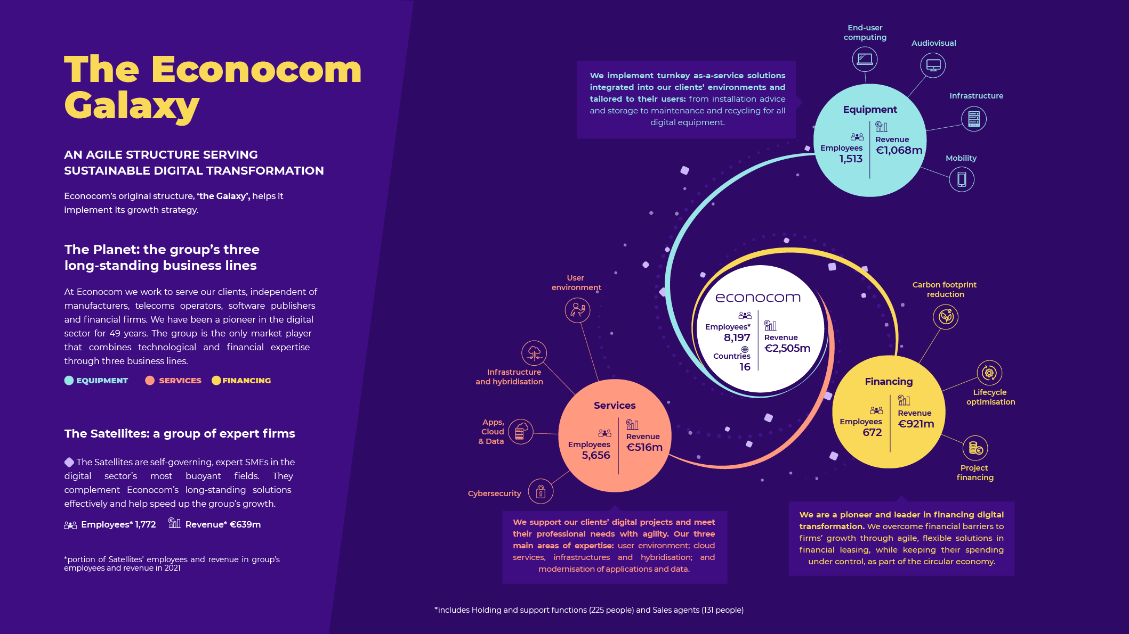
9

Slide 10



We work and support our clients based on strong values...
Good Faith
Boldness
Responsiveness
Our company culture and determination to create an ethical and innovation-friendly environment for our clients are based on the values that underpin our actions, behaviour and success.
Notes:
DARING: Love the risks of entrepreneurship, try things that others won't, innovate. Dare, master your fear to build something good and useful.
GOOD FAITH
Say what you think and think what you say. Move straight ahead together, in the same direction, build, adjust. Honour the spirit of the contract above the letter of the contract.
REACTIVITY
Be ready to move fast to keep up with our customers. React to incoming signals. Learn from mistakes and bounce back

Slide 11


Pioneering the digital circular economy for over 47 years
… consistent with responsible commitments
Buying/selling second-hand equipment since the group began, working hand-in-hand with leading Social Economy Companies.
Mature, recognised and award-winning ESG policy
HR policy that encourages diversity and inclusion
Rollout of “Mission Handicap” and “Digital Women” programmes.
#CSR
#CommittedEmployer
Decarbonisation of activities
#ResponsibleDigital
50% reduction in the group's digital footprint through ambitious programmes to measure and reduce its energy footprint.

Slide 12


We innovate to bring our clients services and expertise that support them in reducing their digital environmental footprint.
Signature of the Planet tech’Care manifesto
Offers designed to reduce environmental or digital footprint
Cutting-edge expertise in extending equipment lifetimes and refurbishment
offerings built with partner companies from the social economy
combating the digital divide
(equipment donations with the Connexion d’Urgence collective AND joint gifts with OUR clients)
Download our Impact Report
12
12
12

Slide 13
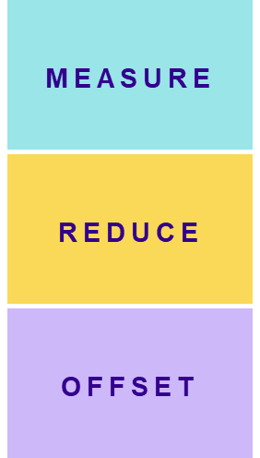

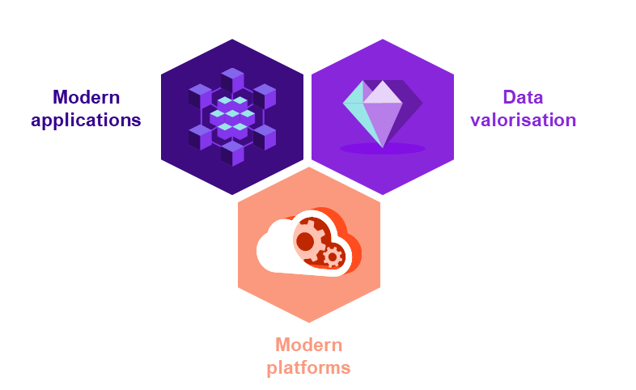
New offers to boost organic growth
Responding to sustainable digital challenges…
… and digital transformation
ecocarbon
ecotwice
Employee resale plateform
productcare
Service center
for mobile terminals
Apps, cloud & data
3 integrated offers
ecolease
Financing of refurbished equipment
13

Slide 14


Econocom
video presentation

Slide 15
Appendices

Slide 16
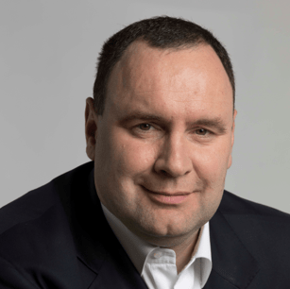

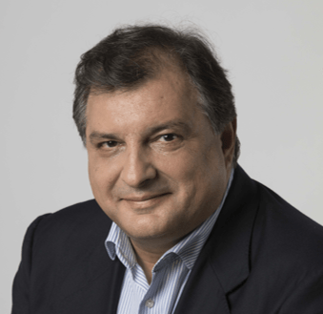
Management team
Laurent ROUDIL
CEO, Econocom Group
Jean-Louis BOUCHARD
Founder
Chairman
Angel BENGUIGUI
Executive Managing Director
16

Slide 17
Econocom
Europe’s leading global digital services company
At 31 December 2021
16 countries
Europe, USA, Canada, …
8,200
employees
49 years
experience
7m
technology assets under management

Slide 18







Products & Solutions
Flexible and forward-looking approach to changing demand
Becoming a major
player in Europe
Solutions tailored
to needs
One stop shop
multi-brand,
multi-vendor,
multi-product
> €1 billion revenue
No. 1 in France
Strong positions
in Italy, Spain, Germany,
Netherlands and UK
Related services
customisation, logistics, maintenance
Product Care
Extending mobile product lifetime

Slide 19


Services
A single contact to support and oversee the whole value chain of digital projects
Strong reputation in
France, Belgium and Spain
High value-added
offerings
€516m of revenue
No. 7 digital services company in France
No. 1 user environment outsourcer
5,656 employees
Workstation and mobility services
Leading workstation (run) outsourcer in France
Infrastructure
services
Application services
“Apps, Cloud & Data”

Slide 20

Technology Management & Financing
Financing solutions tailored to technology, industrial and energy issues
Near 50 years experience
Solutions tailored
to needs
€921m of revenue
No. 1 in France
Strong positions
in leading European countries
Project finance
Life-cycle optimisation
Reduction of digital footprint

Slide 21
We offer end-to-end responsible services
360° purpose-built offering, unique to the market, that pools the expertise of our three business lines to support our clients in cutting their digital footprint:
ecocarbon
Measure
Audit of the environmental footprint from IT equipment.
Reduce
Reduction and best-practice plans to limit energy impacts.
Offset
Offsetting of carbon footprint by investing in responsible sustainable projects.
3 pillars to cut digital impact:
MEASURE
REDUCE
OFFSET
21

Slide 22
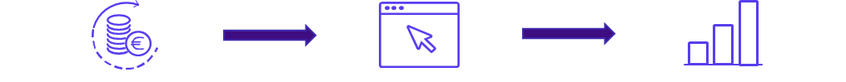
We offer end-to-end responsible services
And what do you do with equipment
at the end of its financial lease?
EcoTwice: The solution for giving your equipment
a new lease of life while increasing user satisfaction
Employee satisfaction
Increase employee satisfaction by giving them the opportunity to buy their own equipment at a competitive price
Responsible digital impact
Adopt an innovative and eco-responsible approach by extending the useful life of equipment
Cost optimisation
Free yourself from end-of-life management of equipment: deletion, reuse, recycling, reconditioning
Reduce damage to equipment
Raising awareness-of your employees from the very beginning of the equipment use to maximise the maintenance of equipment in good condition
ecotwice
a platform for reselling assets to employees
possibility of buying
your own equipment
provision of a secured platform for the purchase of equipment
real-time monitoring of sales to employee
22

Slide 23
We offer end-to-end responsible services
How can you replace your equipment while limiting both your environmental impact and spending?
EcoLease: Providing and leasing refurbished products as good as new
ecolease
Provision of products
Provision of new accessories (charger and cable)
Equipment delivery
24-month guarantee
Refurbished equipment leased
PRODUCTS
ACCESSORIES
Sourcing and leasing of reconditioned products
Supply of a new charger
and cable
DELIVERY
GUARANTEE
At a centralized or multi-site location or at the employee's home
With a minimum duration
of 24 months
23

Slide 24
We offer end-to-end responsible services
Product Care offers eco-responsible management of mobility equipment: smartphones, tablets and laptops
productcare
Product Care delays obsolescence of devices, which are better maintained, regularly updated and repaired as necessary.
Their useful life is extended and residual value maximised.
At the end of the life cycle, devices are assessed for possible refurbishment and/or recovery. All waste is processed and recycled.
24

Slide 25
We offer end-to-end responsible services
Our teams meet the challenges of modernisation, with business application development and data enhancement using new platforms
Apps, cloud & data
Modern applications
3 integrated offerings, adapted to the digital transformation challenges of our clients
Design of business applications
Application refactoring
Code optimisation / micro services
Data enhancement
Modern applications
Data
enhancement
Extraction & Collection
Architecture & Processing
Analysis & Enhancement
Modern platforms
Architecture & orchestration of applications
Design & orchestration of multi-cloud infrastructure
FinOps & PerfOps
Modern platforms
25

Slide 26
We offer end-to-end responsible services
User working environment that blends different resources to suit their business profile and circumstances:
oneworkplace
One or more devices
physical or virtual
Infrastructure solutions
link devices with company IT
Collaborative and application solutions
support mission achievement
Services
to design, integrate and modernise the working environment and provide the right support for any profile
“as a service” pricing
the flexibility of pay-as-you-go billing
an offer combining innovation and expertise
Collaborative
solutions
Infrastructure
solutions
Services
Devices
All part of a resolutely responsible approach that optimises digital environmental impacts
26
Notes:
The Digital Workplace is a strategy that supports company performance and seeks to transform employees’ working environment by embracing Consumer Market standards while cutting costs.
In practice, this means a socially responsible digital environment tailored to the needs of your users (secure, collaborative, available anywhere anytime).
Our managed workplace services offering is based around
4 principles:
User experience – People
Access, Management and Security – Platform
Full equipment life-cycles – Products
Impact and Governance - Perennity
2 pillars:
Capacity, in terms of risk-taking and location – Pricing
Technology eco-system to enrich our offers – Partners
3 convictions:
User Experience (focused)
AI (powered)
Automation & Cloud (first)
Customer benefits:
User experience:
Save up to 30% on the production cost of the service to users
A user experience that evolves to embrace BtoC standards
Access, management, security:
Response to user expectations (support for any OS and all work situations: office, remote working, co-working)
Improved business continuity
Streamlining of technologies and expertise (€)
LIFE CYCLE:
A complete programme of choice of equipment offered to employees
Provide end-to-end experience compliant with Zero Touch programmes
Save on equipment supply
IMPACT & GOVERNANCE:
Faster decision-making thanks to the platform which becomes the reference data source
Control the environmental impact of your initiatives
Total cost control
Page 11 (oneworkplace): add key words “innovation” and “expertise”

Slide 27
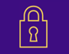

Econocom satellites and their expertise
CYBER SECURITY
ASYSTEL ITALIA • EXAPROBE
Econocom has created an innovating model with a network of expert companies known as Satellites. These are small and medium-sized companies which are
high-performing in their area of expertise and the heads of which retain a significant share of the share capital.
By combining Econocom’s industrial power with the agility of its satellites, the Group offers its customers comprehensive, tailor-made solutions and integrated throughout the digital value chain. As their digital challenges evolve, Econocom offers them solutions that are made for them rather than solutions they will find everywhere.
MICROSOFT
ASYSTEL ITALIA • INFEENY • TRAMS
APPLE
ENERGY NET • TRAMS
APPS & CLOUD
ASP SERVEUR • BIZMATICA • SYNERTRADE • TRAMS
INFRASTRUCTURE & NETWORKS
ASP SERVEUR • ASYSTEL ITALIA • BIZMATICA • EXAPROBE • TRAMS
MOBILITY
ASYSTEL ITALIA • BIZMATICA • DMS • BDF • ENERGY NET • TRAMS
DIGITAL SIGNAGE & MULTIMEDIA
ASYSTEL ITALIA • ALTABOX • BDF • BIS l ECONOCOM
CONSULTING
BIZMATICA • HELIS • TRAMS
27

Slide 28

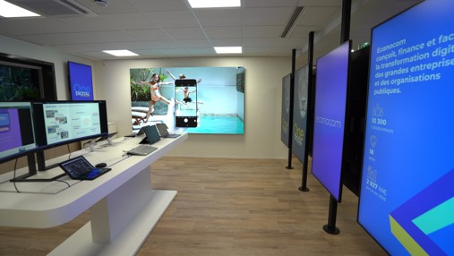
We invite our clients into dedicated spaces to
co-build innovative custom solutions.

Slide 29

We are proud of our robust and sustainable ESG history
From 1973
> Buying/selling second-hand equipment
2012
> Signature of the Global Compact
2016
> Creation of the first Green offer
2017
> EcoVadis Silver Medal (62/100)
2018
> Launch of internal programme to measure and reduce the group's environmental impact
→ In 2021: - 40% digital environmental footprint
2019
> Launch of “Digital Women” and signature of the Numeum manifesto
#ReconversionFemmesNumérique
→ In 2021: 40% women heads of department in-house
> Signature of the manifesto for the inclusion of people with disabilities in economic life (renewed annually)
→ In 2021: employees with disabilities doubled
2020
> Signature of the Planet tech’Care manifesto
> 2,500+ devices donated during Covid crisis
2021
> Nominated for Microsoft Sustainability Award 2021
> One of few digital companies signing IMPACT manifesto for a responsible economy
> Participation in the landmark Produrable conference
> Econocom published its first Impact report

Slide 30


