Slide 1
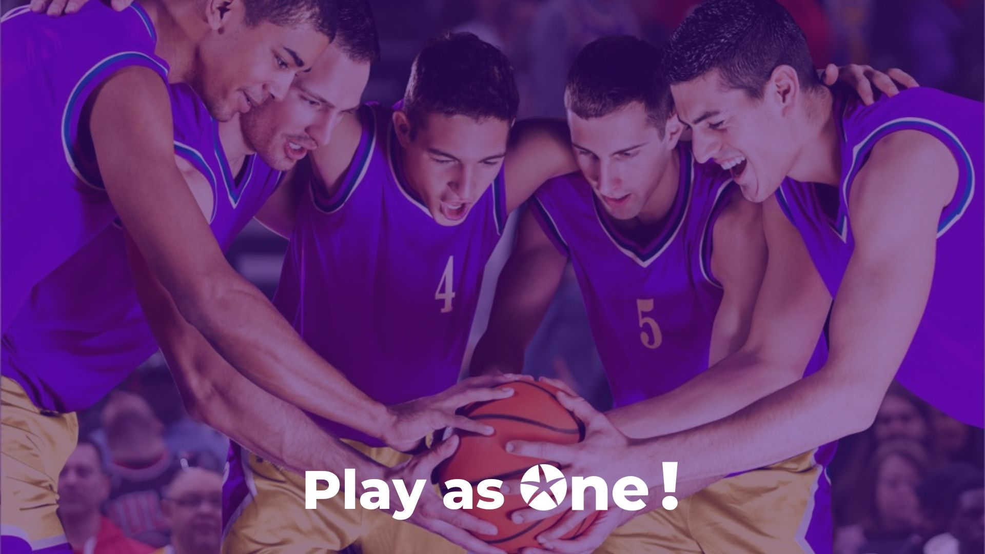
Success Stories Challenge
From June 3rd to September 13th

Slide 2


What are the rules ?
THE OBJECTIVE? Identify the best stories that illustrate the ‘Play as One’ mindset and that have helped to achieve the One Econocom business targets.
HOW DOES IT WORK? It couldn't be easier: fill in the following page to propose a story and submit it to your local communications team or your BU Manager.
ELIGIBILITY CRITERIA:
Significant contribution to the quantified objectives of the strategic plan
Significant level of contribution between countries and/or activities and/or with support functions
WHAT’S NEXT?
- The 3 best stories will be selected at the GMC meeting September 19th and will be presented at the IMM in Istanbul in October 2024.
- They 3 spokespeople will also be rewarded by taking part in the 2024 challenge trip in May 2025 in Istanbul.

Slide 3
Name of the success story
Write a short description
HOW DOES THIS STORY ILLUSTRATE THE ‘PLAY AS ONE’ MINDSET? (Level of cooperation between activities? ; Level of cooperation between countries? ; Level of cooperation with support functions?)
Answer here
HOW DID THIS STORY HELP TO ACHIEVE THE ONE ECONOCOM BUSINESS TARGETS ?
To be answered with qualitative and quantitative elements
WHICH TEAM IS INVOLVED IN THIS PROJECT AND WHO WOULD BE THE SPOKESPERSON FOR THE PROJECT?
To be answered with the global team, everyone’s respective role and the name of the spokesperson
SOME BACKGROUND INFORMATION?
Answer here

