Slide 1
2021
Econocom
corporate presentation

Slide 2

We make it easier for your clients to
say yes NOW
1

Slide 3
Europe’s largest independent provider of financing and as-a-service solutions for transformation projects

Slide 4

Key figures
€2.6Bn
9,200
17
48
2020
revenue
years’ experience
employees
countries

Slide 5

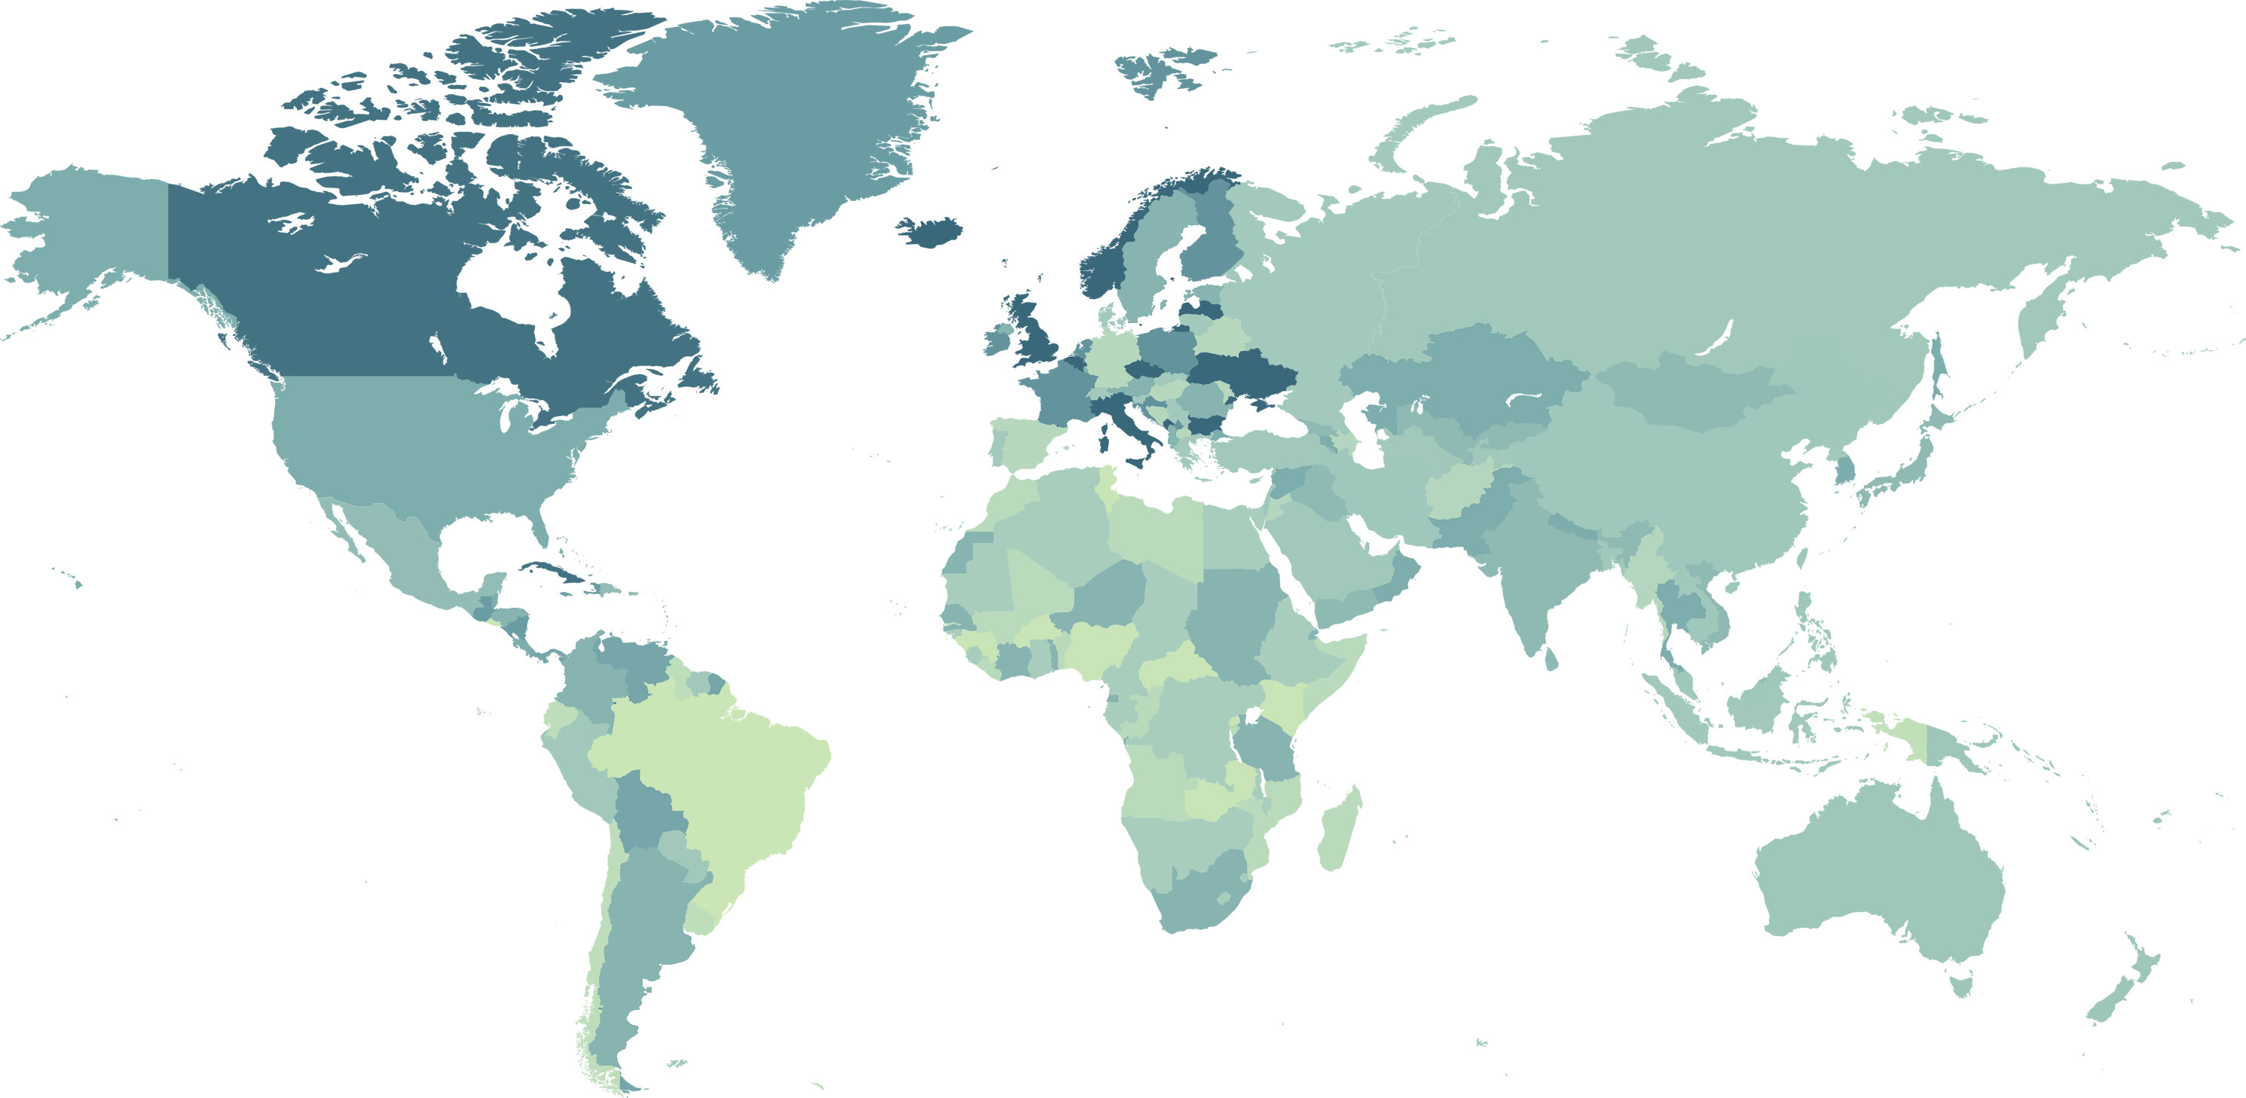
Worldwide activities
e
e
e
e
e
e
e
e
e
e
e
e
e
e
e
e
e
e
e
e
e
Local presence
e
Cross-border deals

Slide 6

Econocom : a unique business model
Independence from
Hardware manufacturers
Telecom carriers
Software vendors
Banks
Financing for a wide range of assets
Technological hardware
Exotic assets
Software
Delivered services
Flexible models
As-a-service
Leasing
Structured finance
Cross-country financing

Slide 7

































A selection of our clients
Our international clients
Our SME clients

Slide 8
Value proposition

Slide 9
What’s in scope?
AV / Digital signage
Software, cloud, network & servers
LED lighting / refrigeration
Meeting room
IT / Modern workplace
Consulting
Ticket machines
Smart lockers
Self checkout / PIN pads
Car park tech
Media equipment
+ any other delivered services + tech delivery + warranty + collection + GDPR data wiping + recycling etc.
As-a-service
Notes:
Services need to be delivered to be funded by us (i.e. completed and accepted by the customer), which would allow Econocom to pay your invoice. The subscription contract would usually be expected to start after the implementation/set-up/transition works had been completed.
If there is an extended time from the date the initial equipment is delivered and the date the implementation/set-up/transition works etc. are completed, then a form of implementation contract may be needed to bridge the duration from when the initial invoice would be paid and the customer subscription contract starts.
For shorter implementation periods (i.e. 3 months), the subscription contract can accommodate known implementation/set-up/transition works costs with a delayed rental start (“buy now, pay later”).
What can not be included in the subscription are on-going services that are performed/delivered during the course of the subscription period, even if these costs are known and fixed in value. These would normally be expected to be billed to the client over the term of your service contract when they occur/are performed.

Slide 10


What’s in it for customers
Cash preservation
Spread costs over time
Avoid up-front investment spike
Revenue expense
Rental rather than finance​
OpEx rather than CapEx​
Lower TCO
End of term costs of decommission, collection, data wiping and disposal all included​

Slide 11
What’s in it for business partners
Differentiation
Turn transformation costs into a subscription model
Revenue recognition
Full revenue and margin recognition upfront
Get paid now
Your invoices are paid in full, even if client subscription hasn’t started

Slide 12



FAQs
Deal size
Minimum of £100,000
Standard term
3-5 years
Eligibility
Clients with good credit eligibility
Econocom can give you a go / no go decision in 24h

Slide 13
Additional offering

Slide 14
How else we can add value
Buy Now, Pay Later
Cash Back
A flexible facility to order solutions on-demand and defer the initial payment
Buy back newly acquired assets to put cash back into business

Slide 15

Any questions?
info.gb@econocom.com
www.econocom.co.uk

